Slide 1
Motor Learning: Stride Change After Success vs Failure
Individual Stride Change Distributions
69 participants
Age range: 7.2 - 17.9 years
Ordered from youngest to oldest

Slide 2
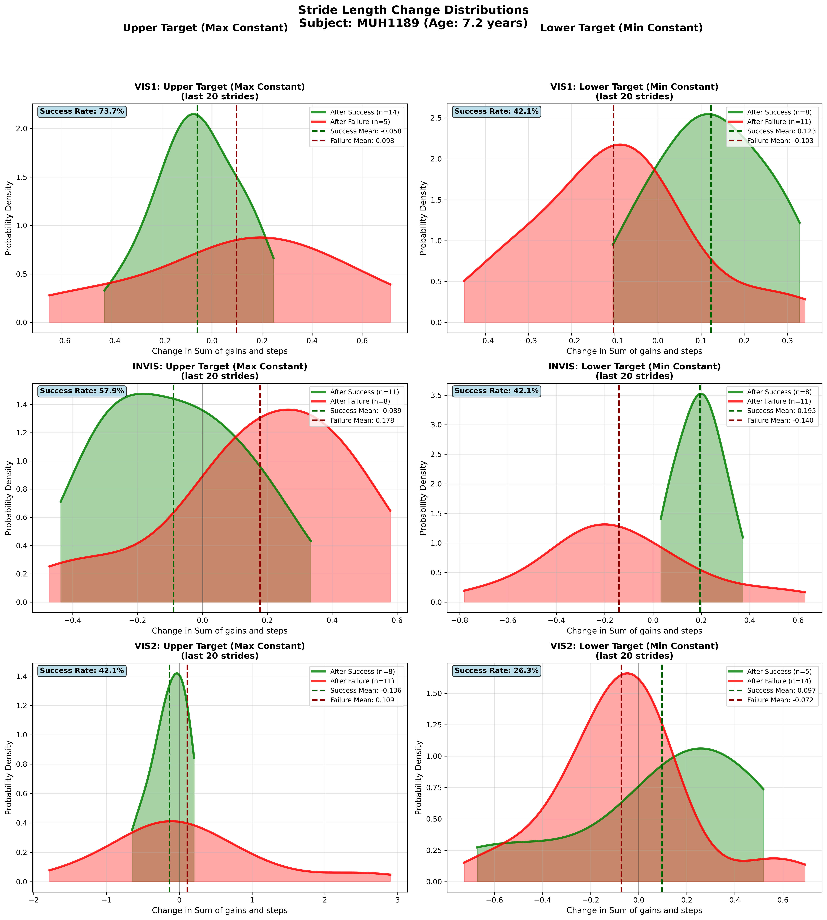
Subject MUH1189 (Age: 7.2 years) - Slide 1 of 69

Slide 3
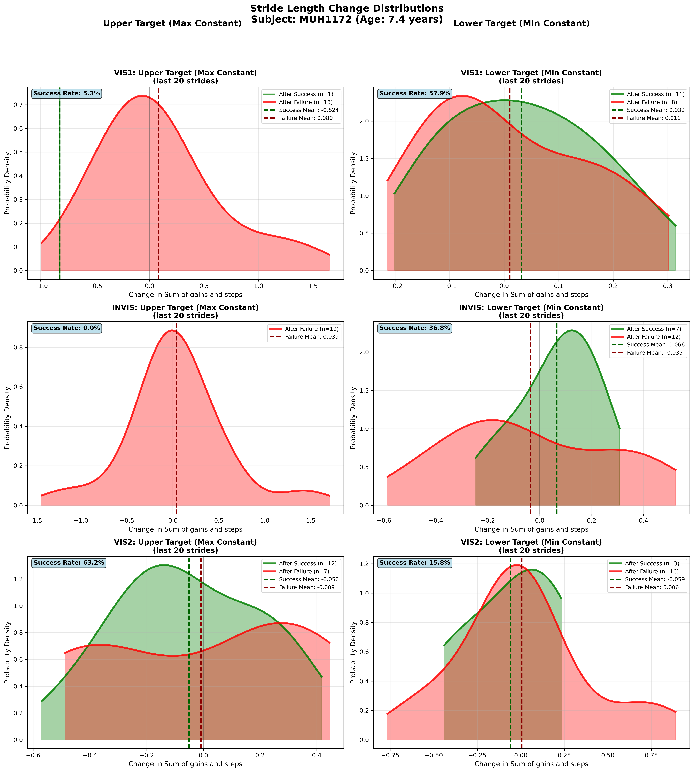
Subject MUH1172 (Age: 7.4 years) - Slide 2 of 69

Slide 4
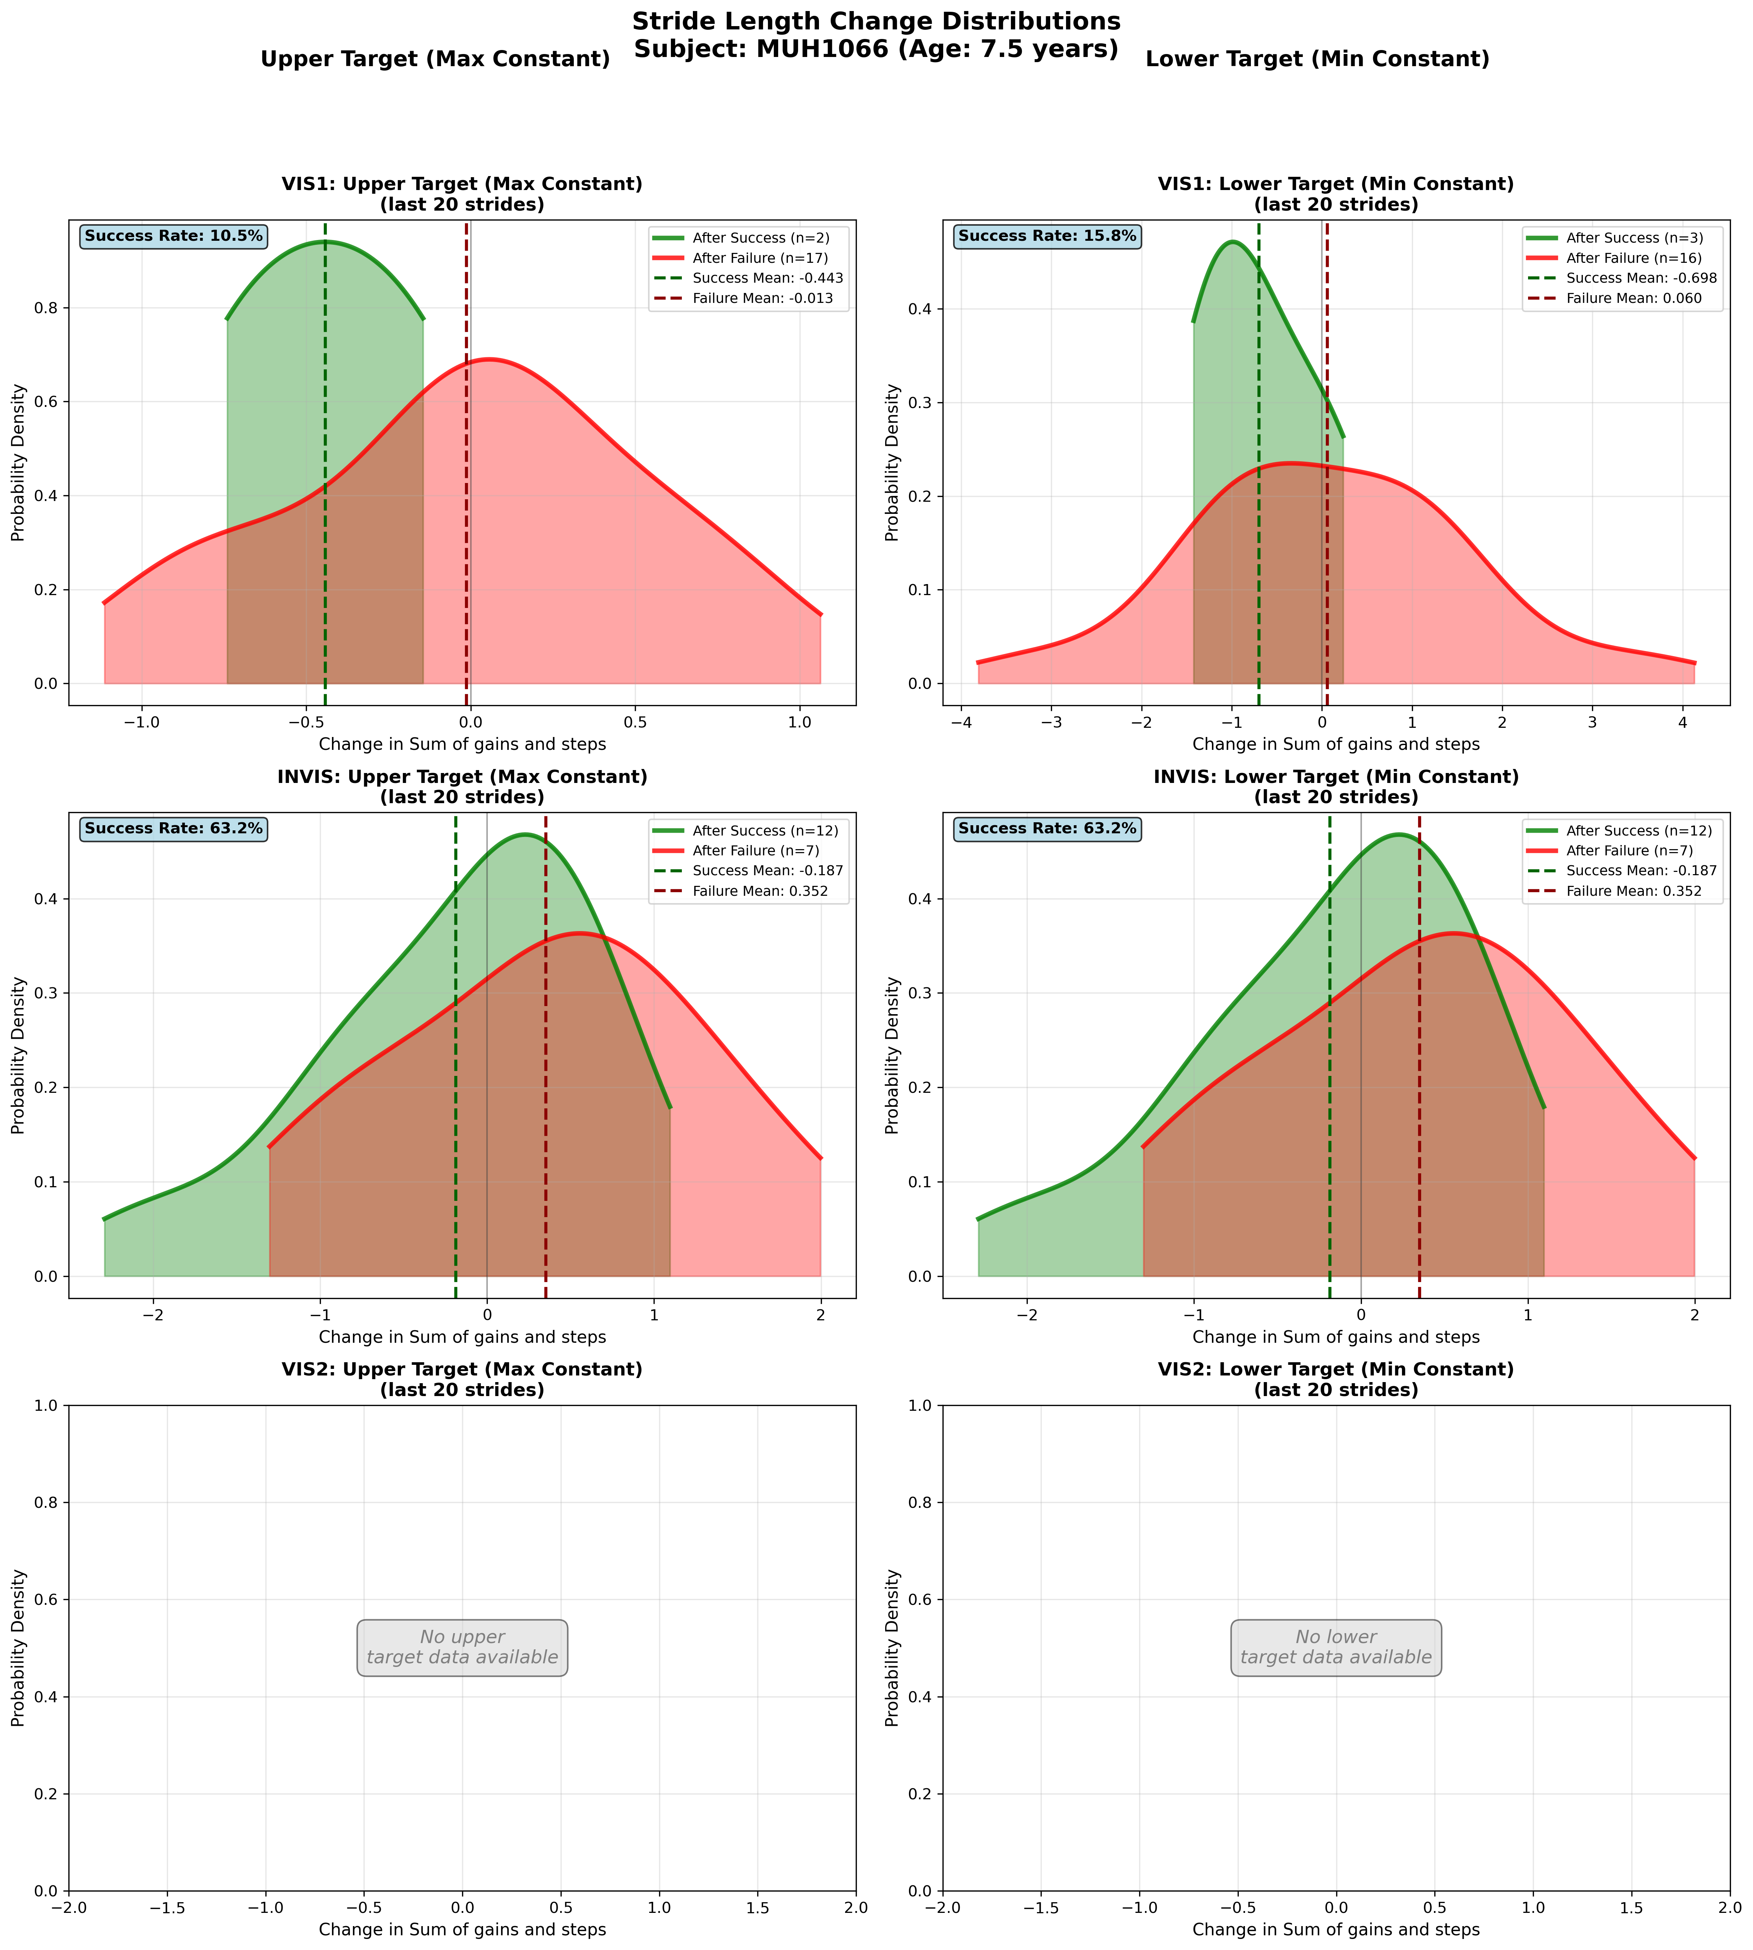
Subject MUH1066 (Age: 7.5 years) - Slide 3 of 69

Slide 5
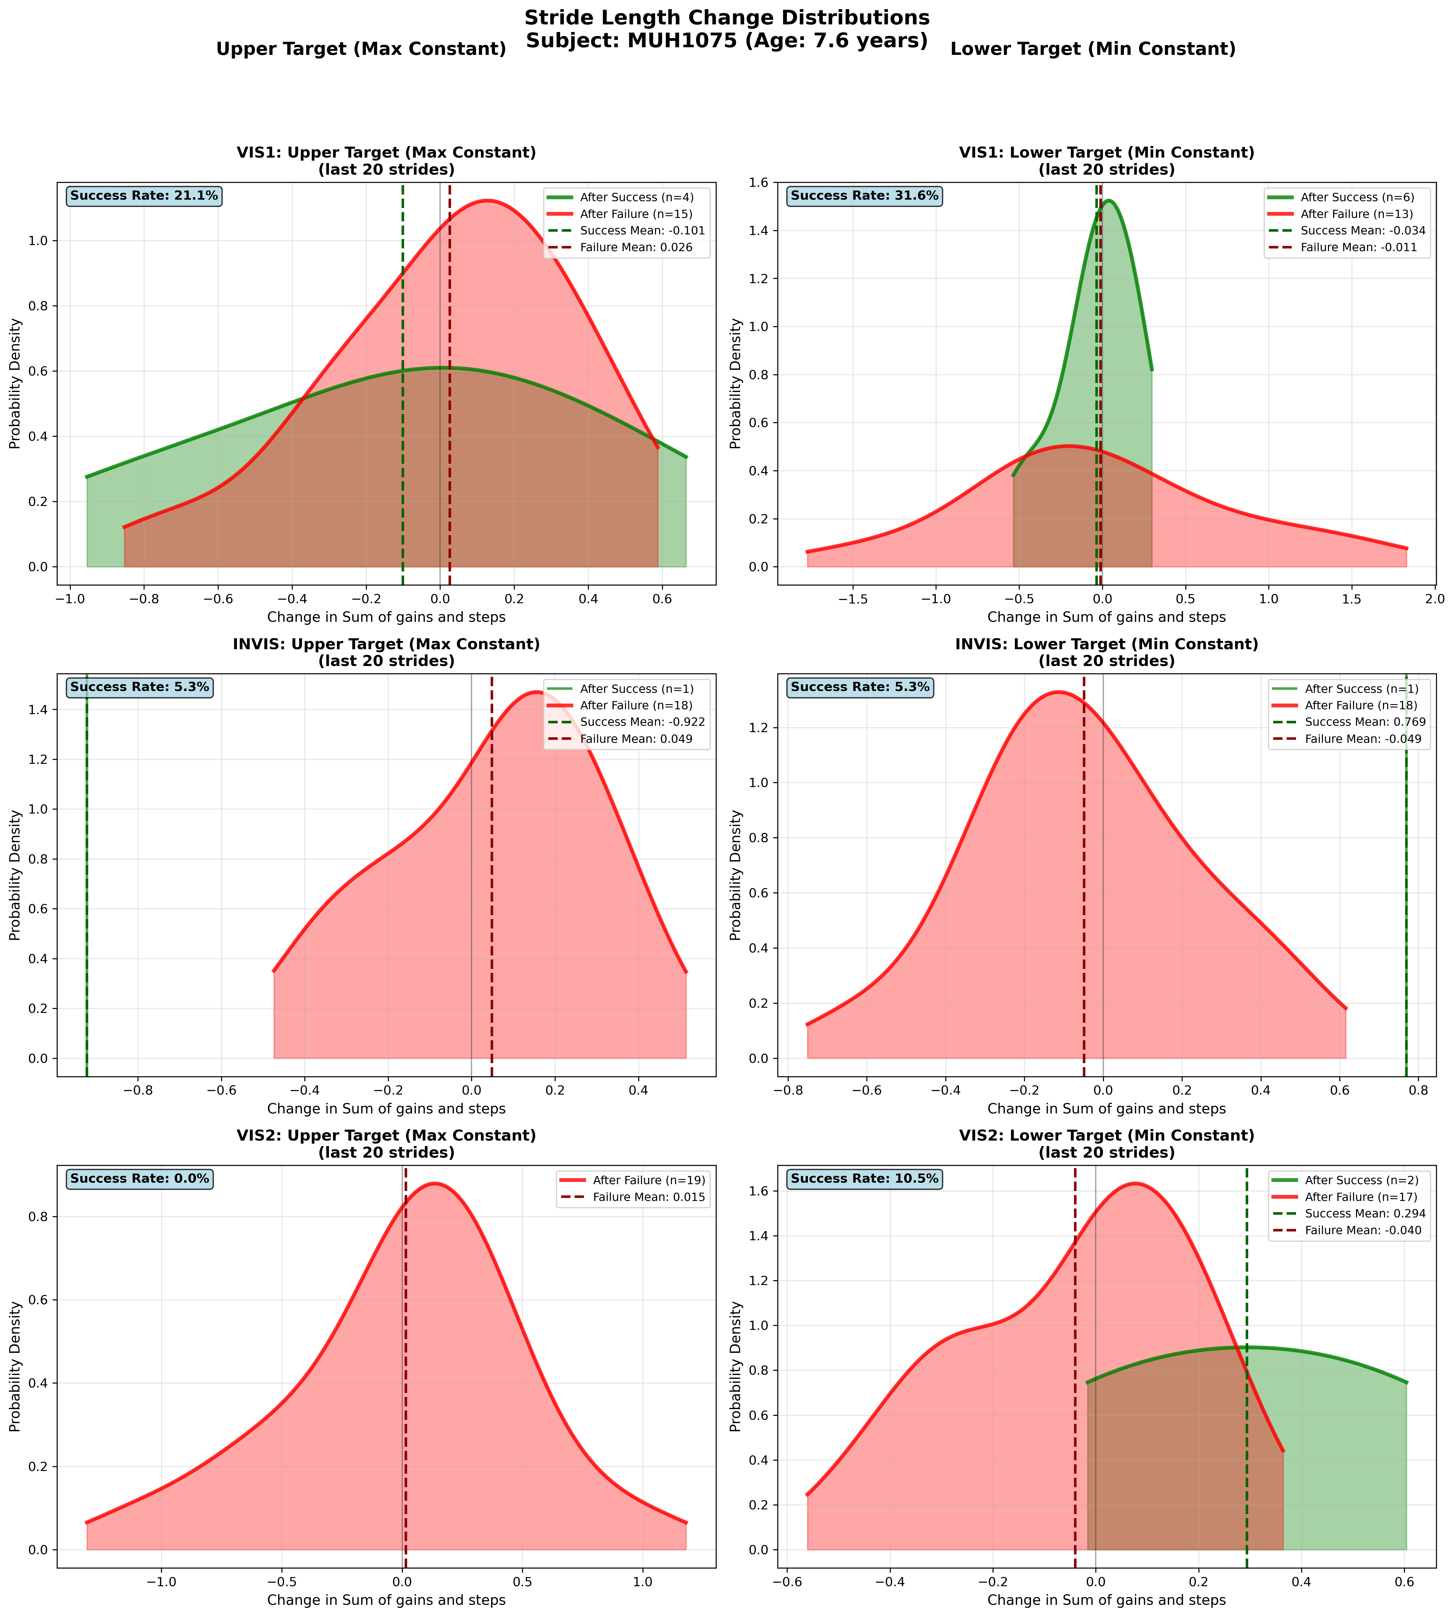
Subject MUH1075 (Age: 7.6 years) - Slide 4 of 69

Slide 6
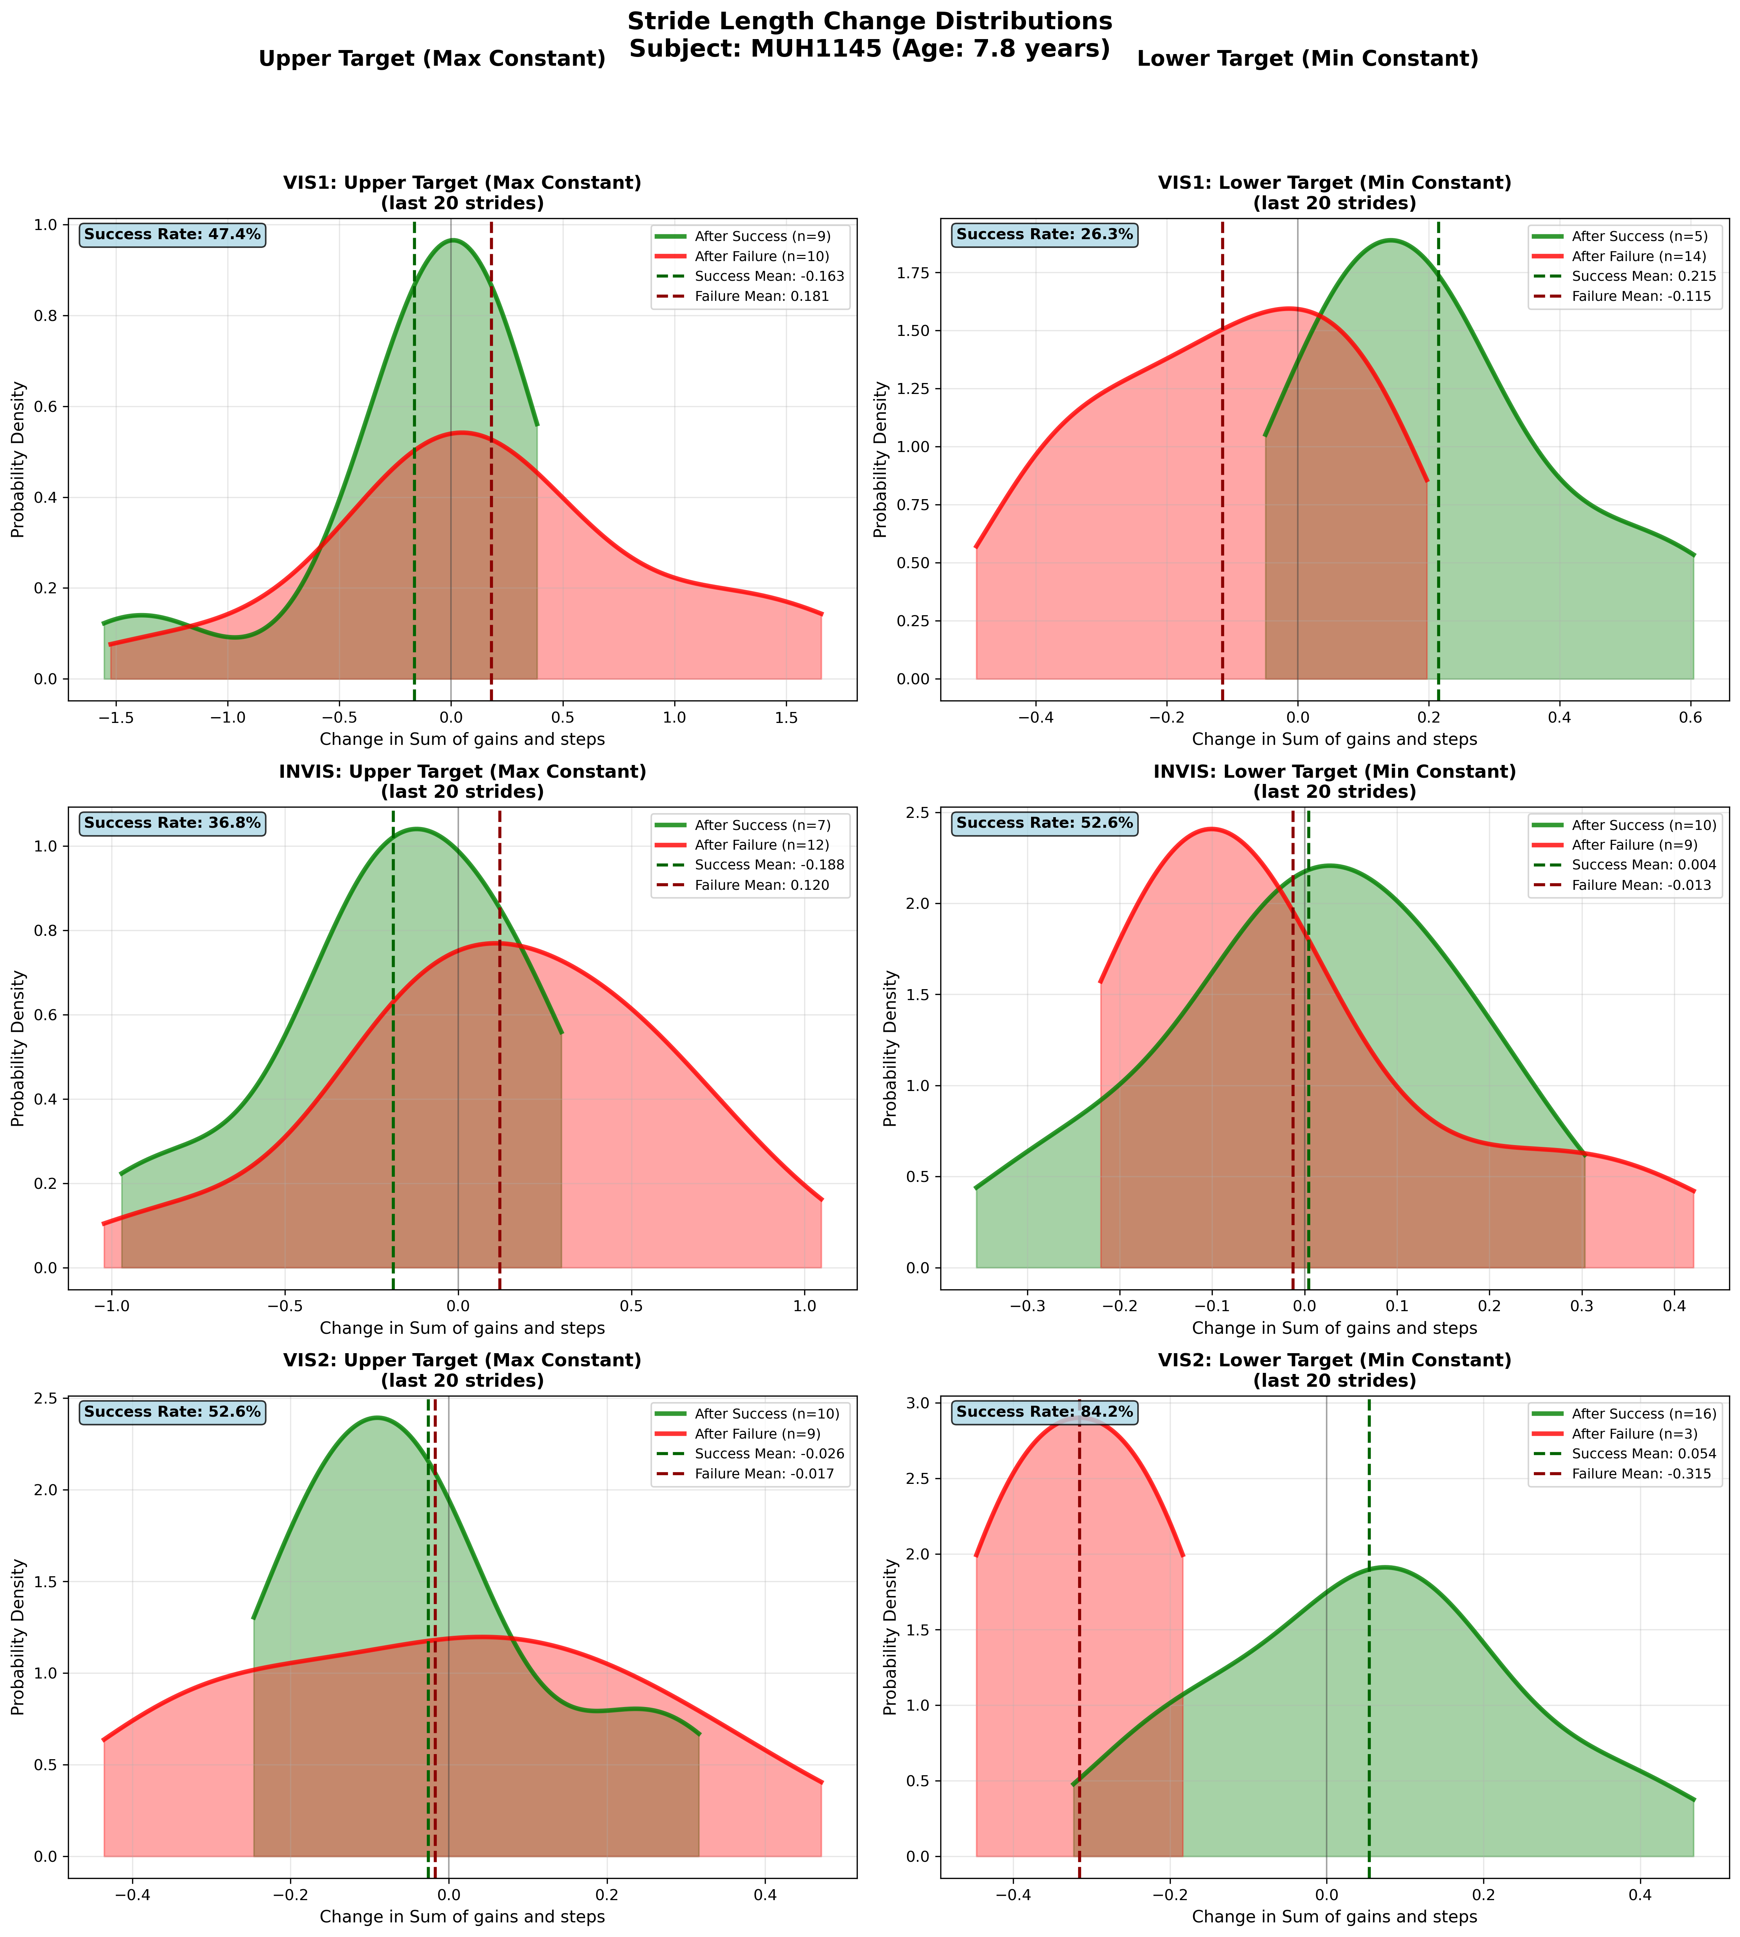
Subject MUH1145 (Age: 7.8 years) - Slide 5 of 69

Slide 7
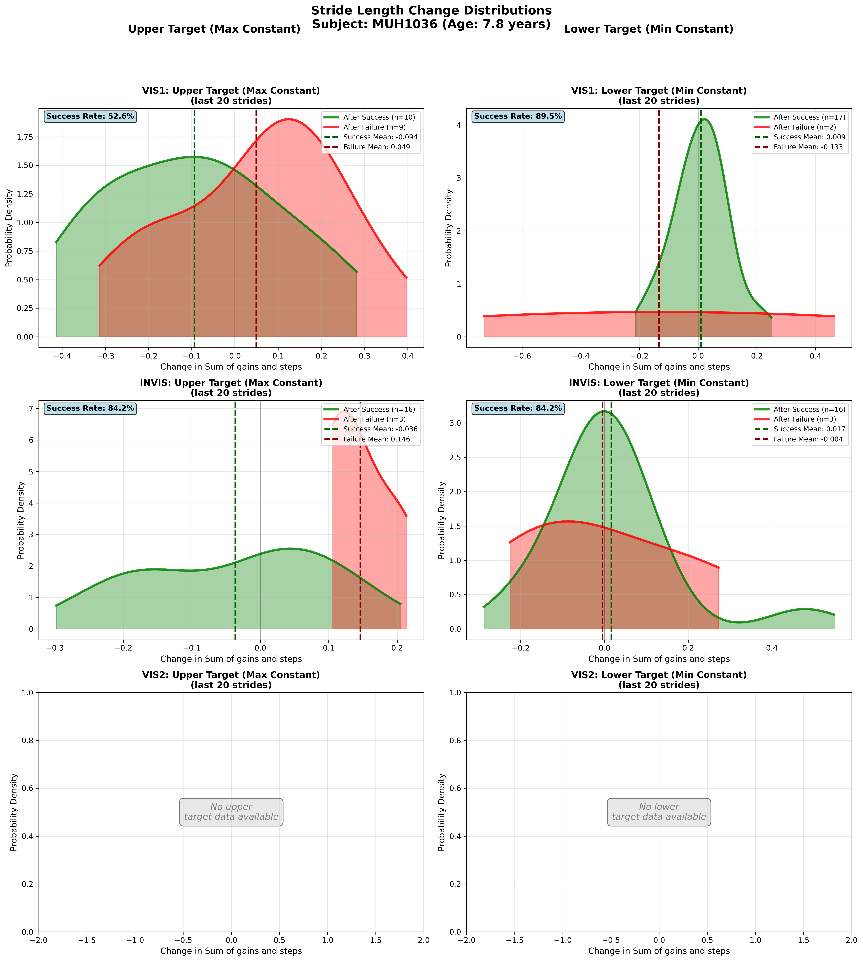
Subject MUH1036 (Age: 7.8 years) - Slide 6 of 69

Slide 8
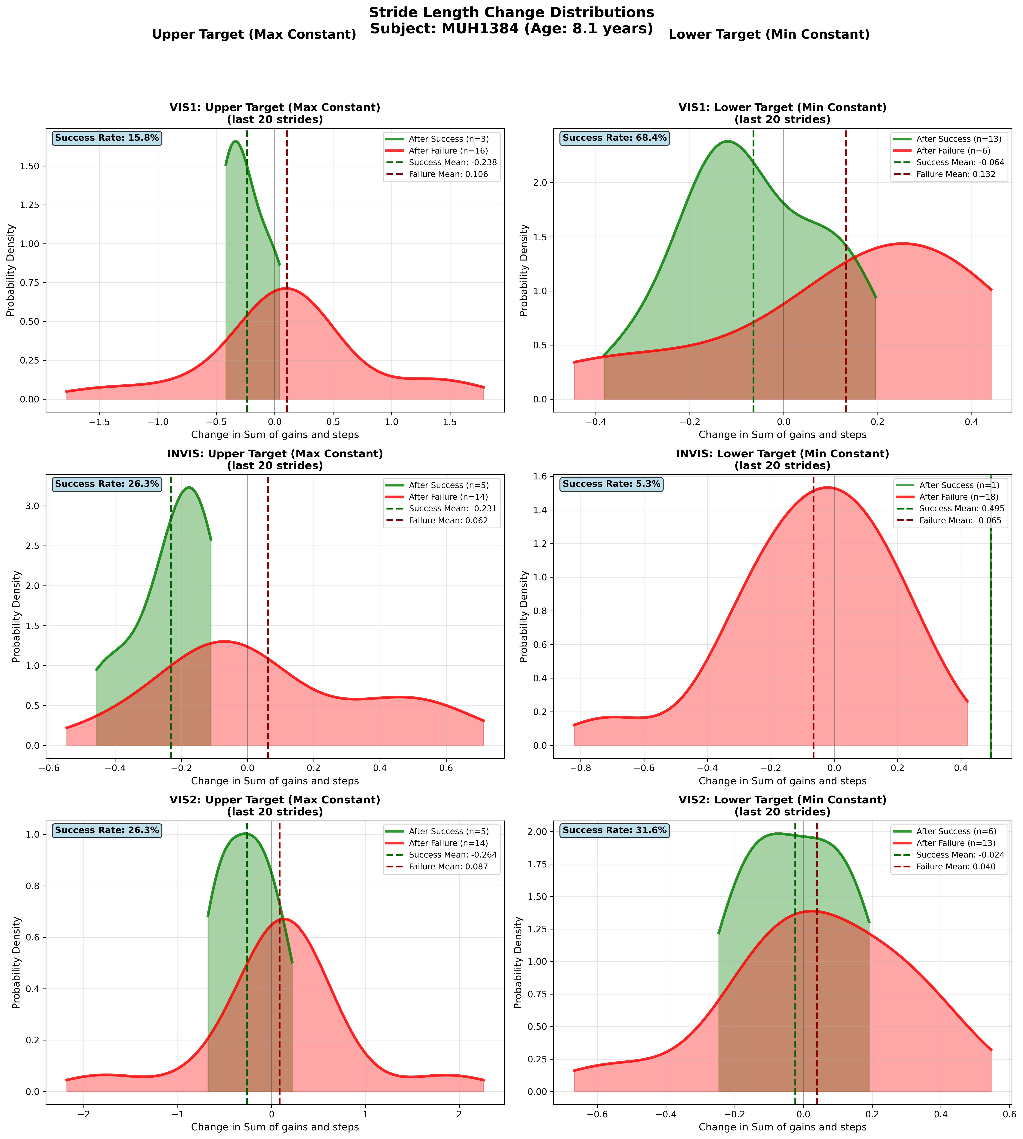
Subject MUH1384 (Age: 8.1 years) - Slide 7 of 69

Slide 9
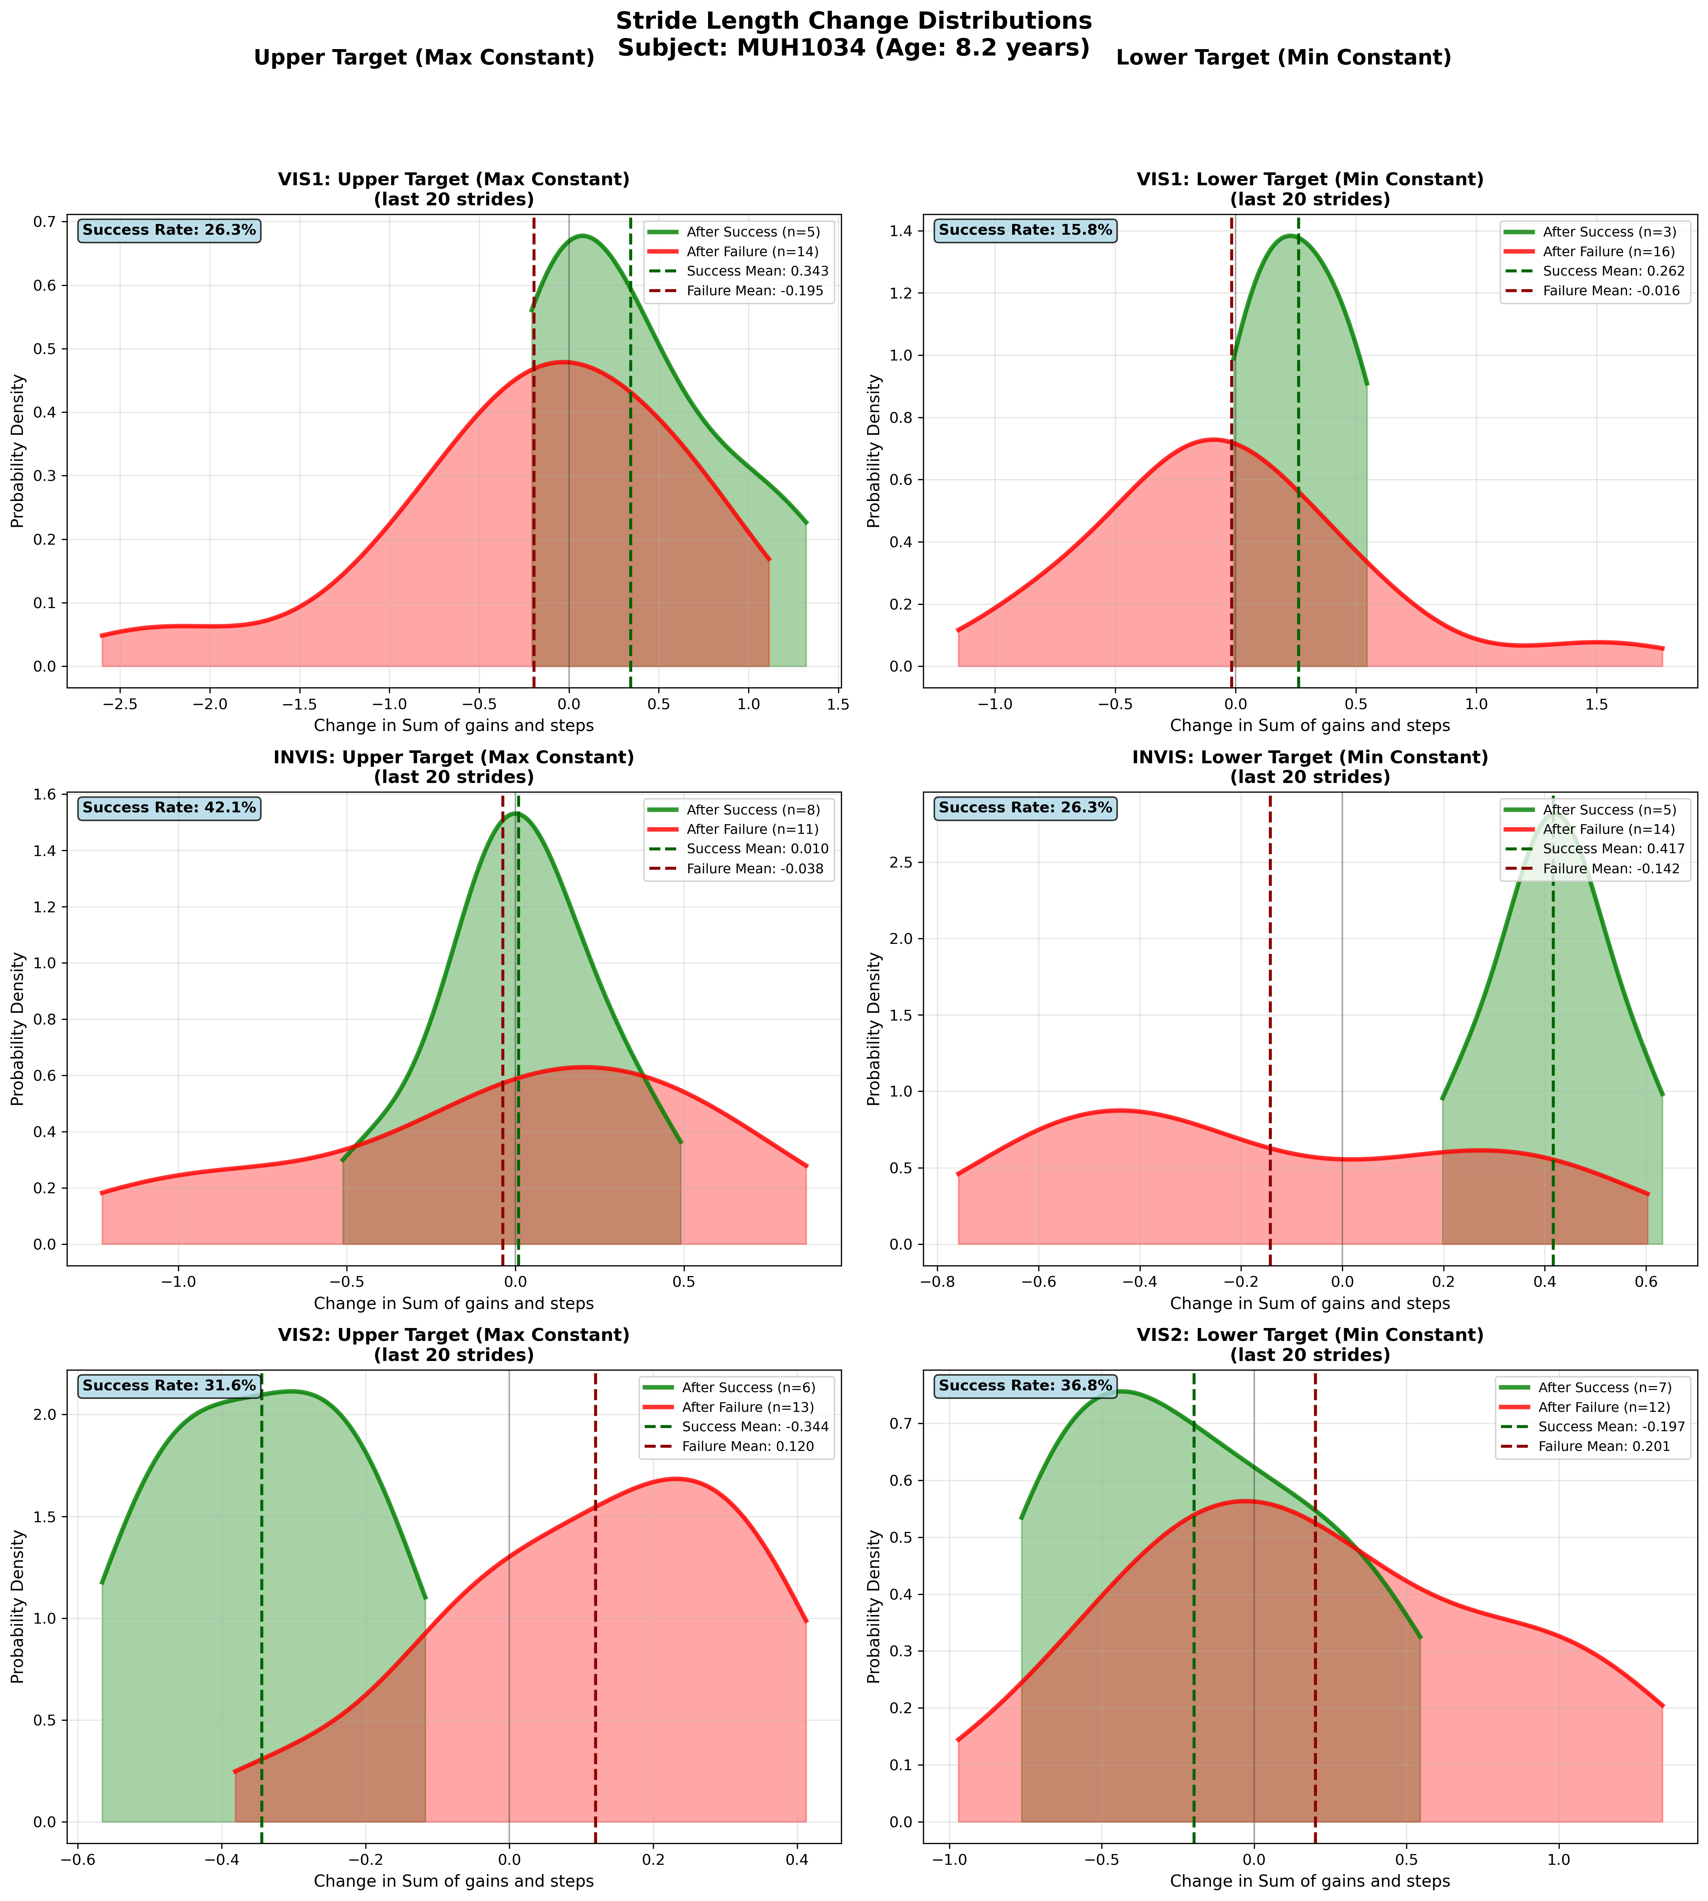
Subject MUH1034 (Age: 8.2 years) - Slide 8 of 69

Slide 10
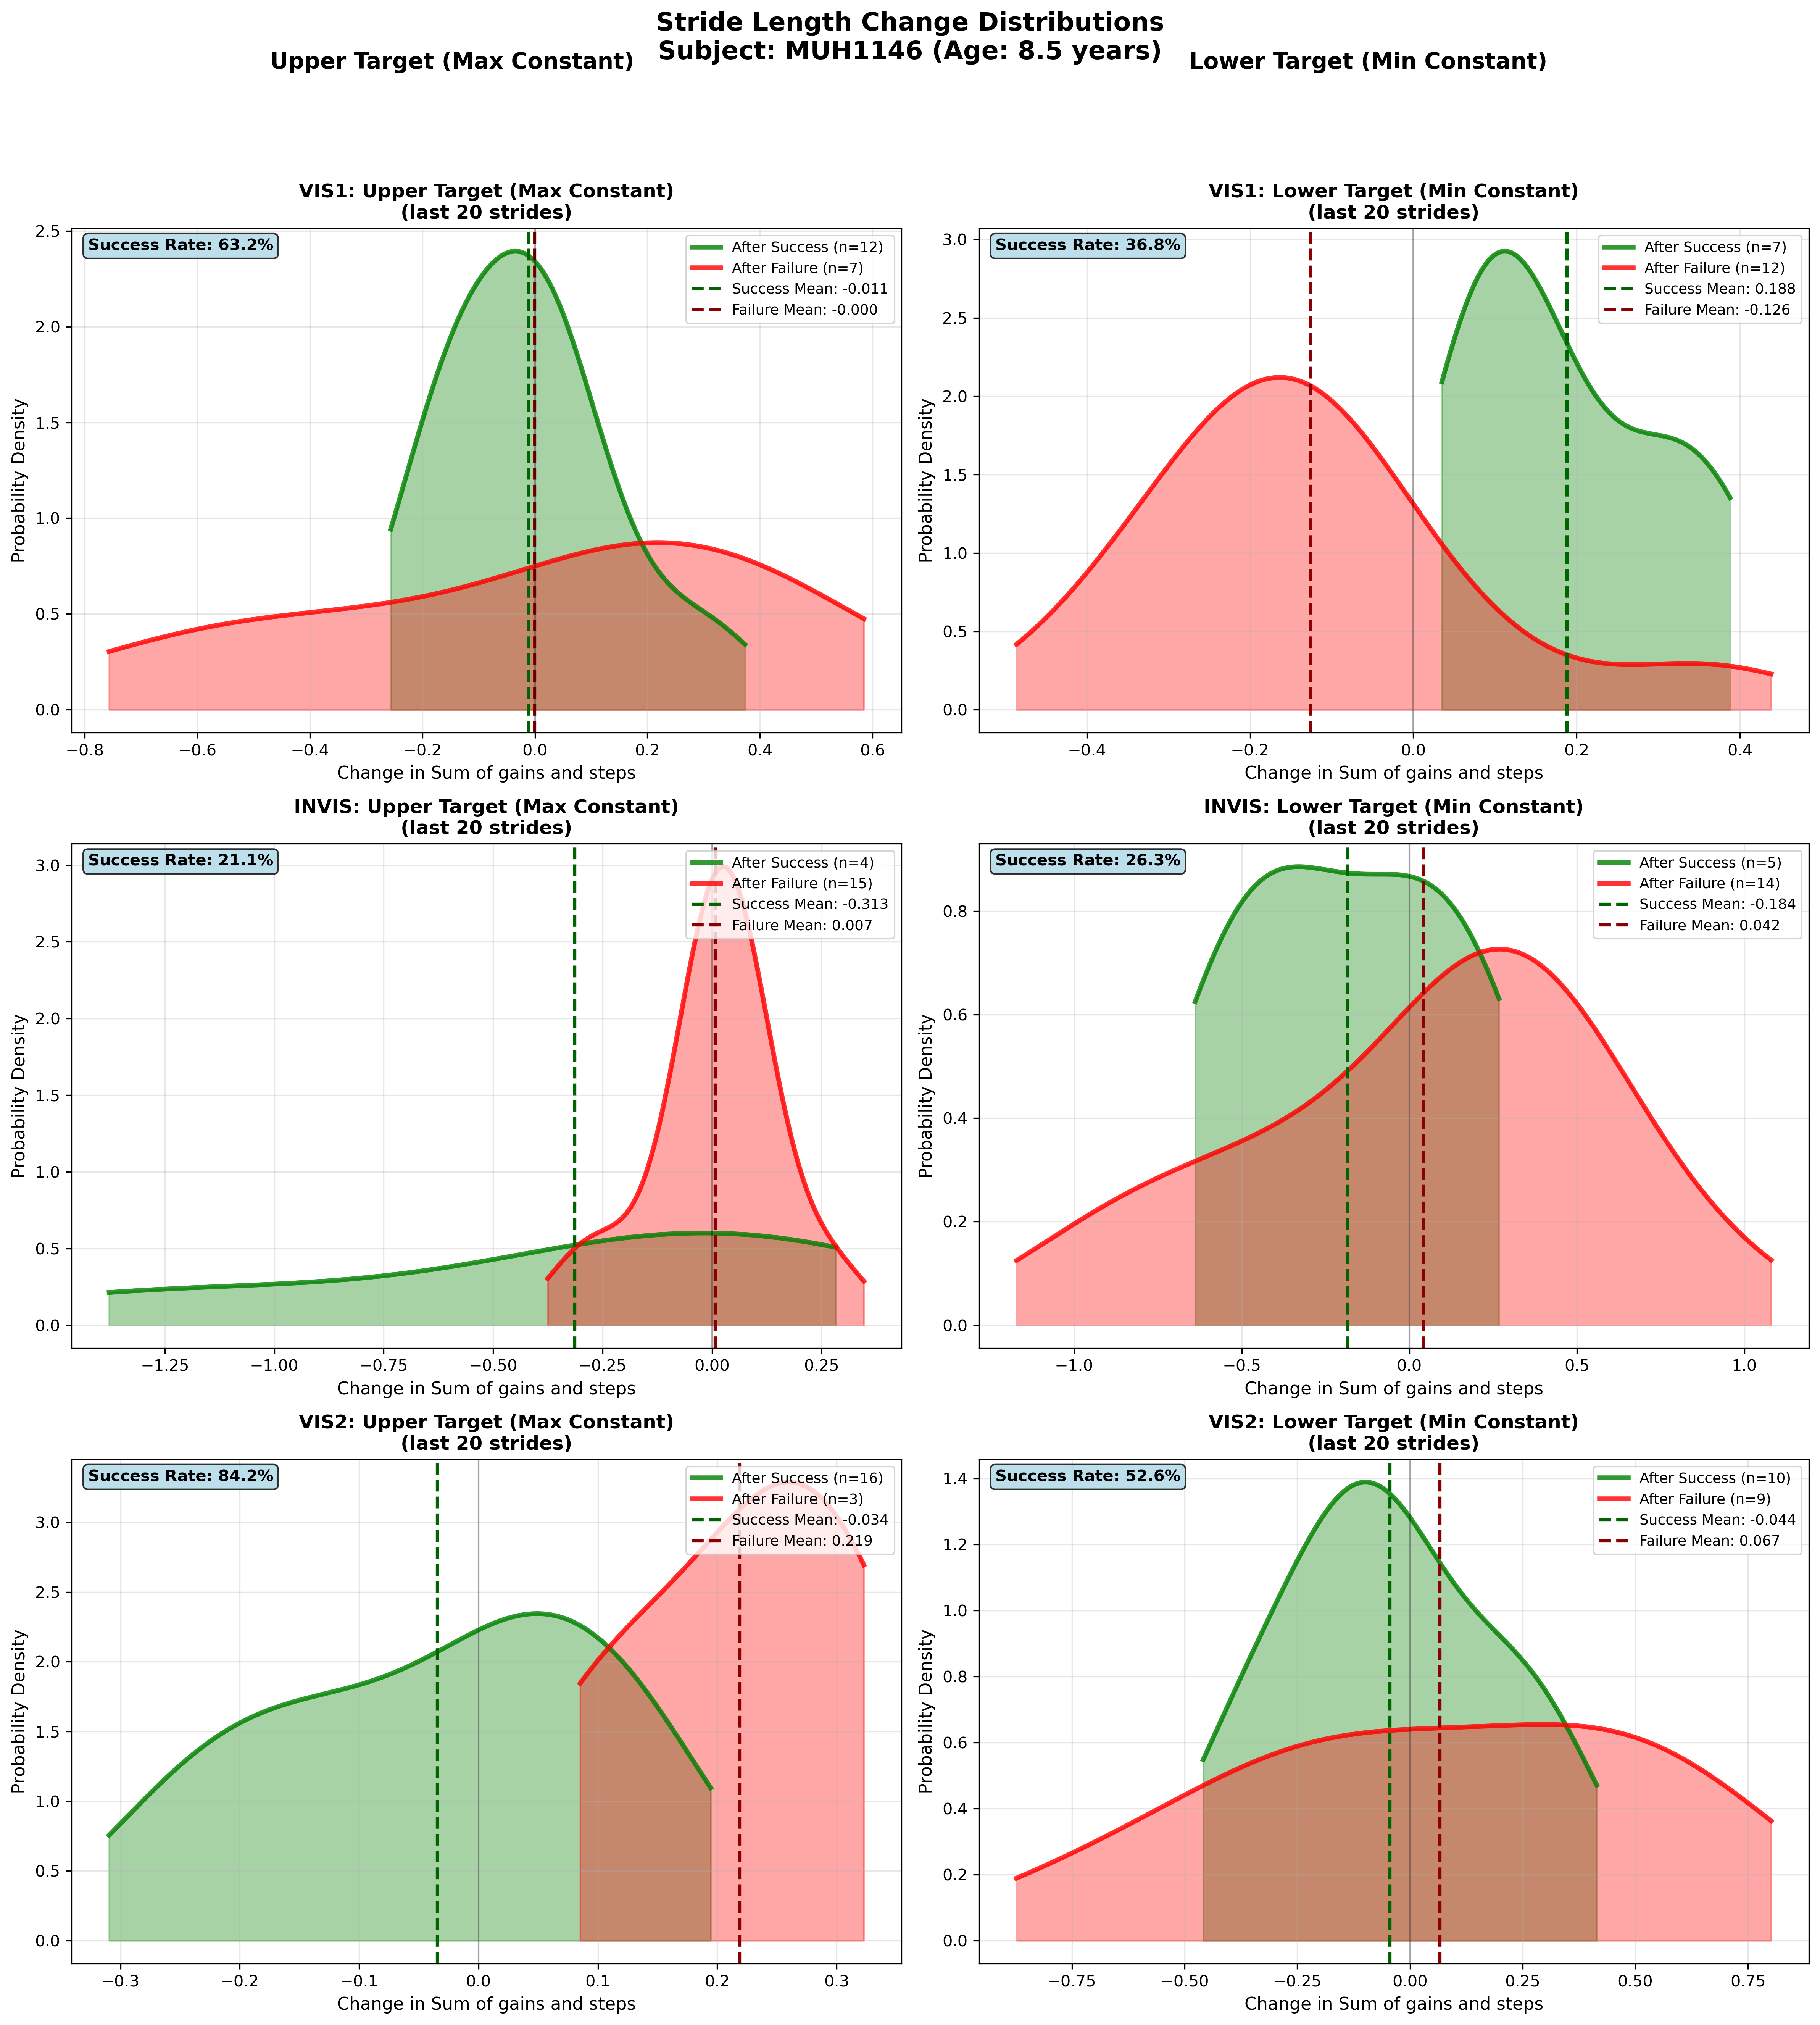
Subject MUH1146 (Age: 8.5 years) - Slide 9 of 69

Slide 11
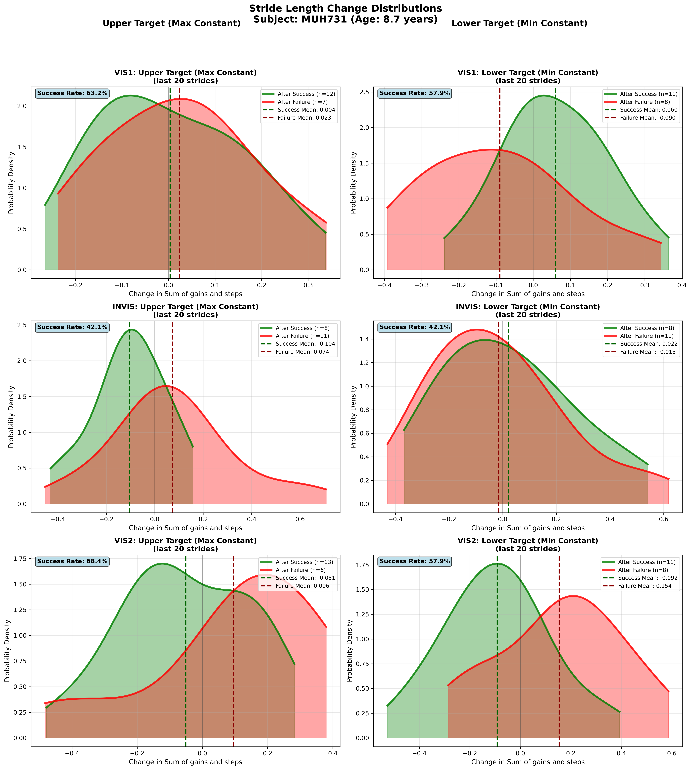
Subject MUH731 (Age: 8.7 years) - Slide 10 of 69

Slide 12
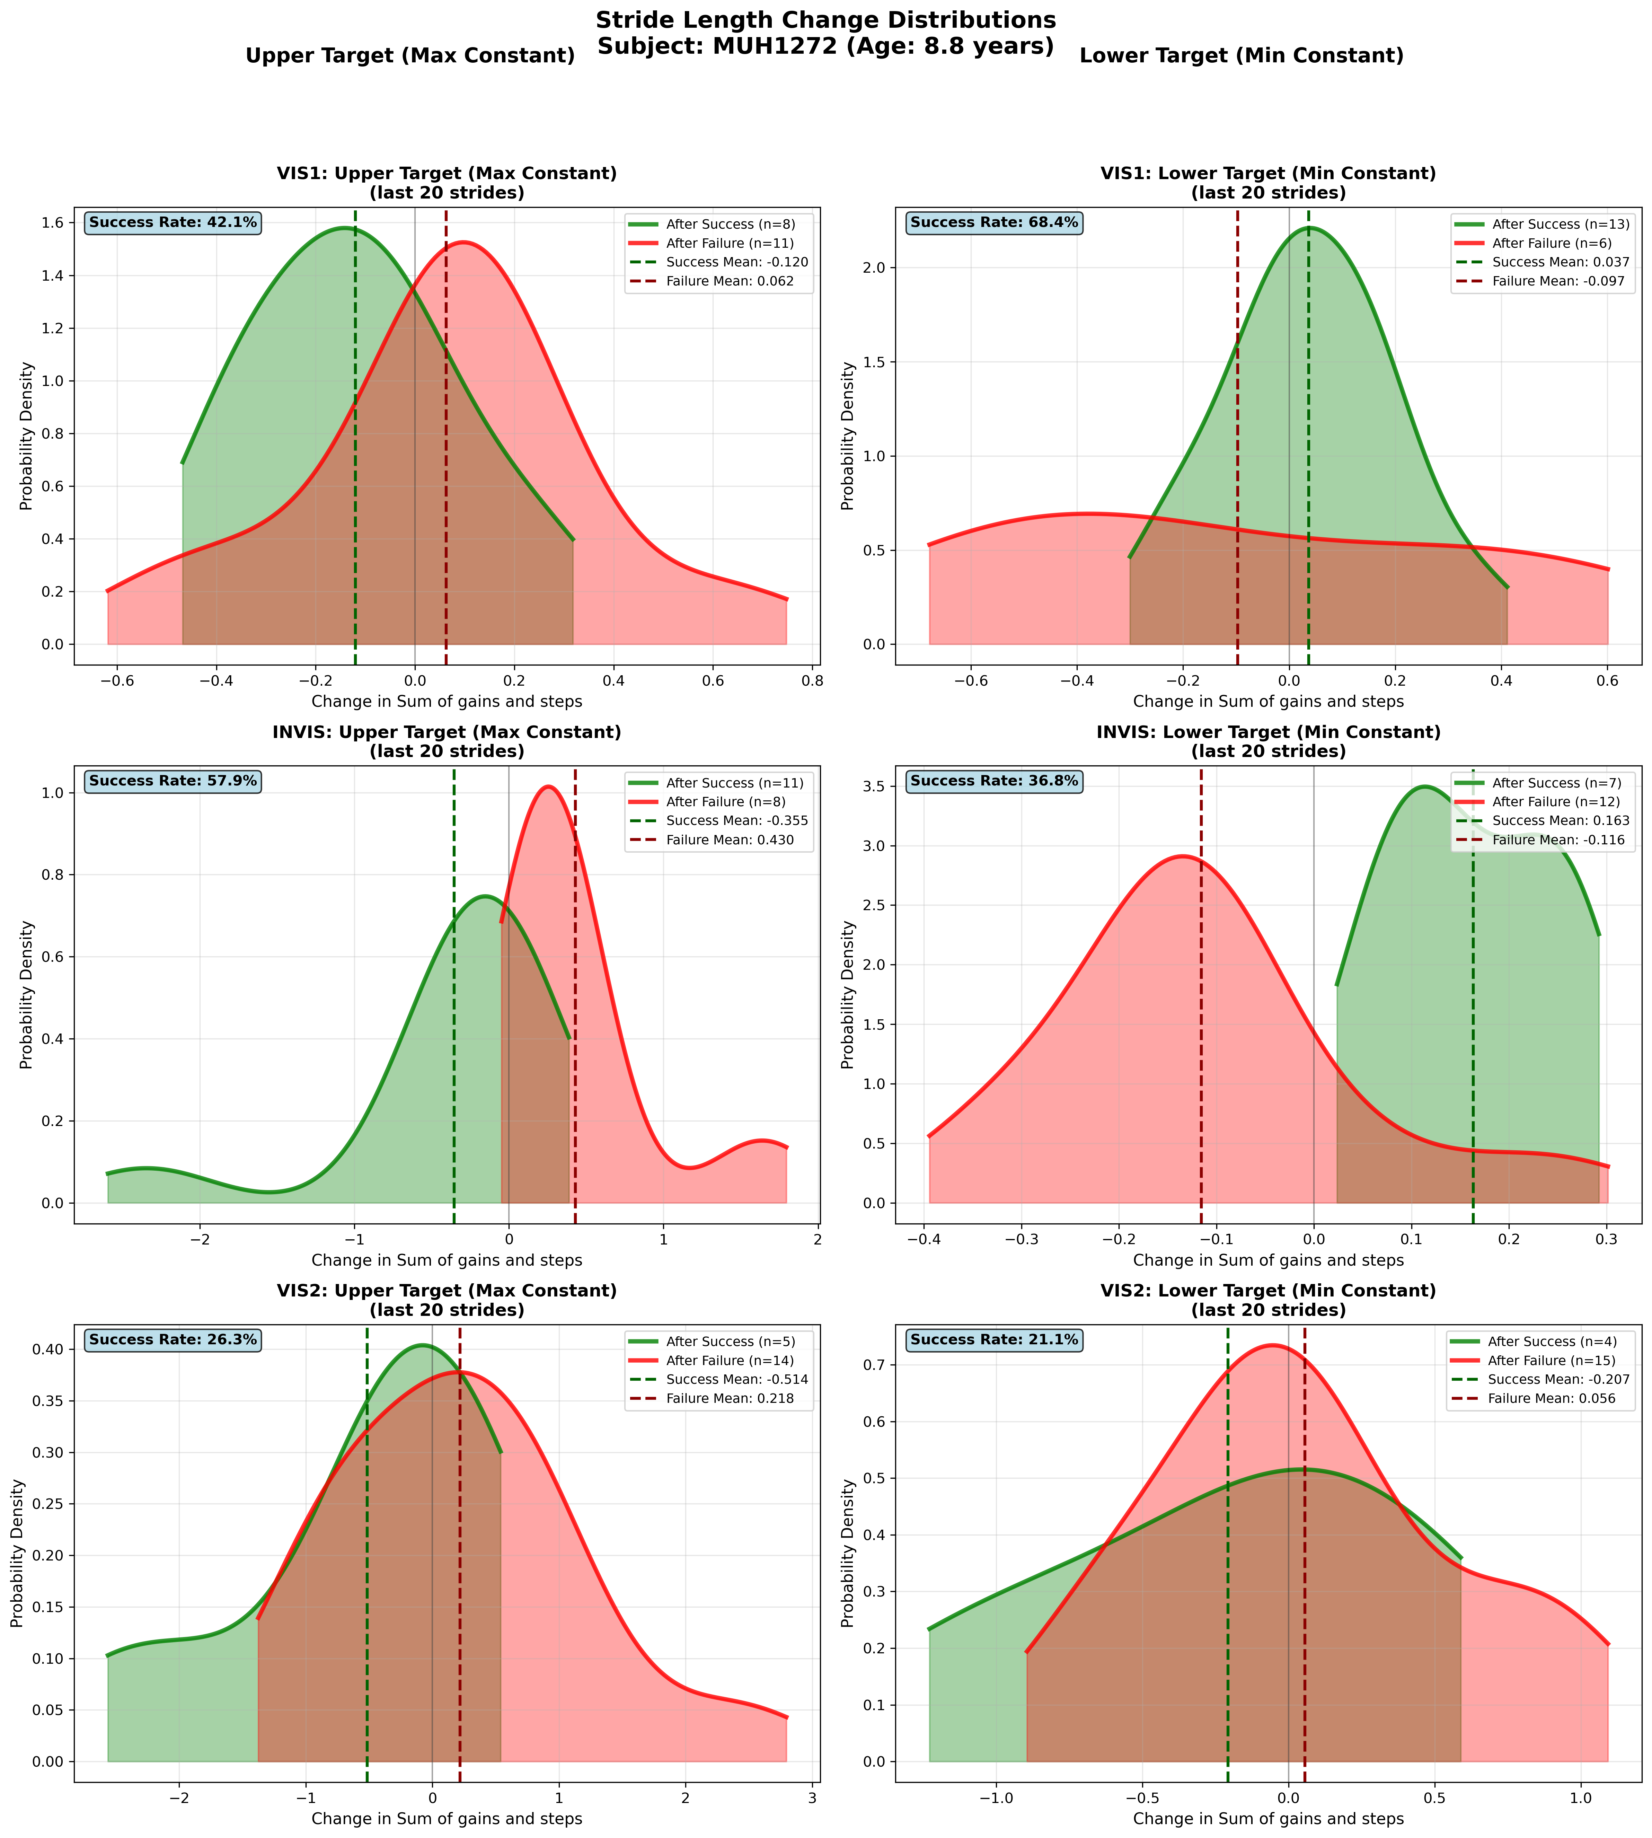
Subject MUH1272 (Age: 8.8 years) - Slide 11 of 69

Slide 13
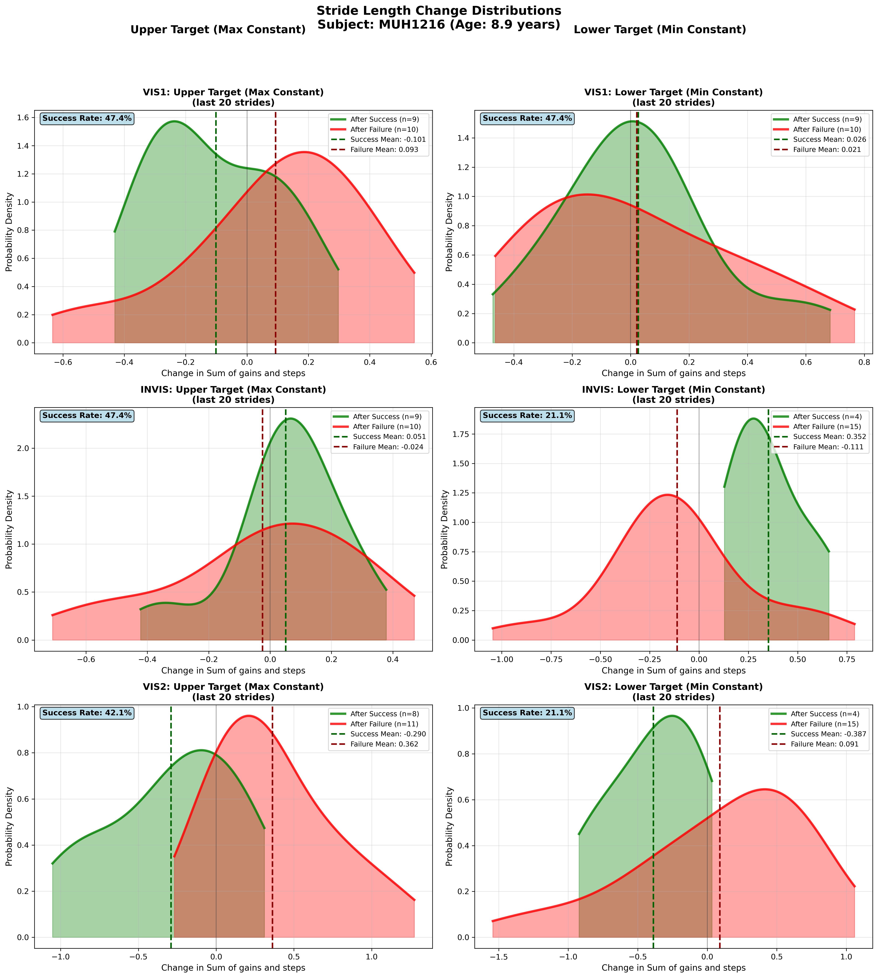
Subject MUH1216 (Age: 8.9 years) - Slide 12 of 69

Slide 14
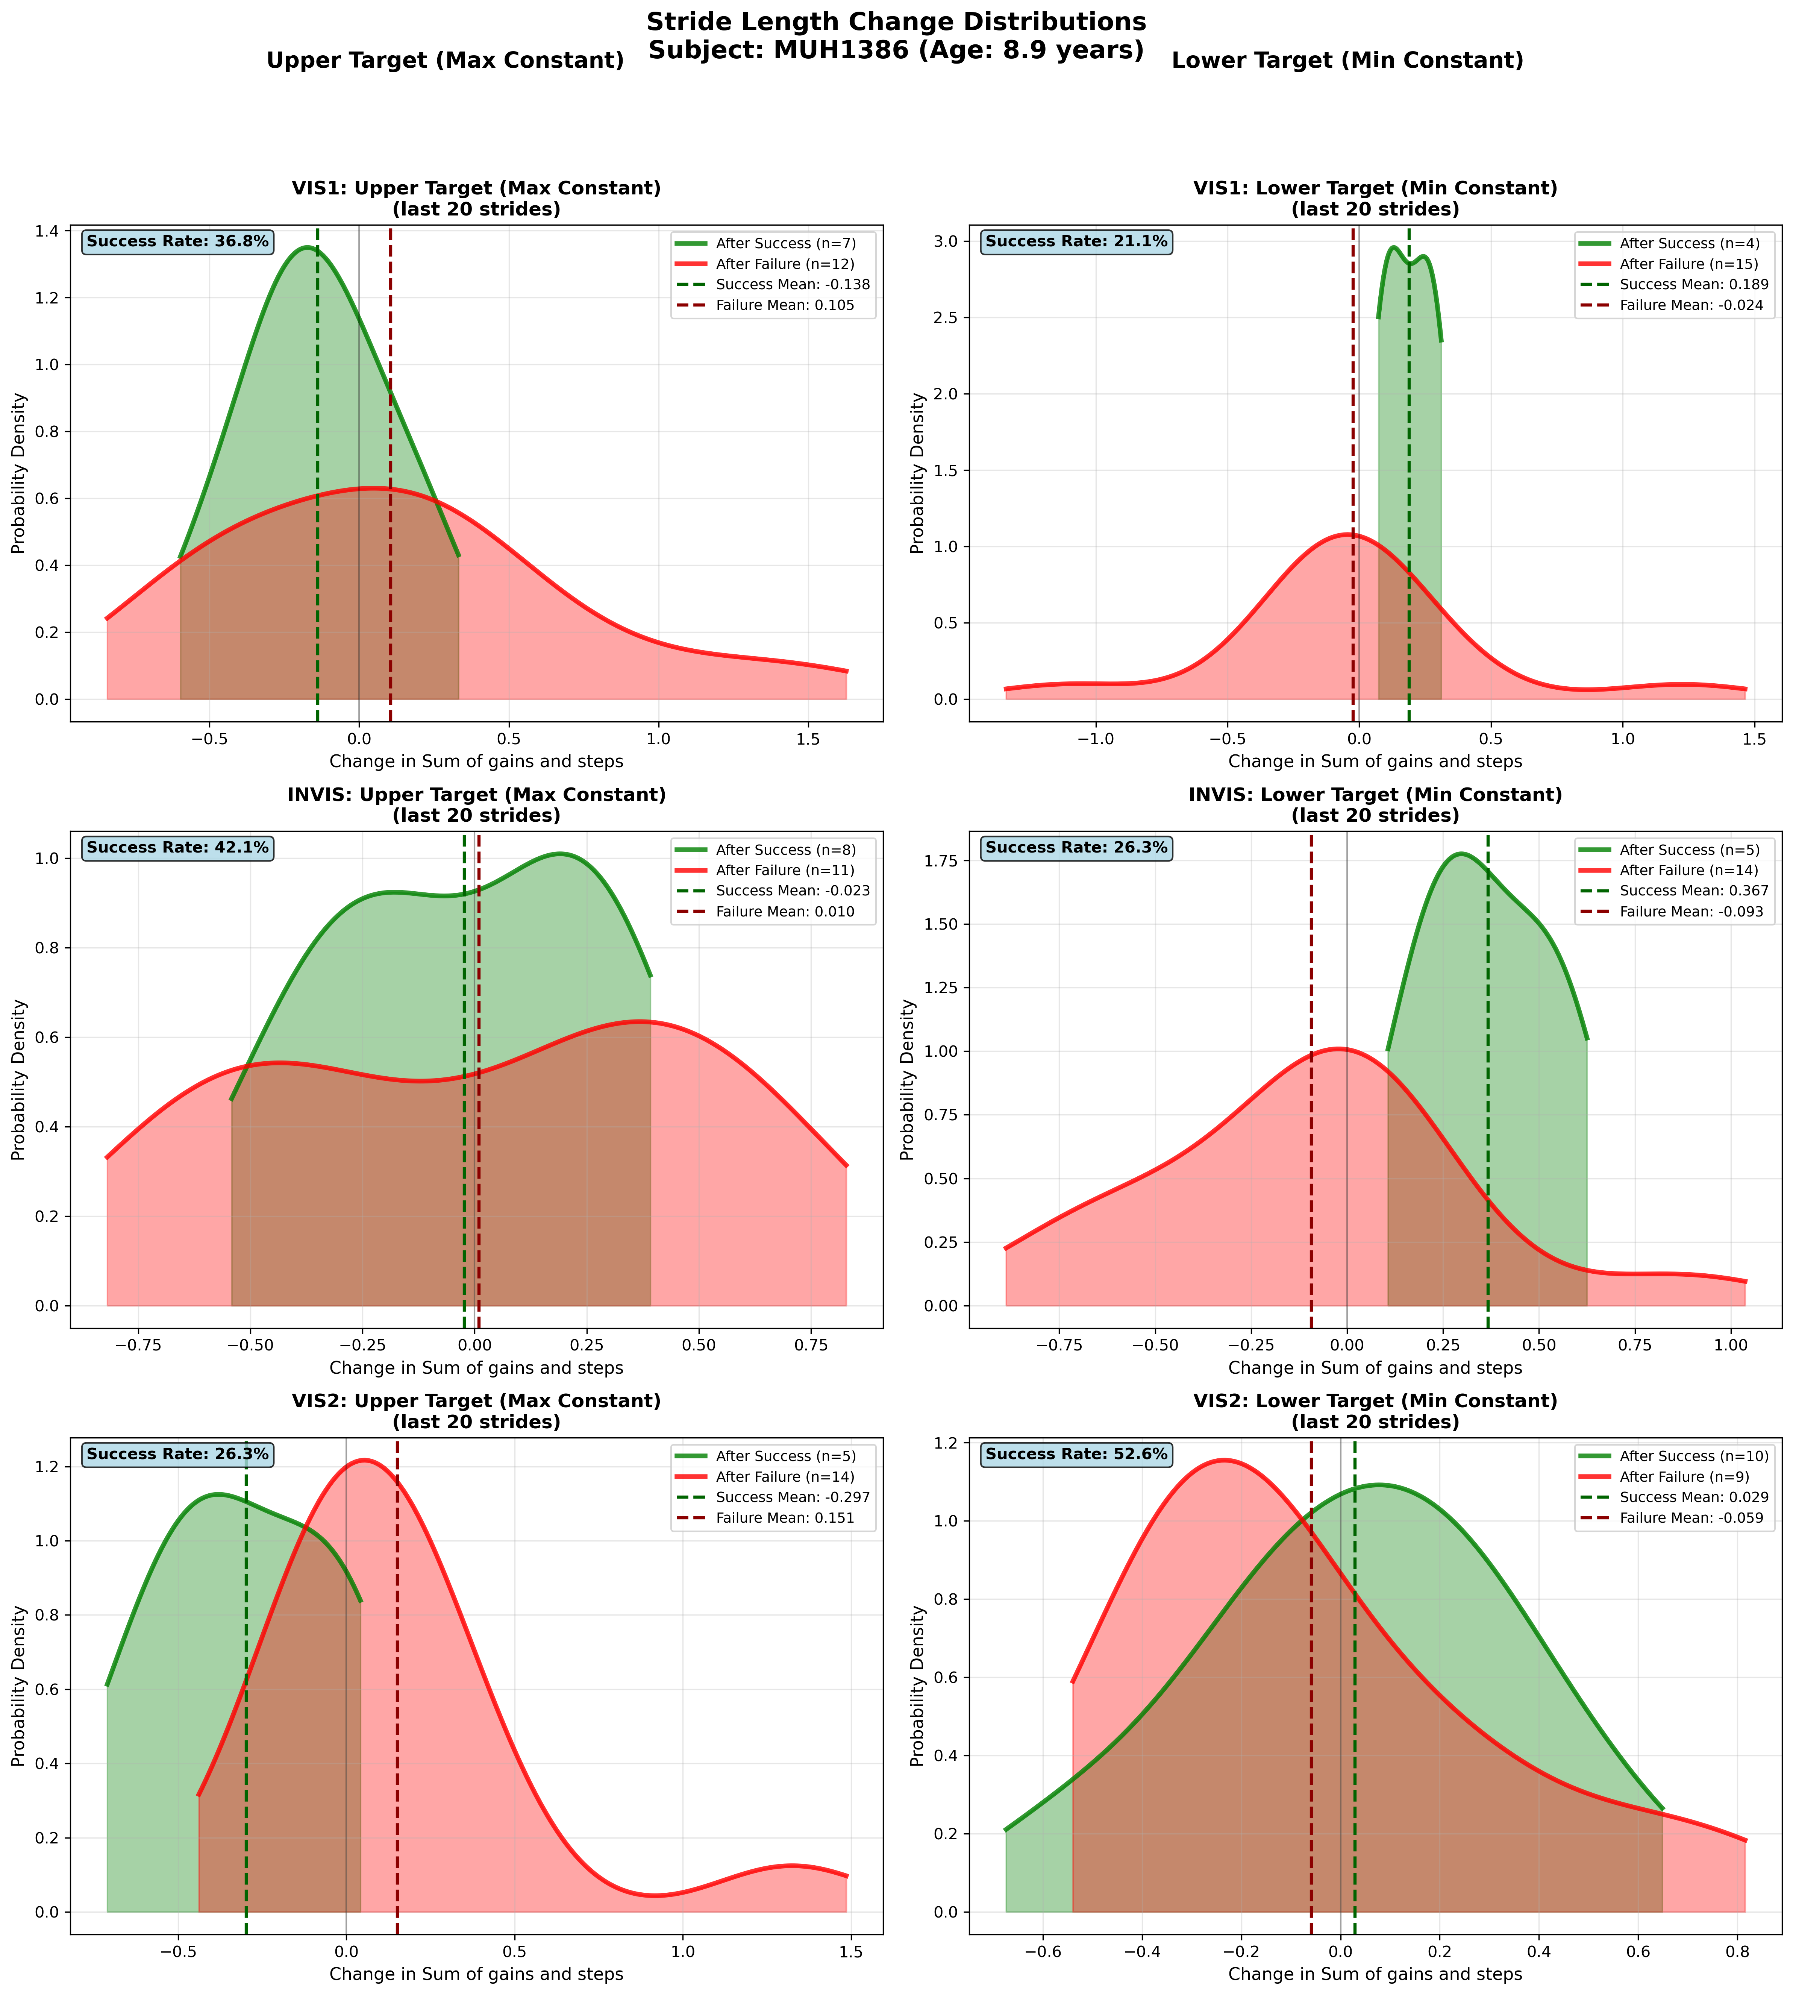
Subject MUH1386 (Age: 8.9 years) - Slide 13 of 69

Slide 15
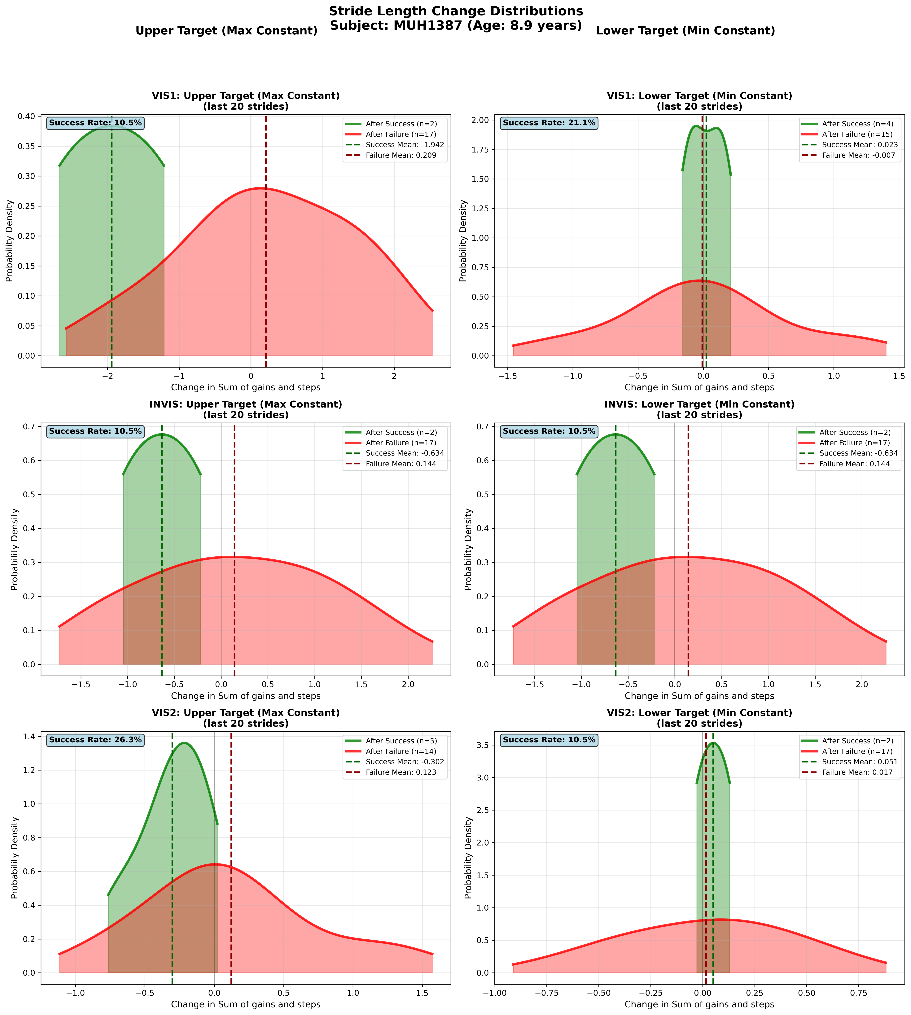
Subject MUH1387 (Age: 8.9 years) - Slide 14 of 69

Slide 16
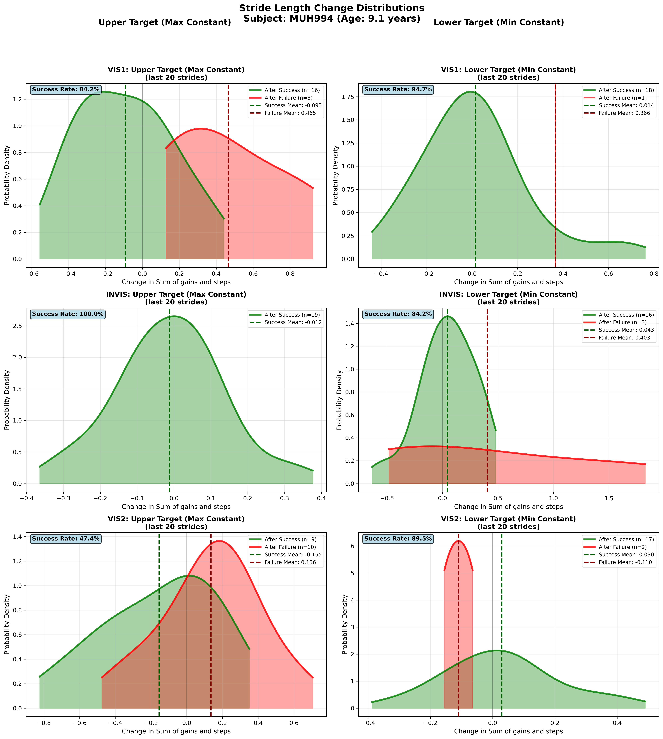
Subject MUH994 (Age: 9.1 years) - Slide 15 of 69

Slide 17
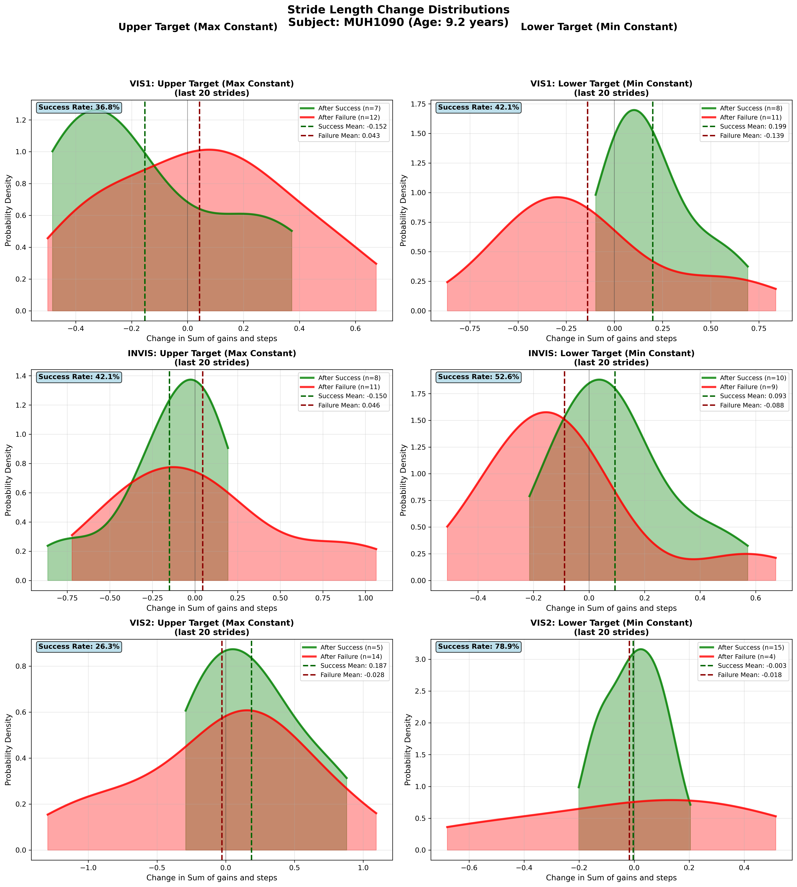
Subject MUH1090 (Age: 9.2 years) - Slide 16 of 69

Slide 18
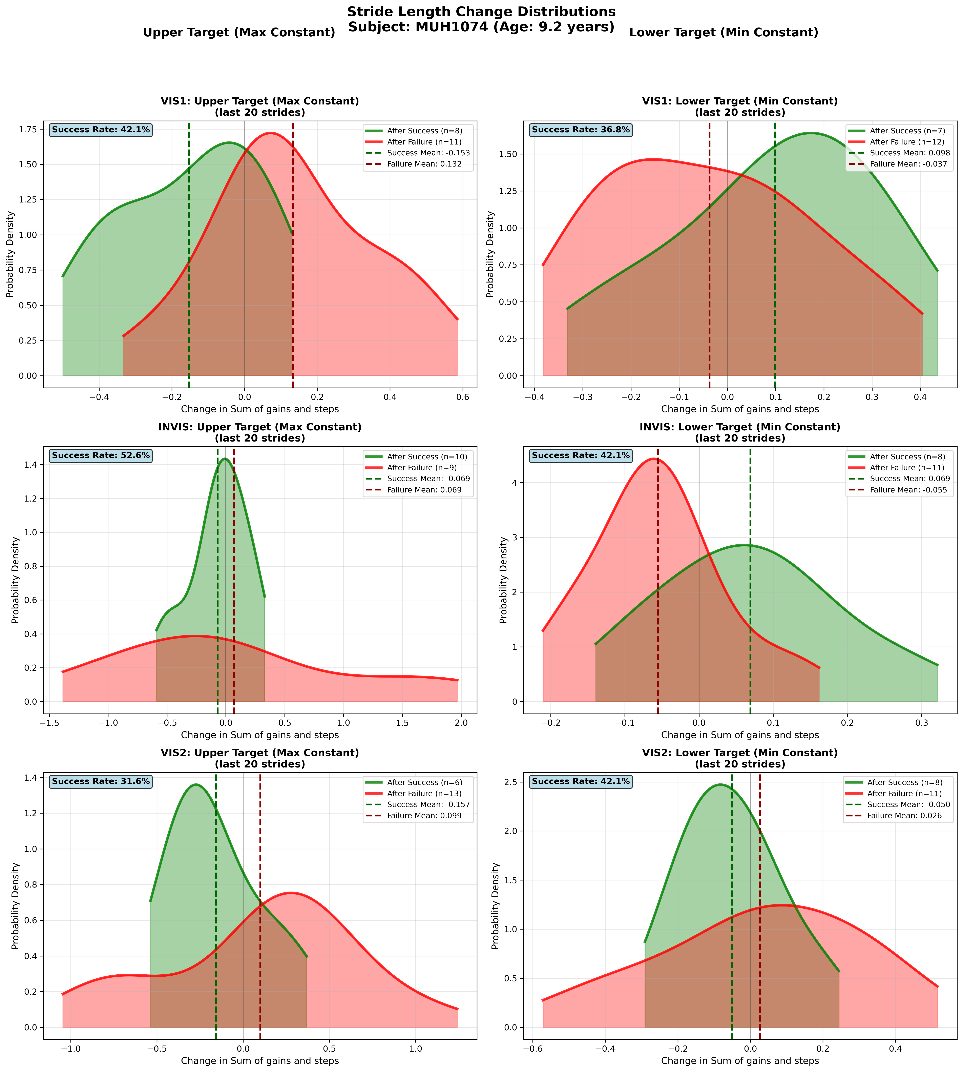
Subject MUH1074 (Age: 9.2 years) - Slide 17 of 69

Slide 19
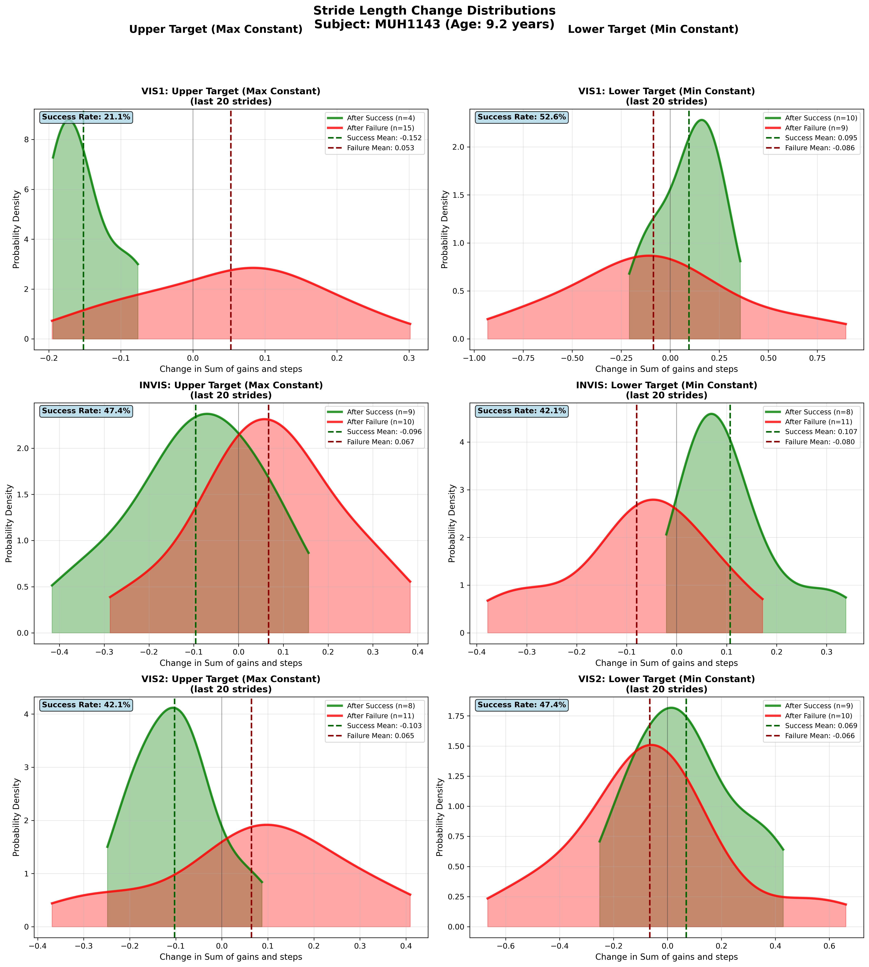
Subject MUH1143 (Age: 9.2 years) - Slide 18 of 69

Slide 20
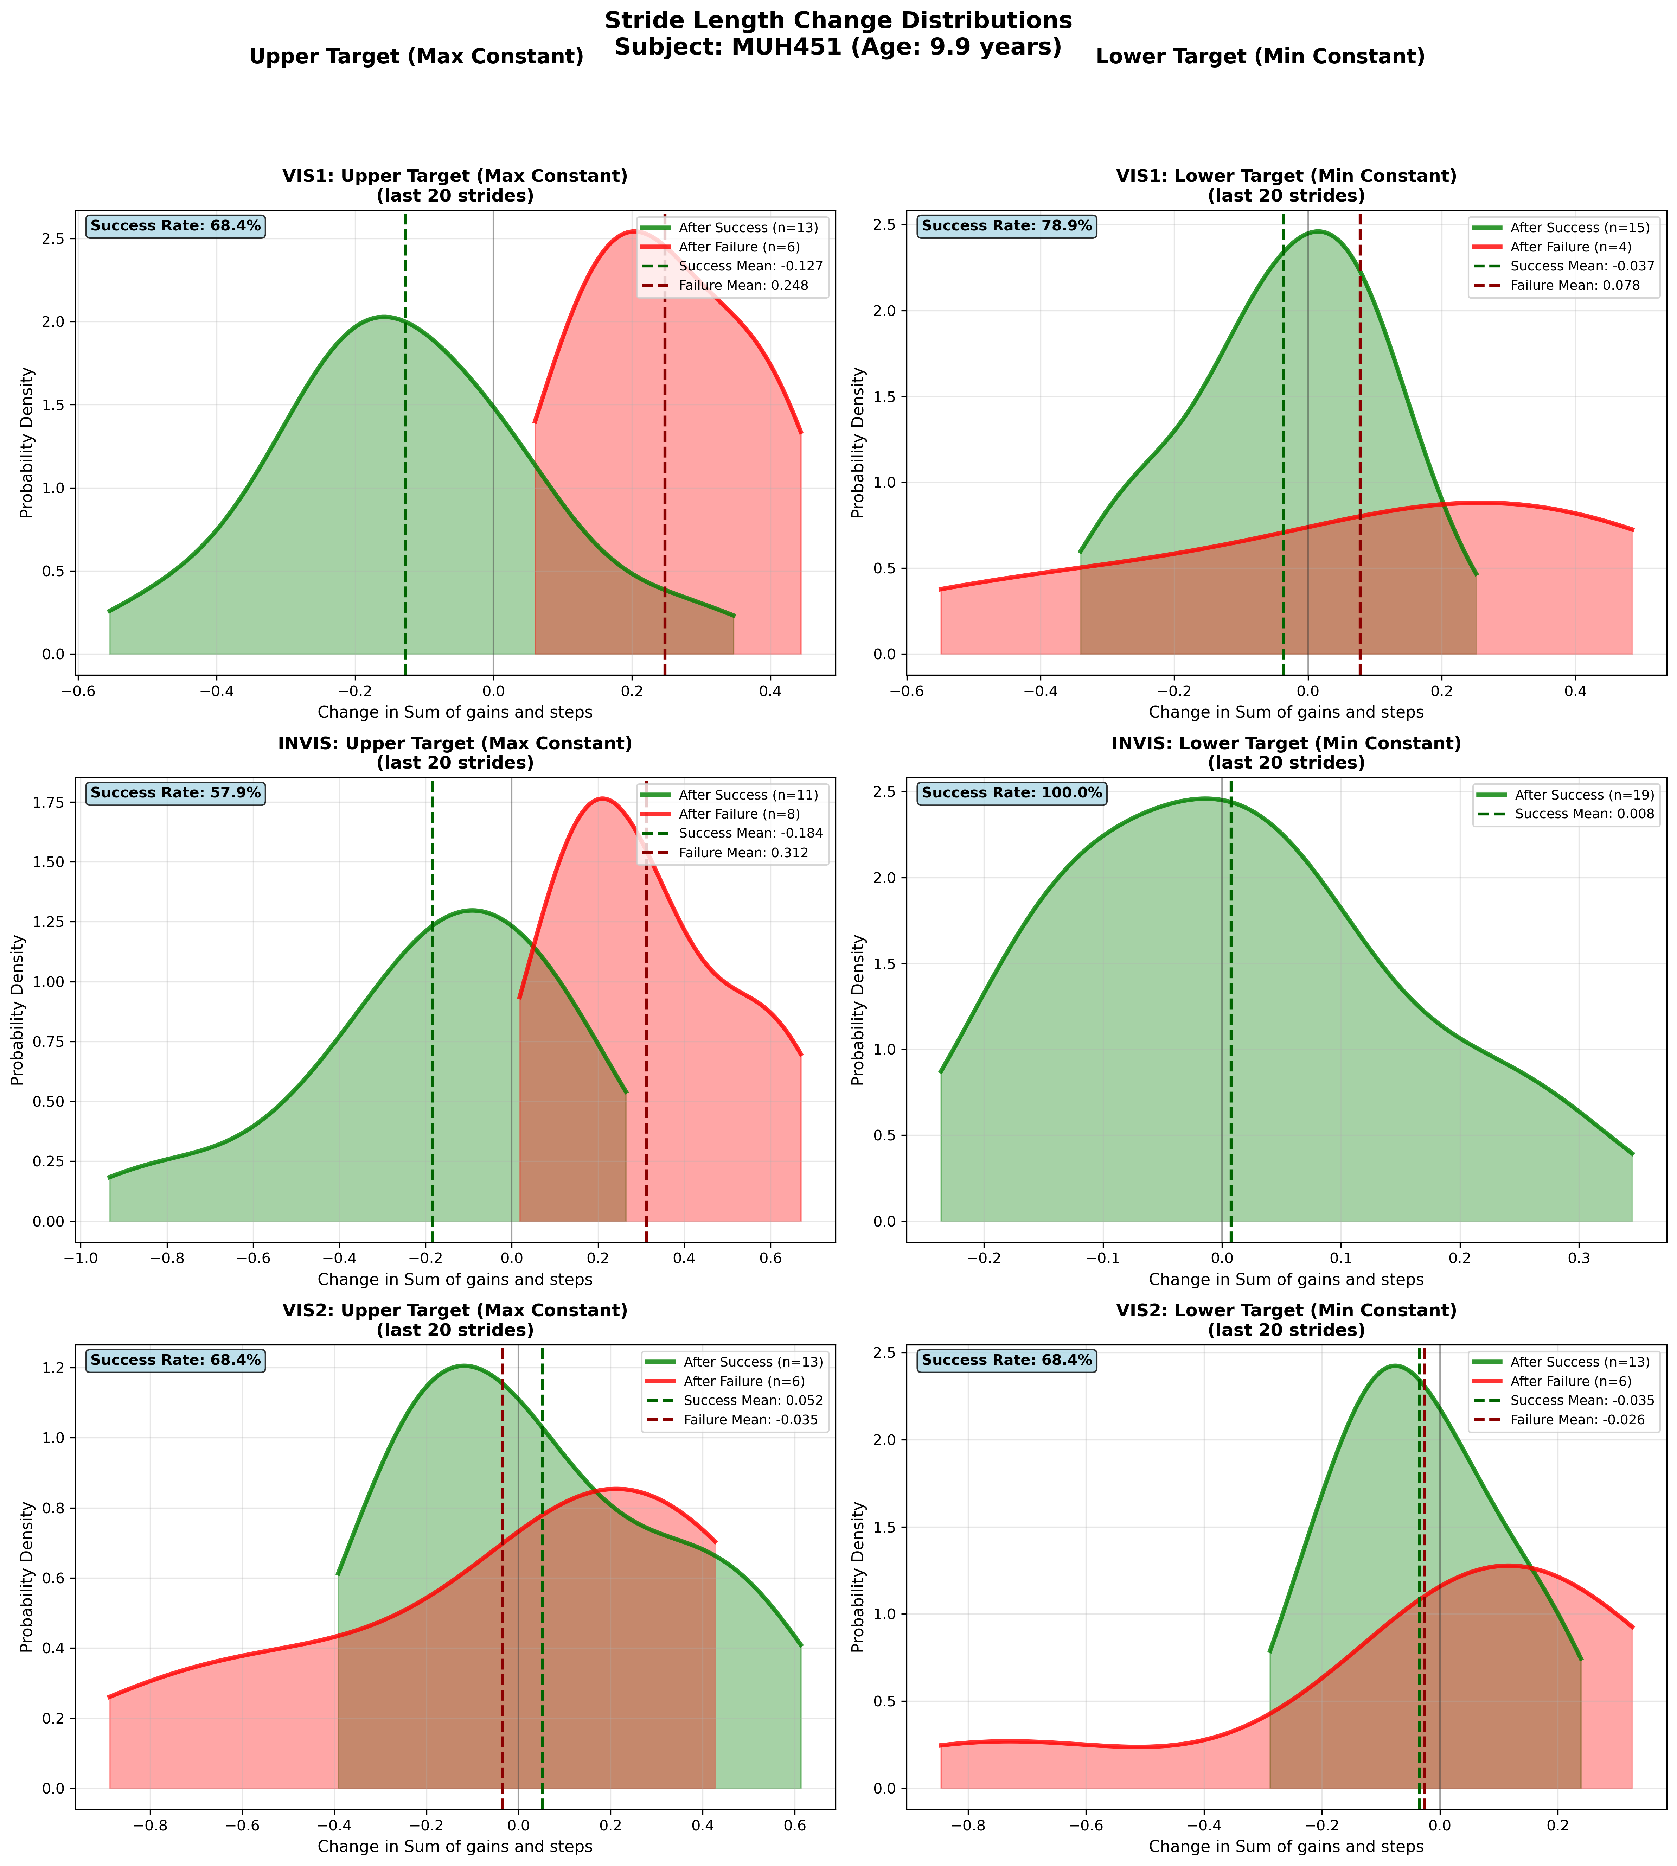
Subject MUH451 (Age: 9.9 years) - Slide 19 of 69

Slide 21
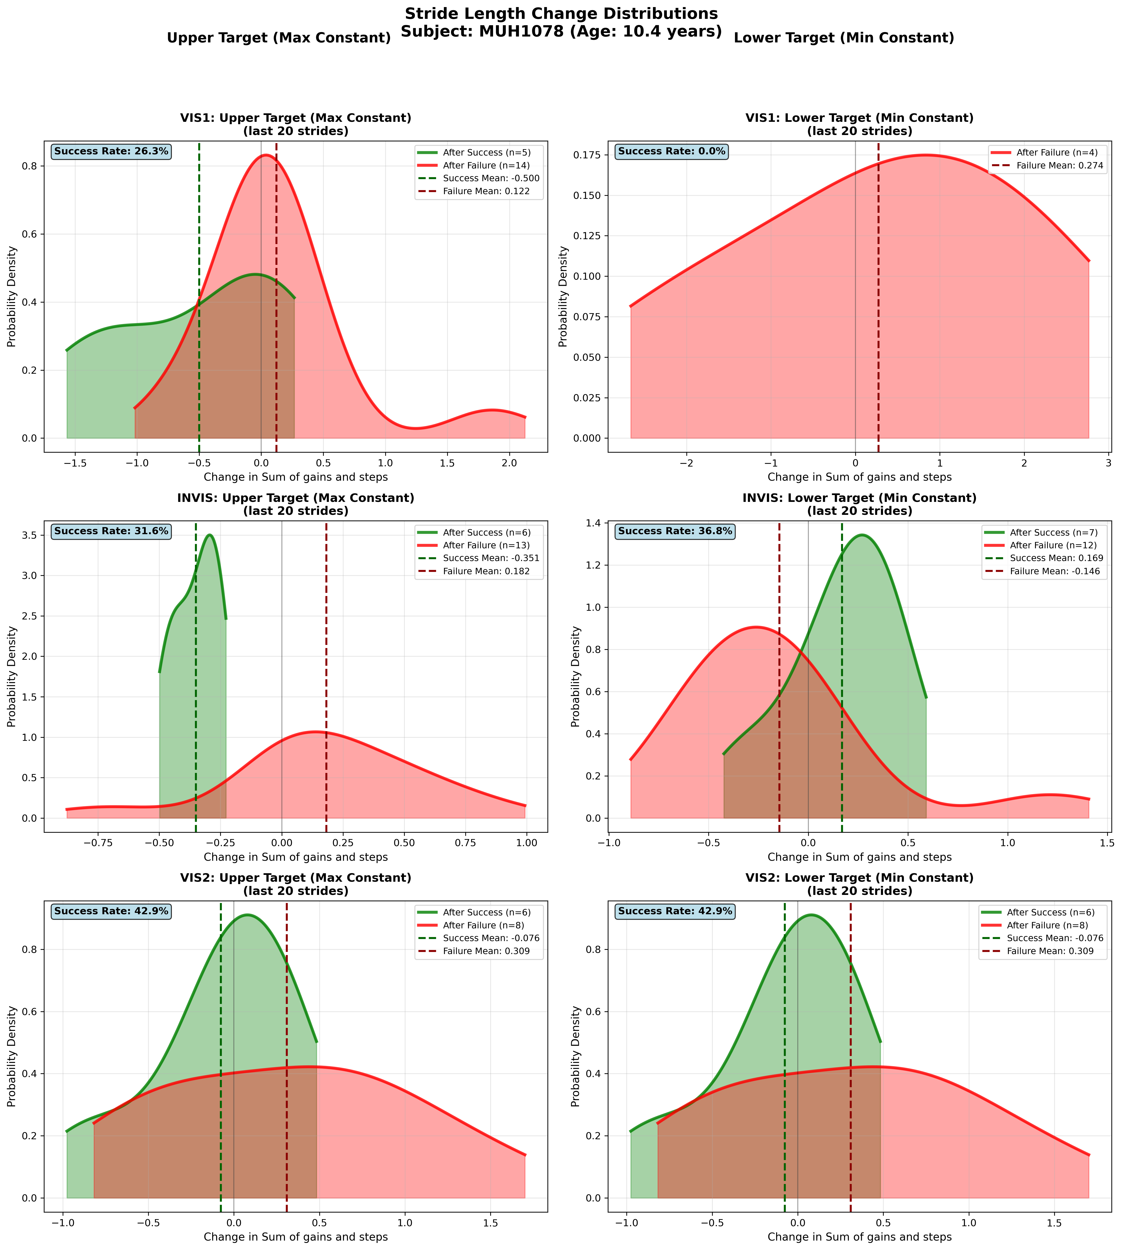
Subject MUH1078 (Age: 10.4 years) - Slide 20 of 69

Slide 22
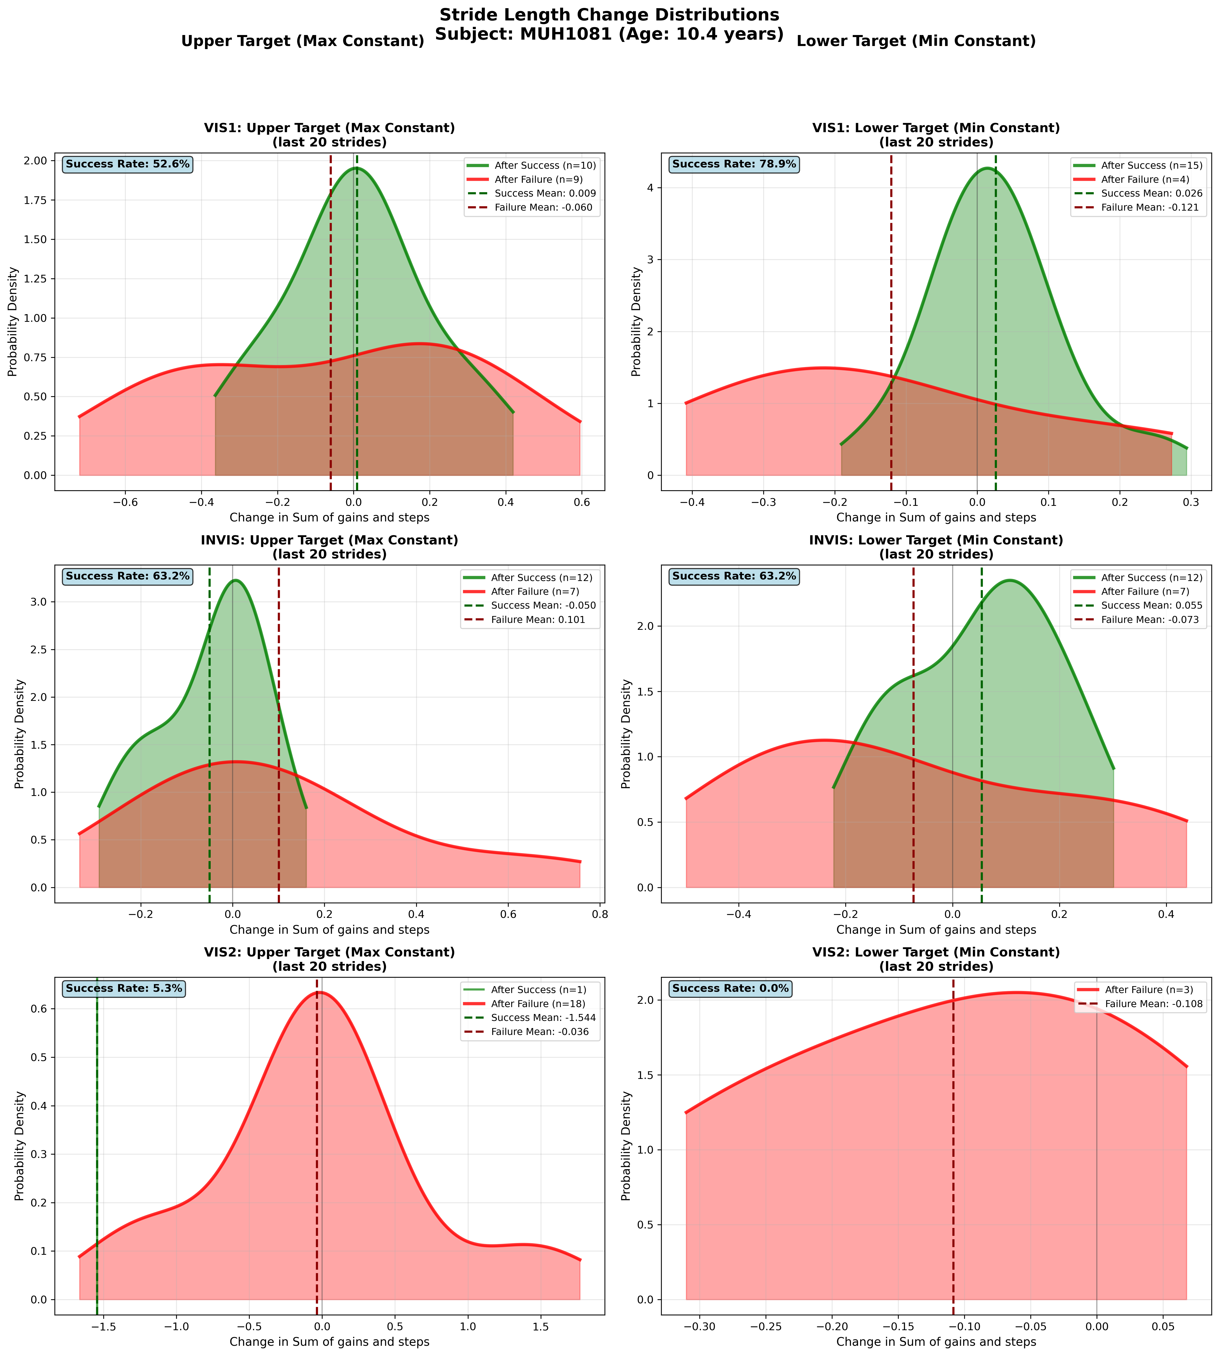
Subject MUH1081 (Age: 10.4 years) - Slide 21 of 69

Slide 23
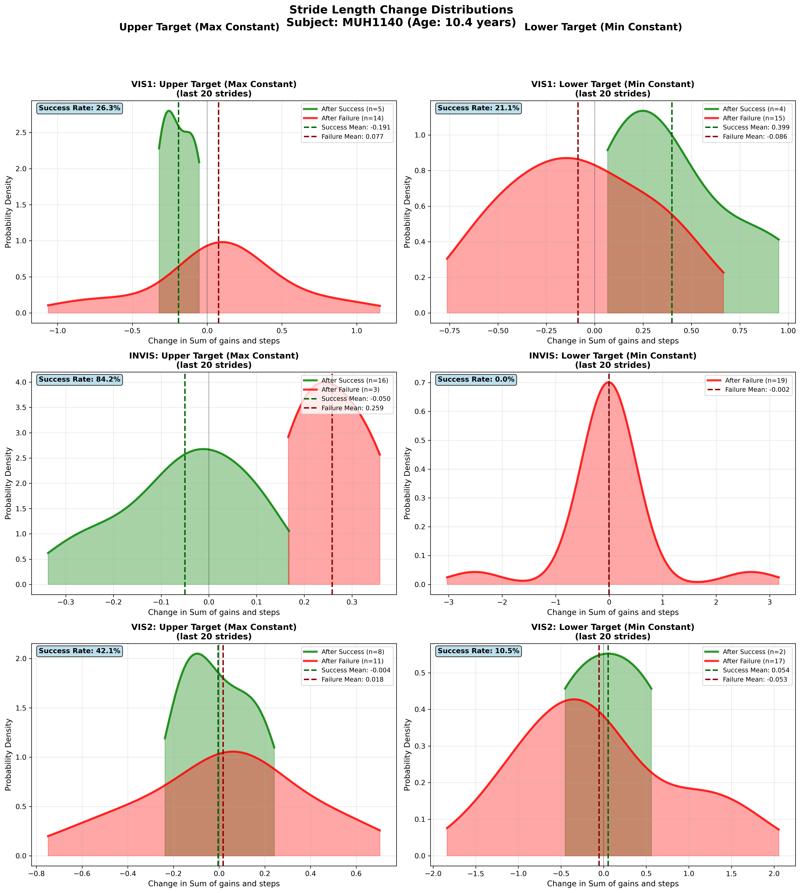
Subject MUH1140 (Age: 10.4 years) - Slide 22 of 69

Slide 24
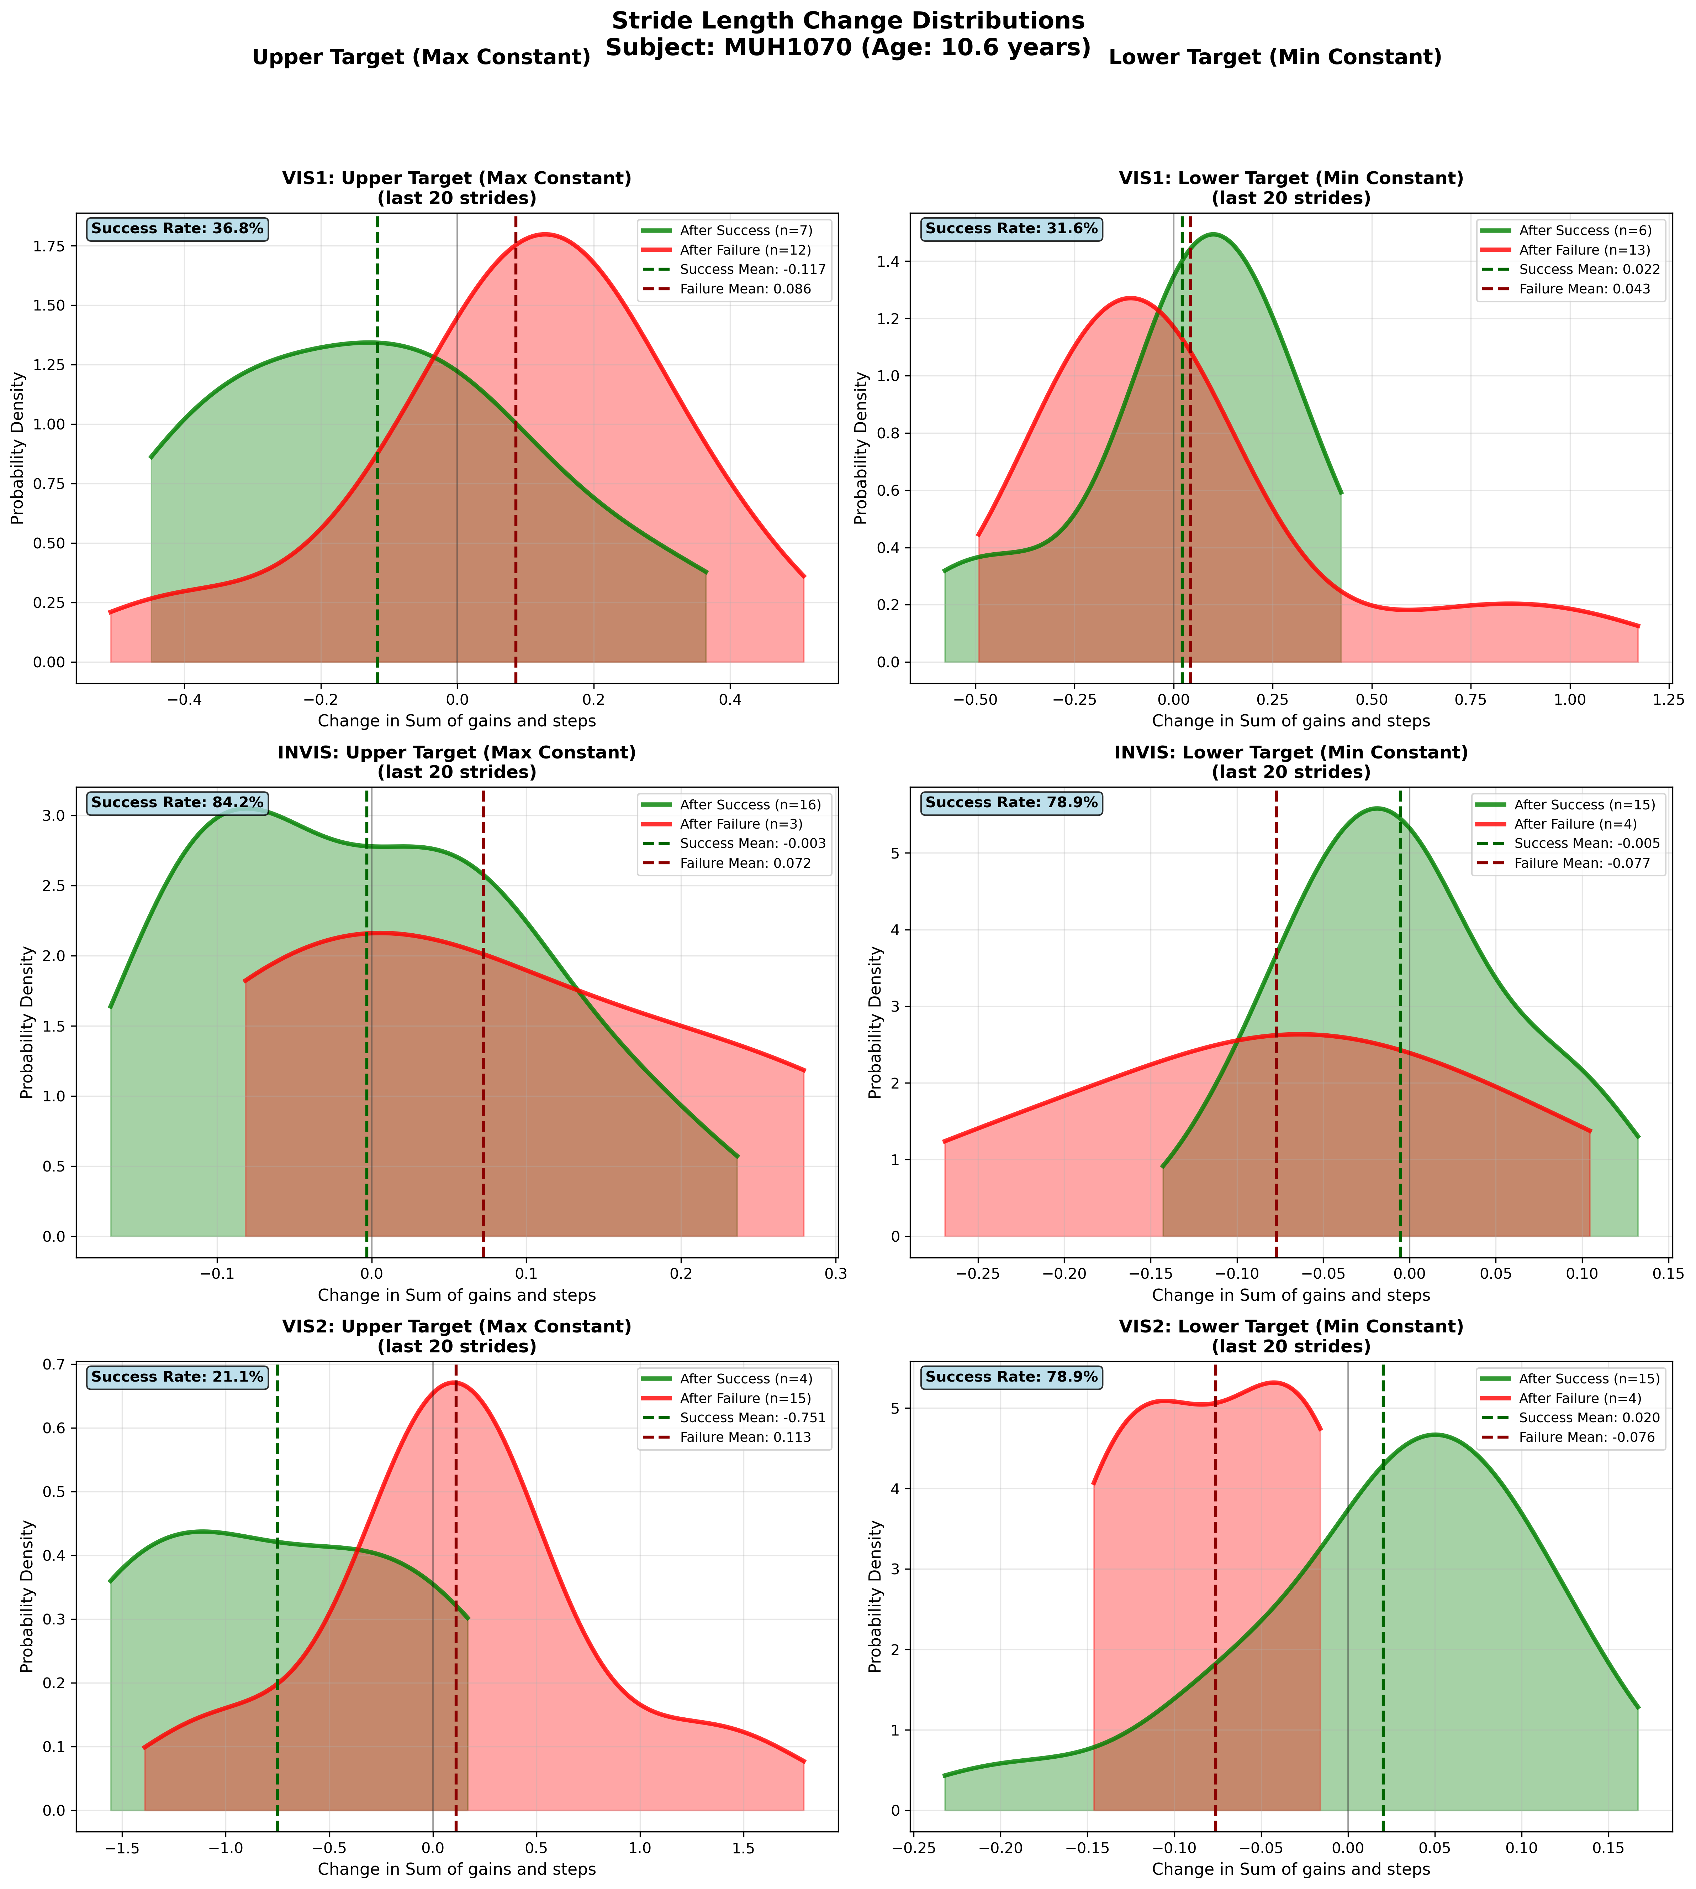
Subject MUH1070 (Age: 10.6 years) - Slide 23 of 69

Slide 25
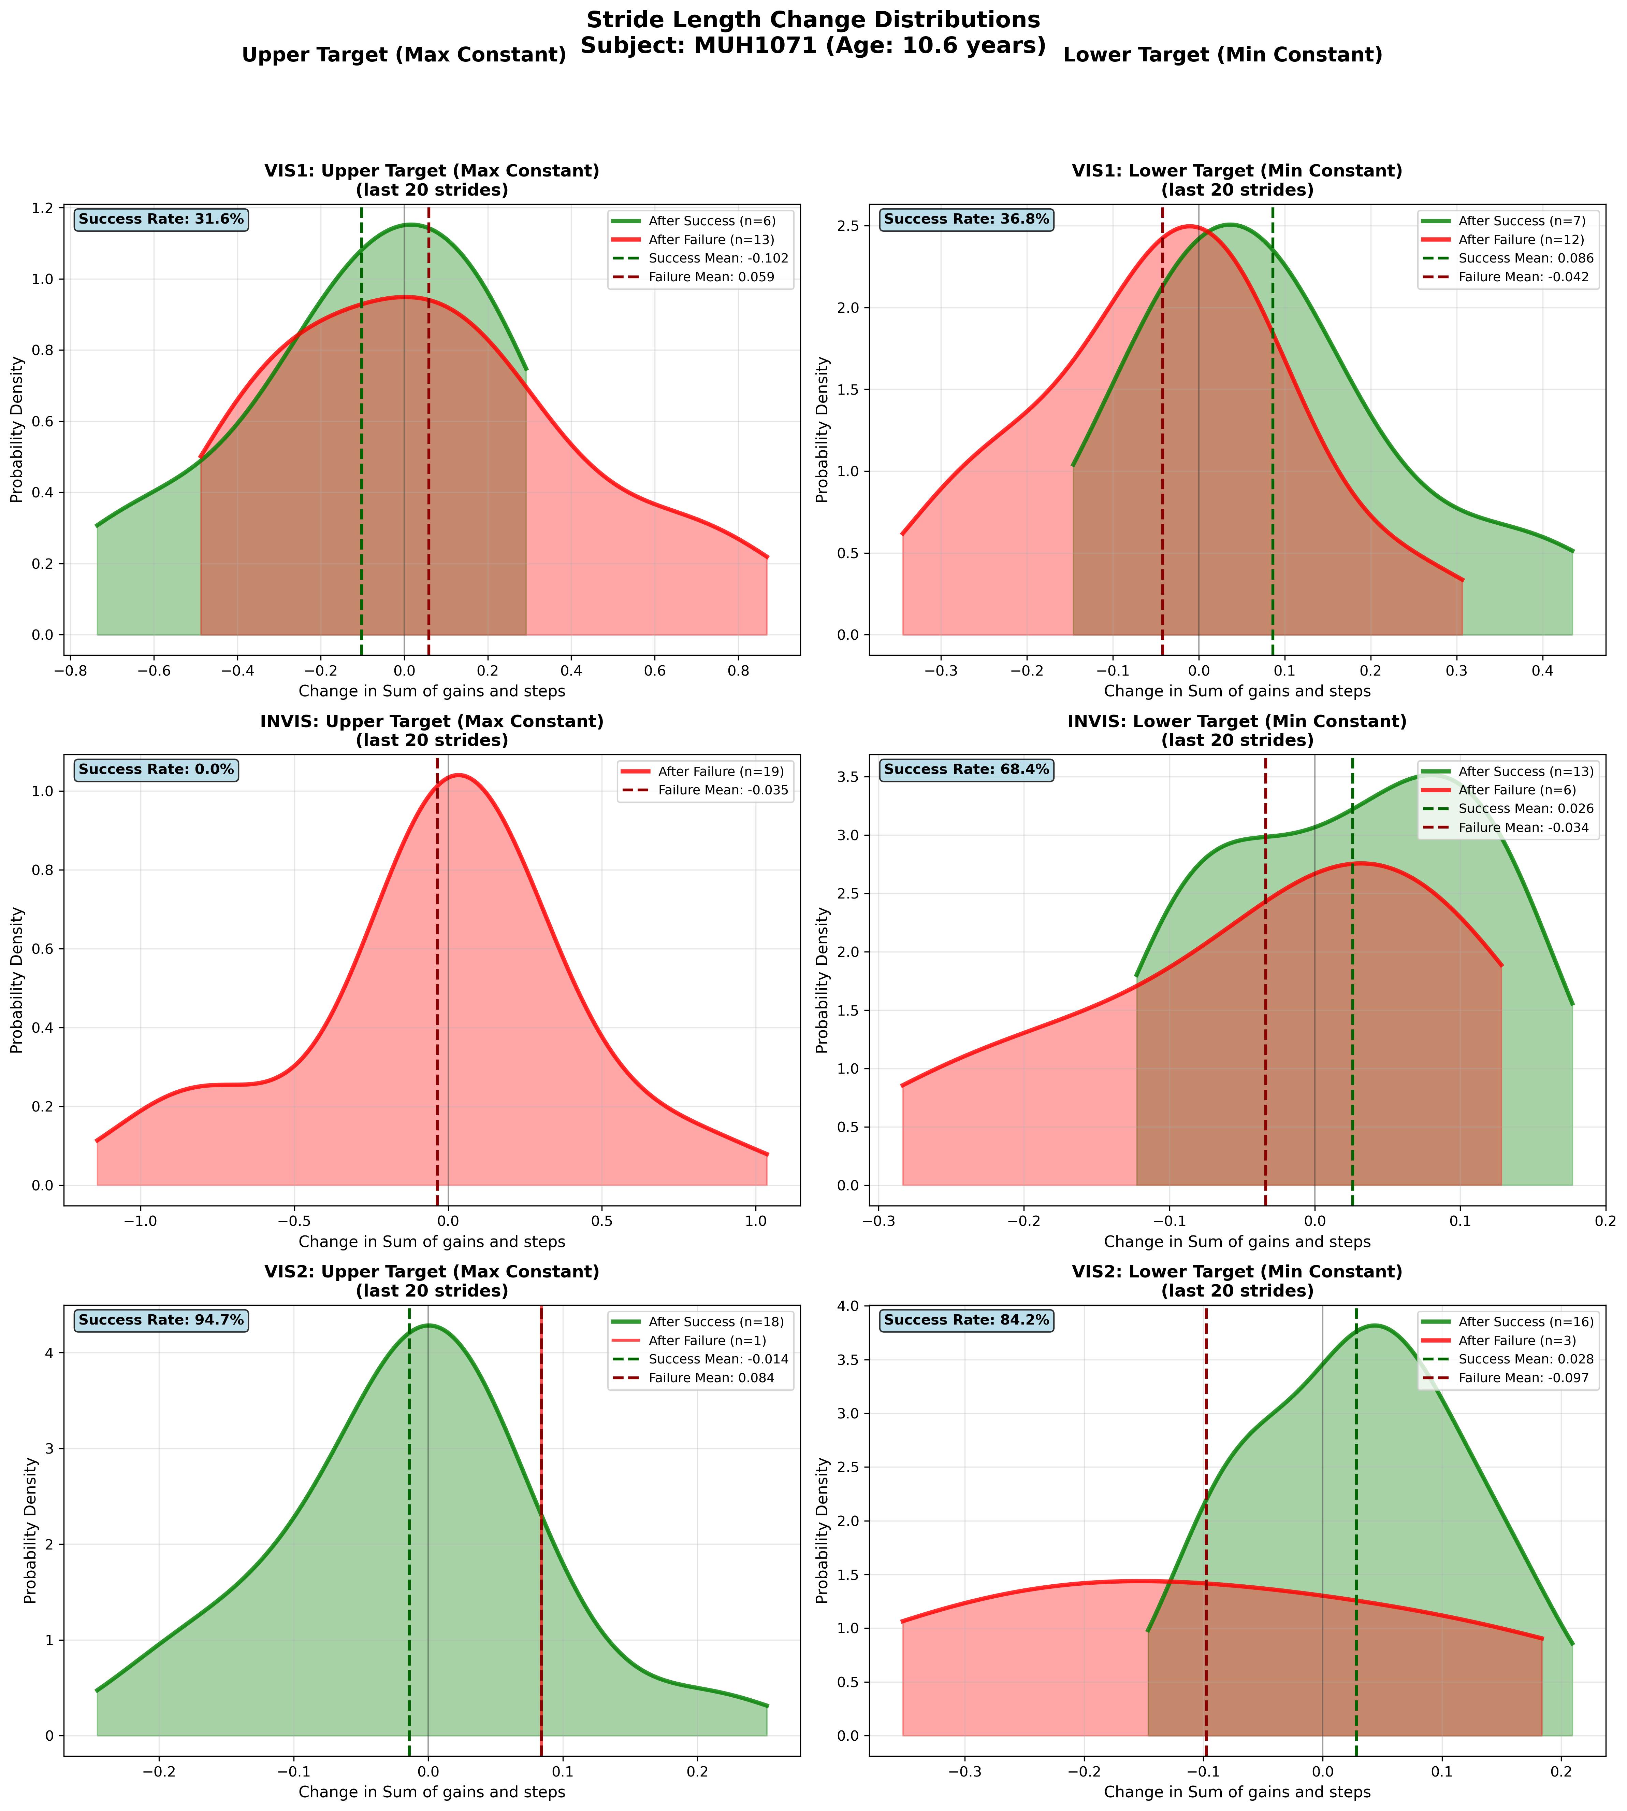
Subject MUH1071 (Age: 10.6 years) - Slide 24 of 69

Slide 26
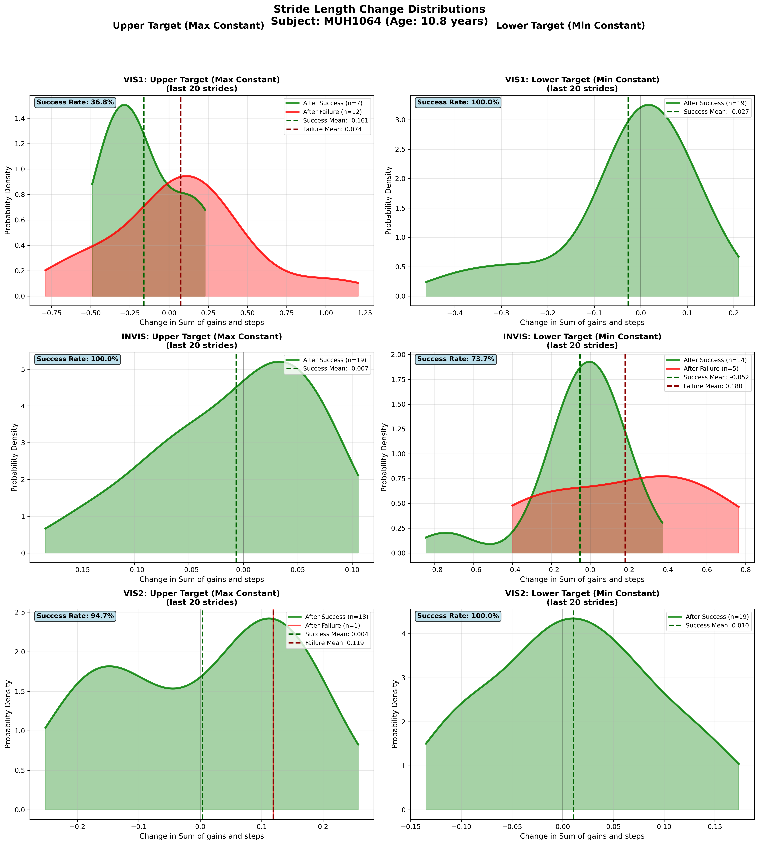
Subject MUH1064 (Age: 10.8 years) - Slide 25 of 69

Slide 27
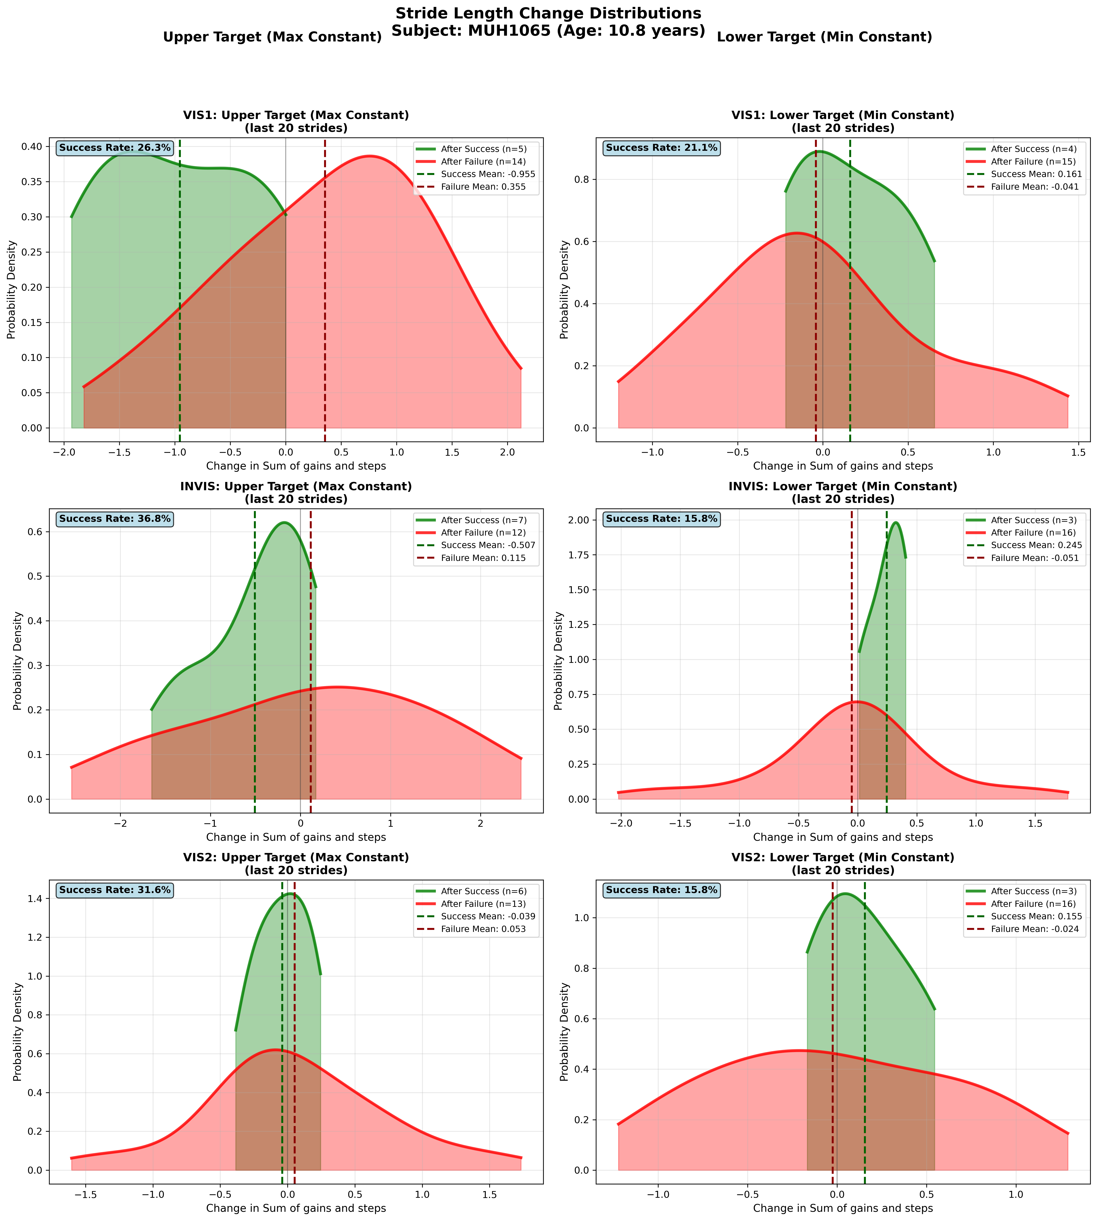
Subject MUH1065 (Age: 10.8 years) - Slide 26 of 69

Slide 28
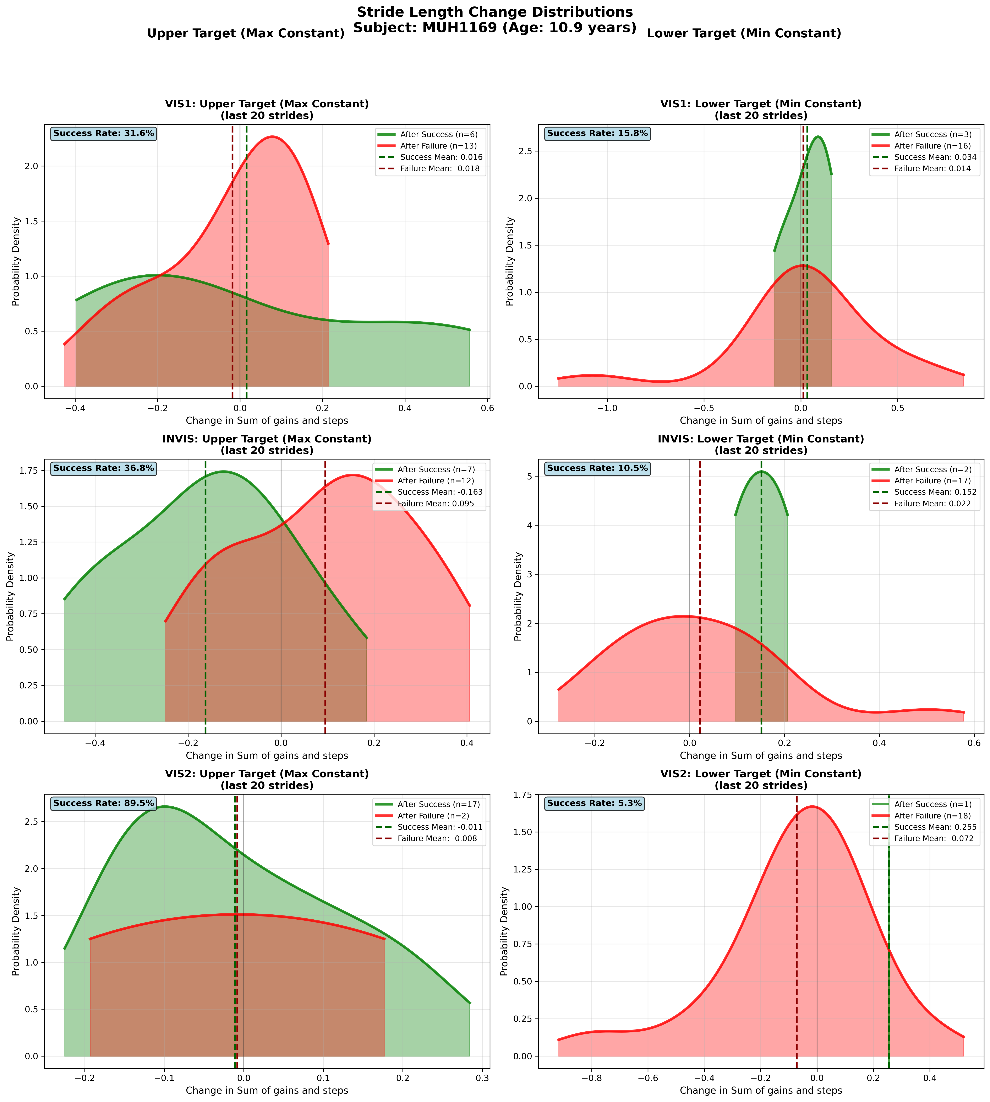
Subject MUH1169 (Age: 10.9 years) - Slide 27 of 69

Slide 29
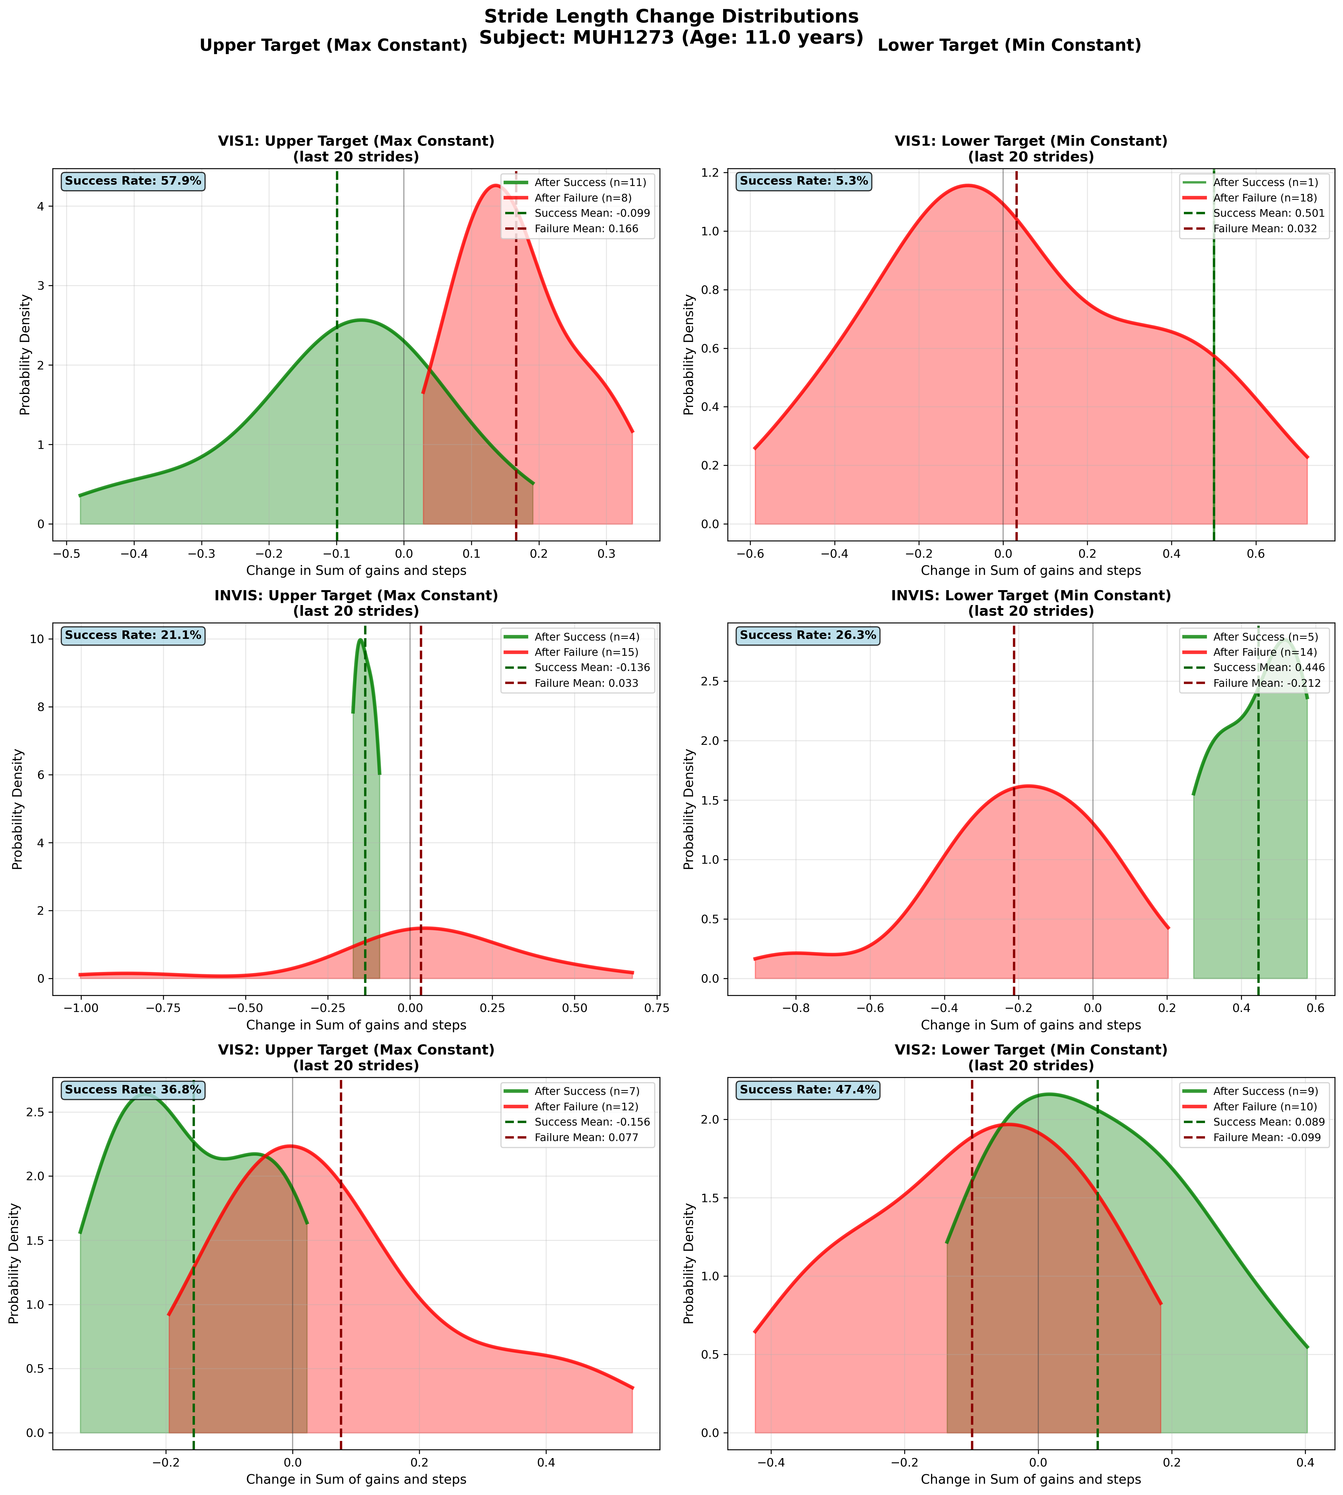
Subject MUH1273 (Age: 11.0 years) - Slide 28 of 69

Slide 30
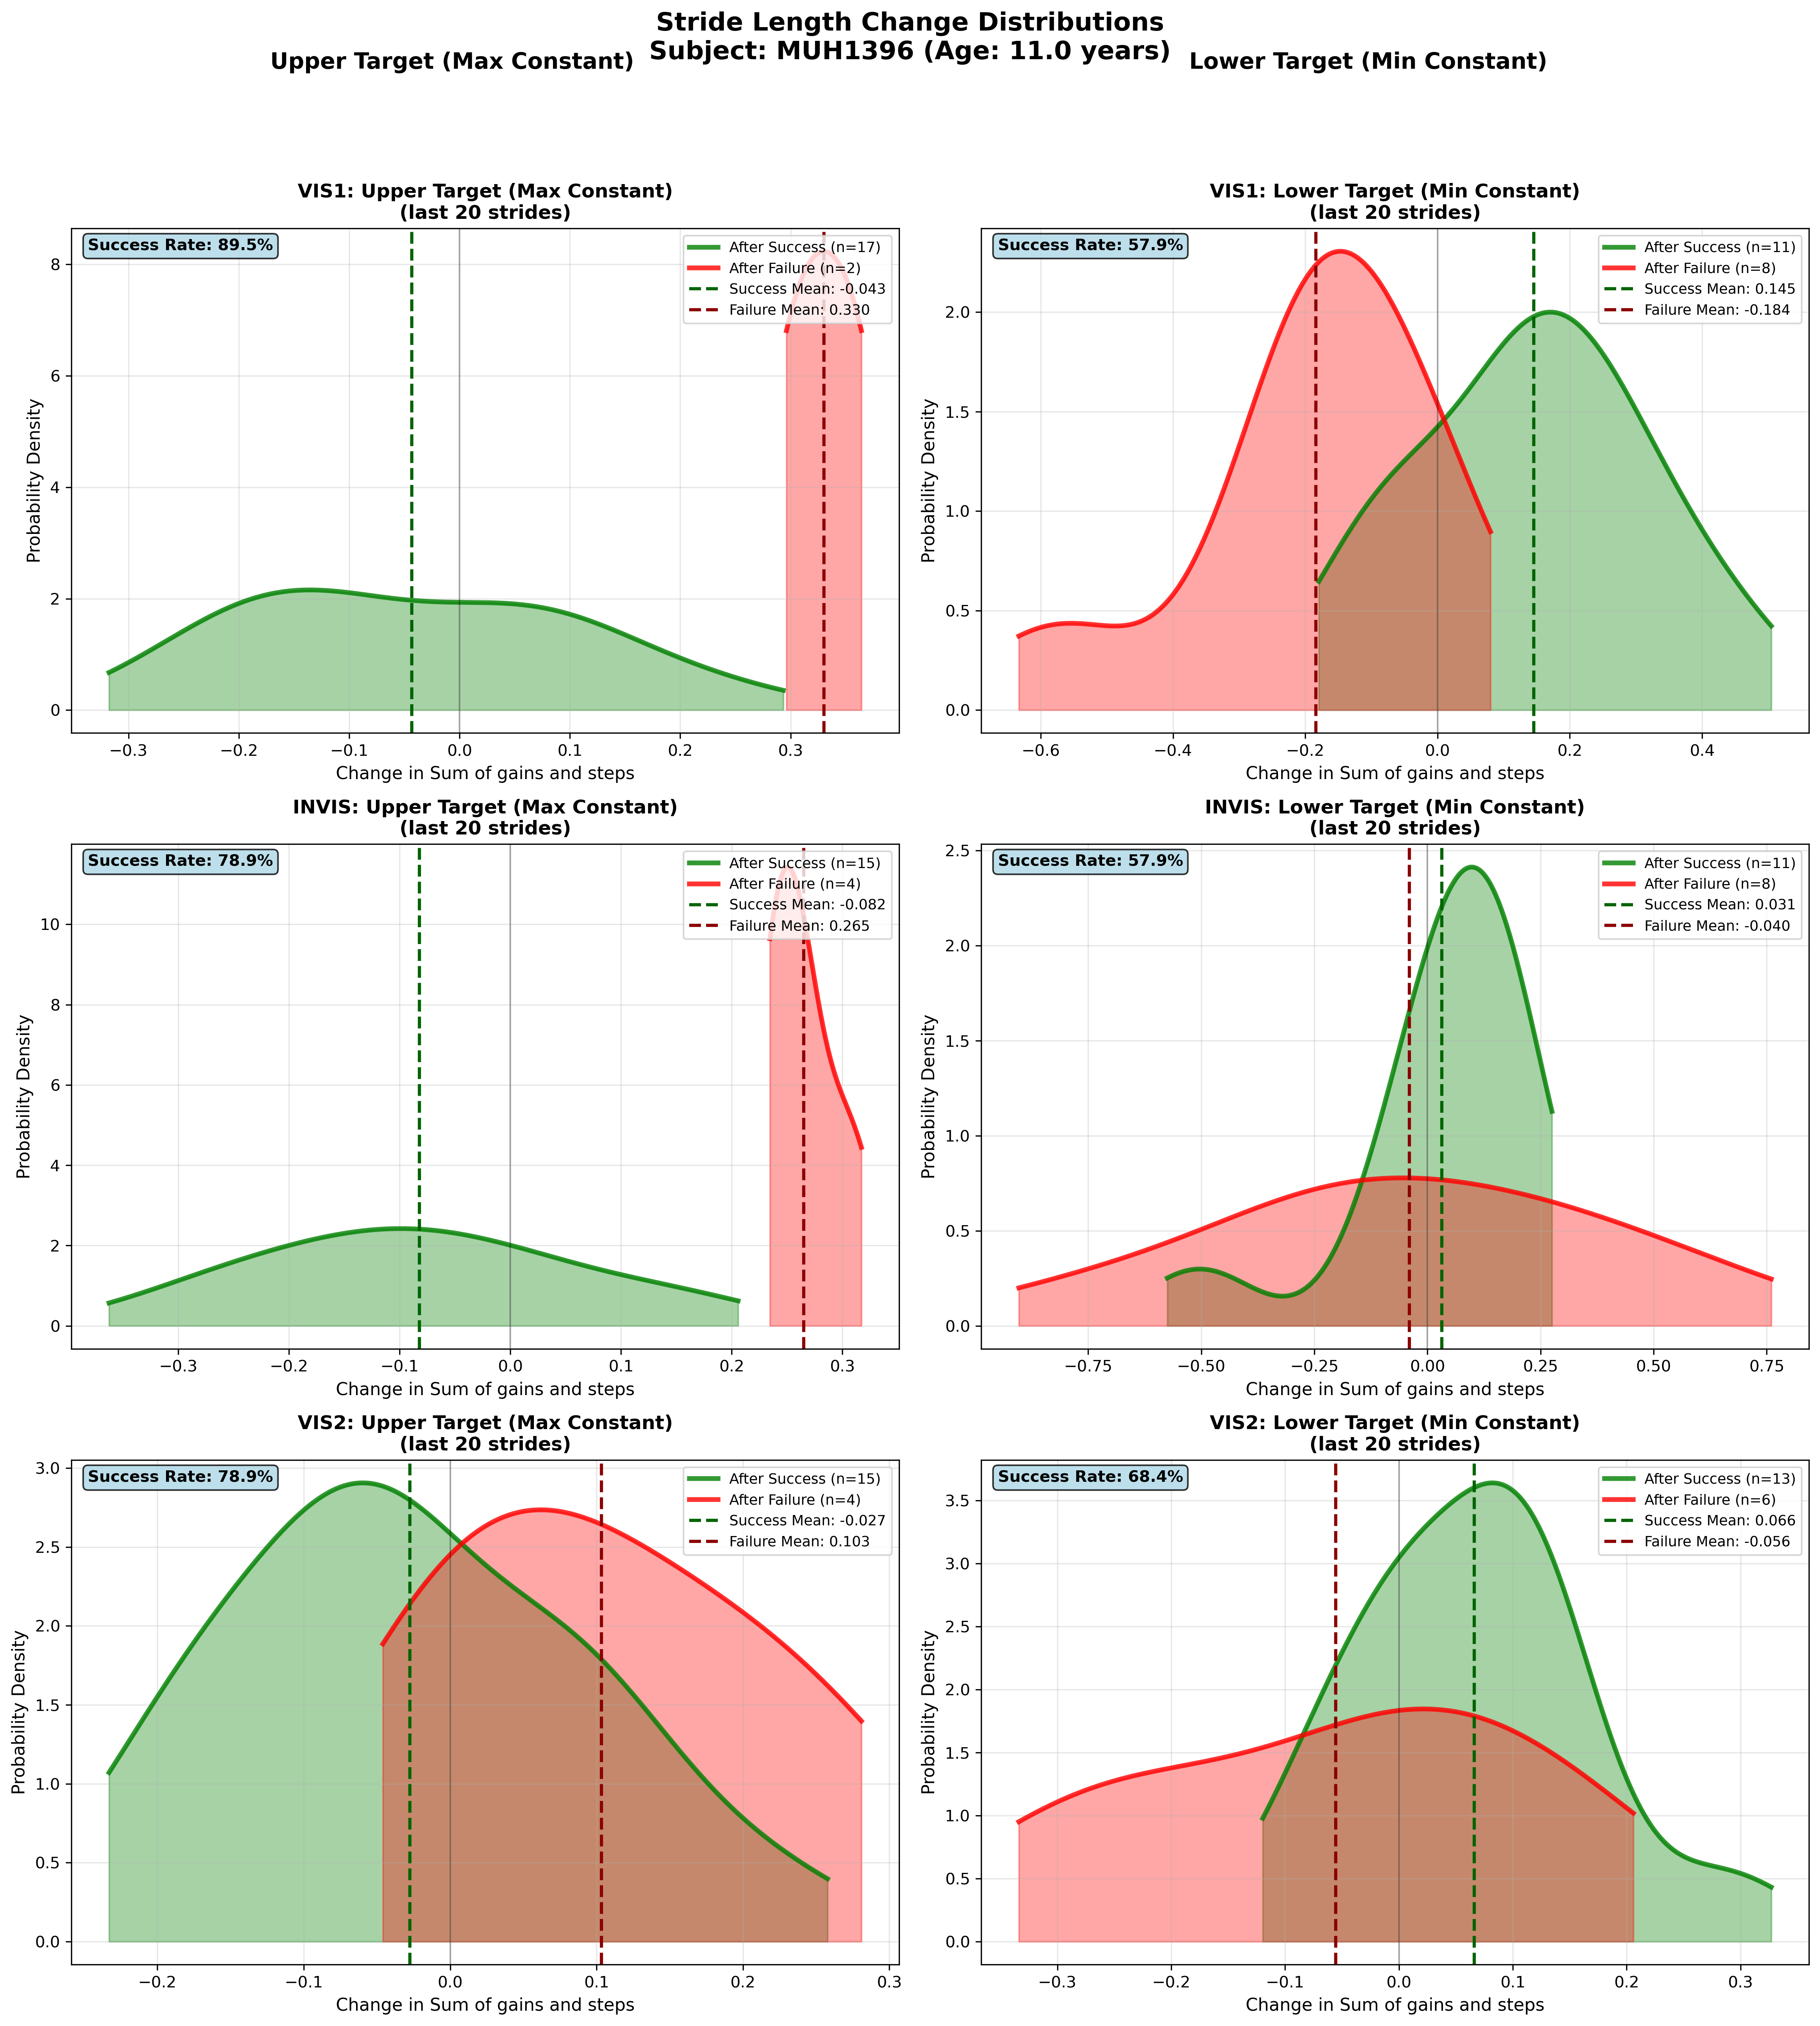
Subject MUH1396 (Age: 11.0 years) - Slide 29 of 69

Slide 31
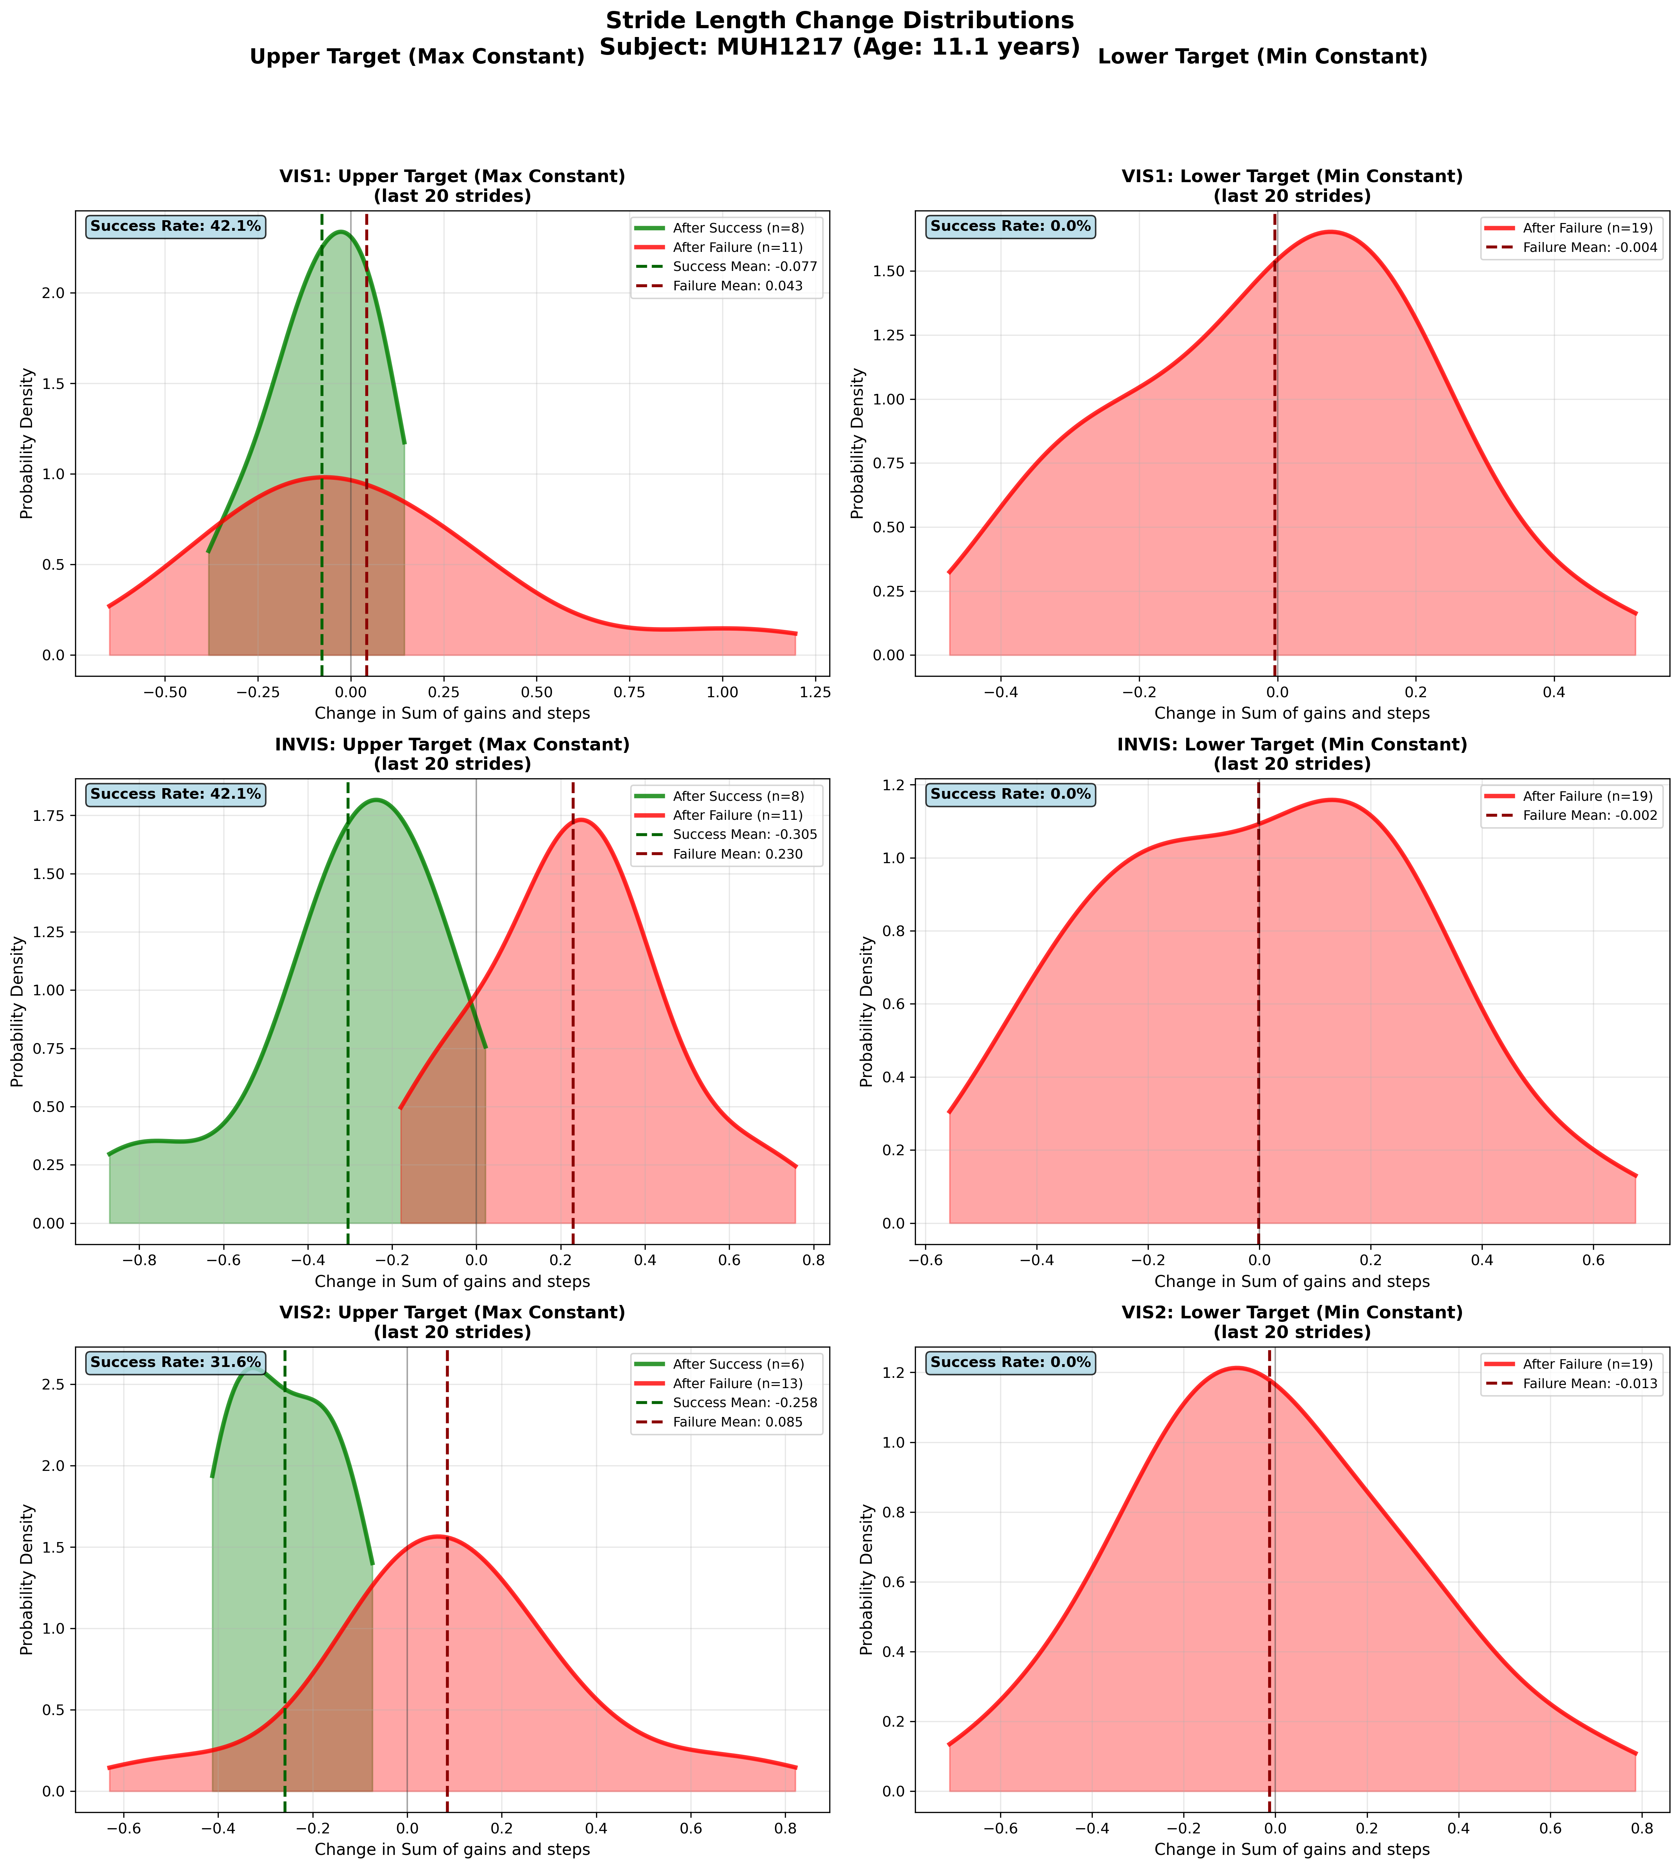
Subject MUH1217 (Age: 11.1 years) - Slide 30 of 69

Slide 32
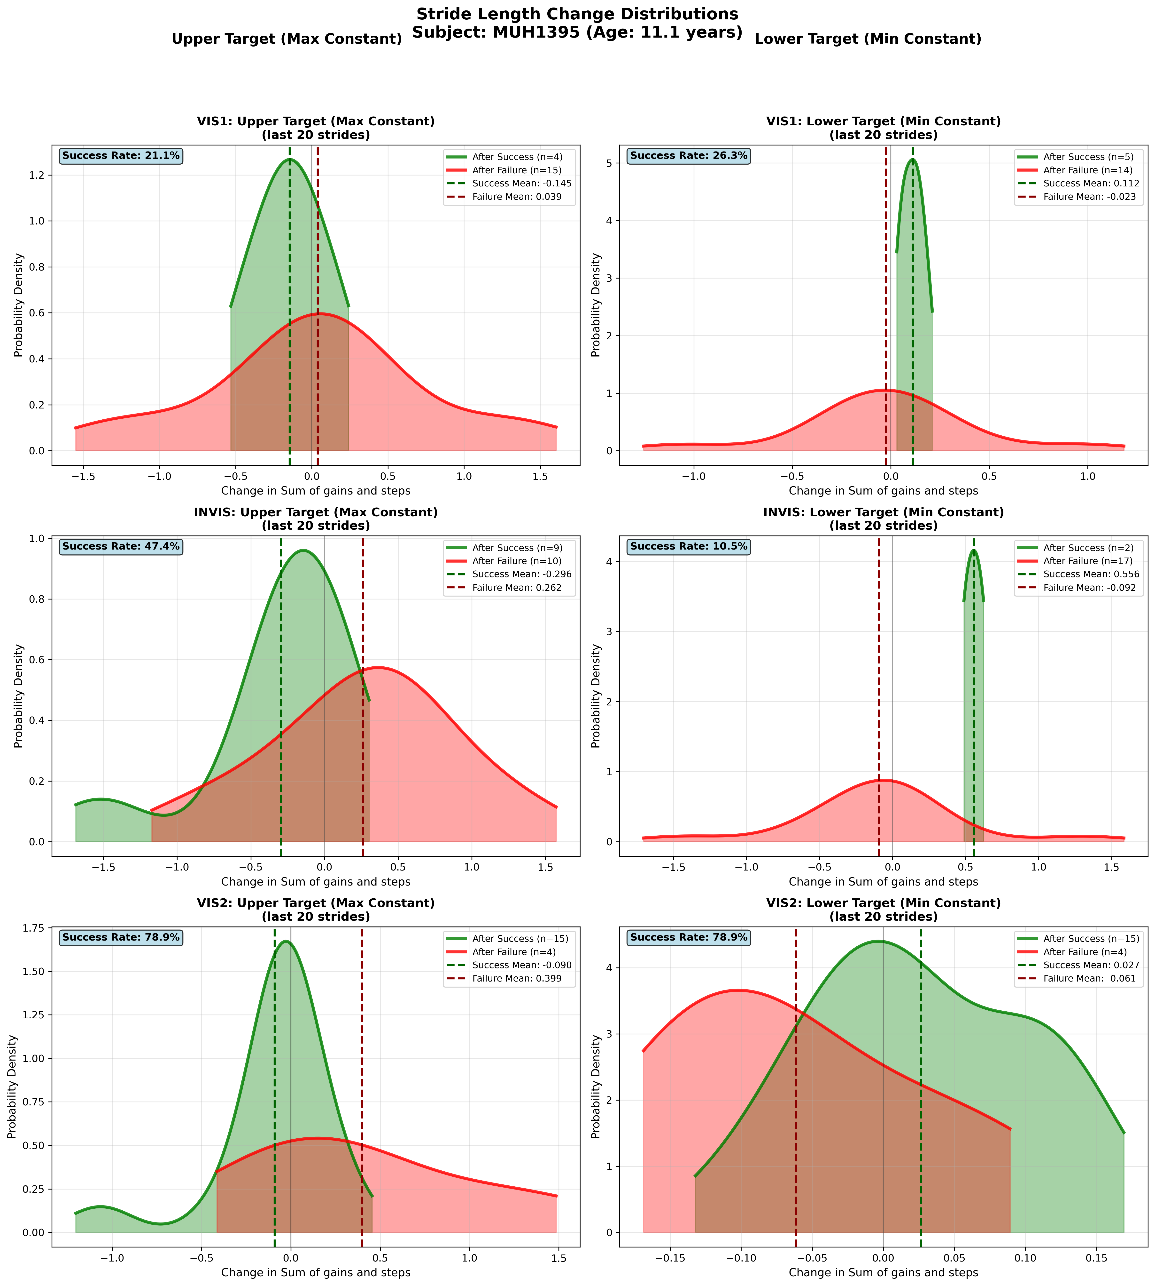
Subject MUH1395 (Age: 11.1 years) - Slide 31 of 69

Slide 33
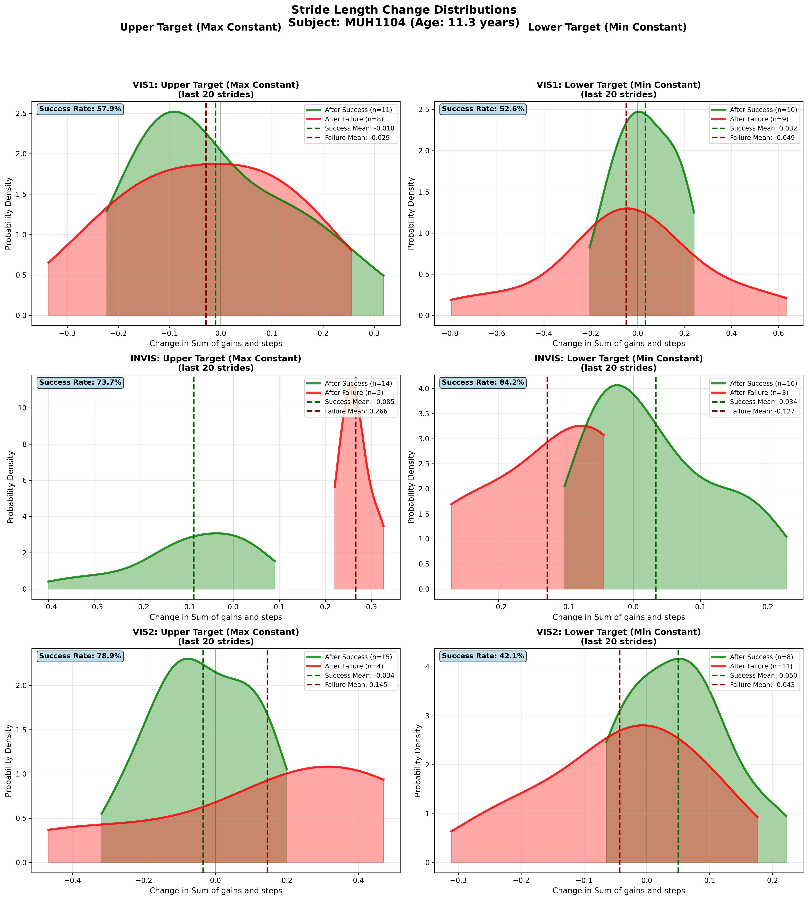
Subject MUH1104 (Age: 11.3 years) - Slide 32 of 69

Slide 34
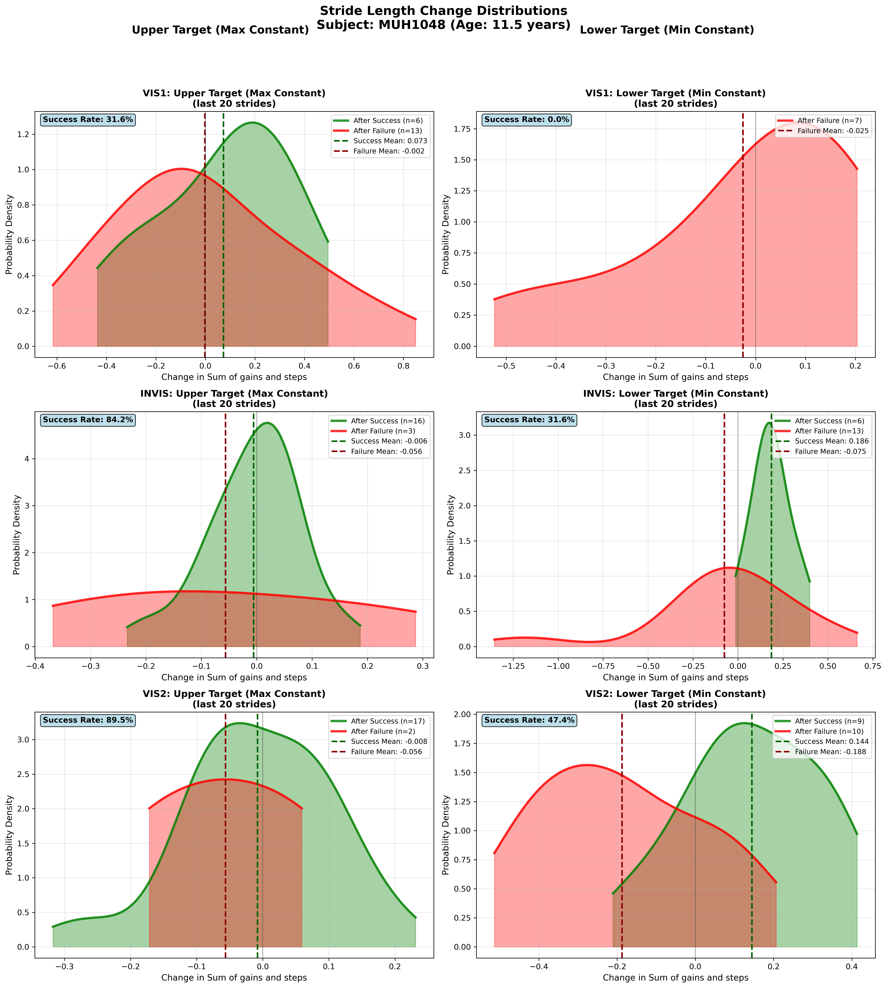
Subject MUH1048 (Age: 11.5 years) - Slide 33 of 69

Slide 35
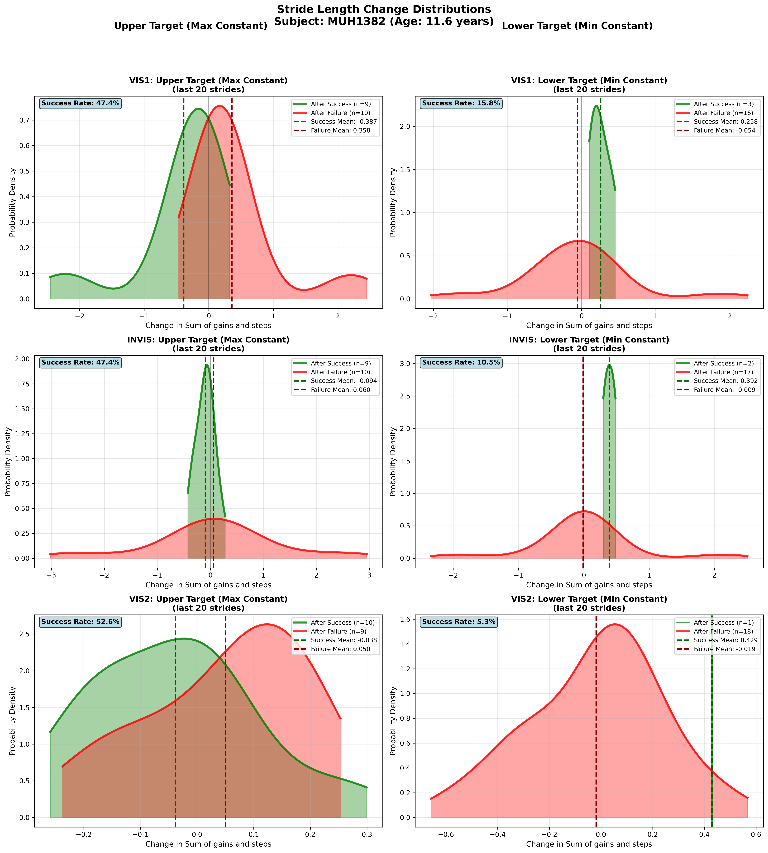
Subject MUH1382 (Age: 11.6 years) - Slide 34 of 69

Slide 36
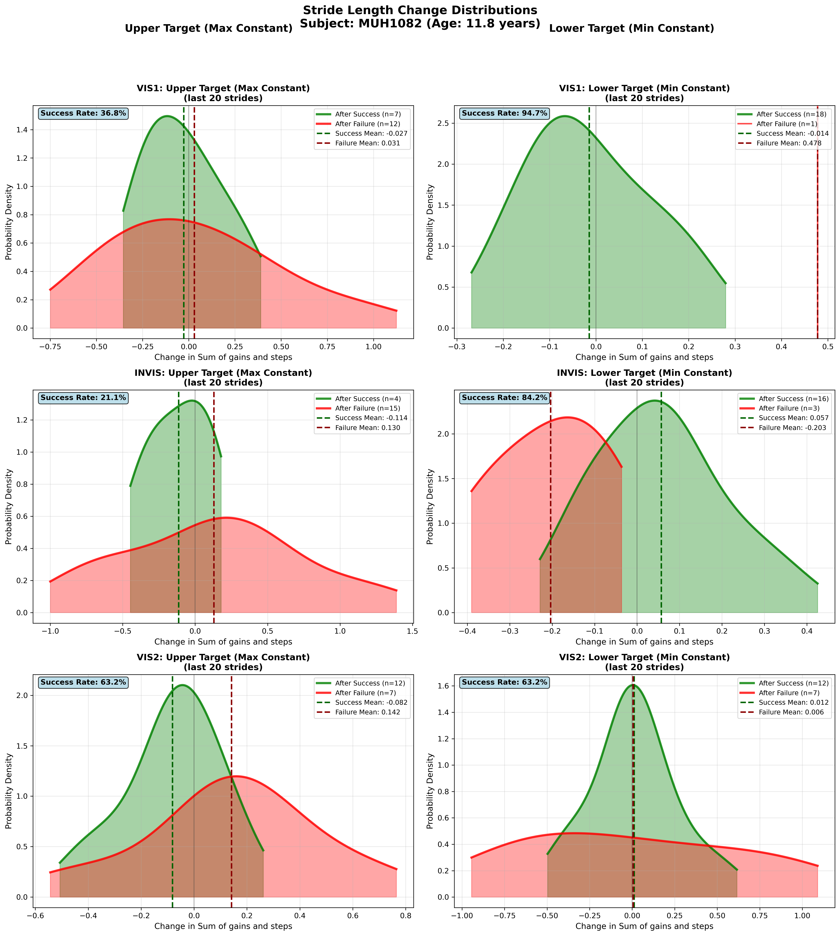
Subject MUH1082 (Age: 11.8 years) - Slide 35 of 69

Slide 37
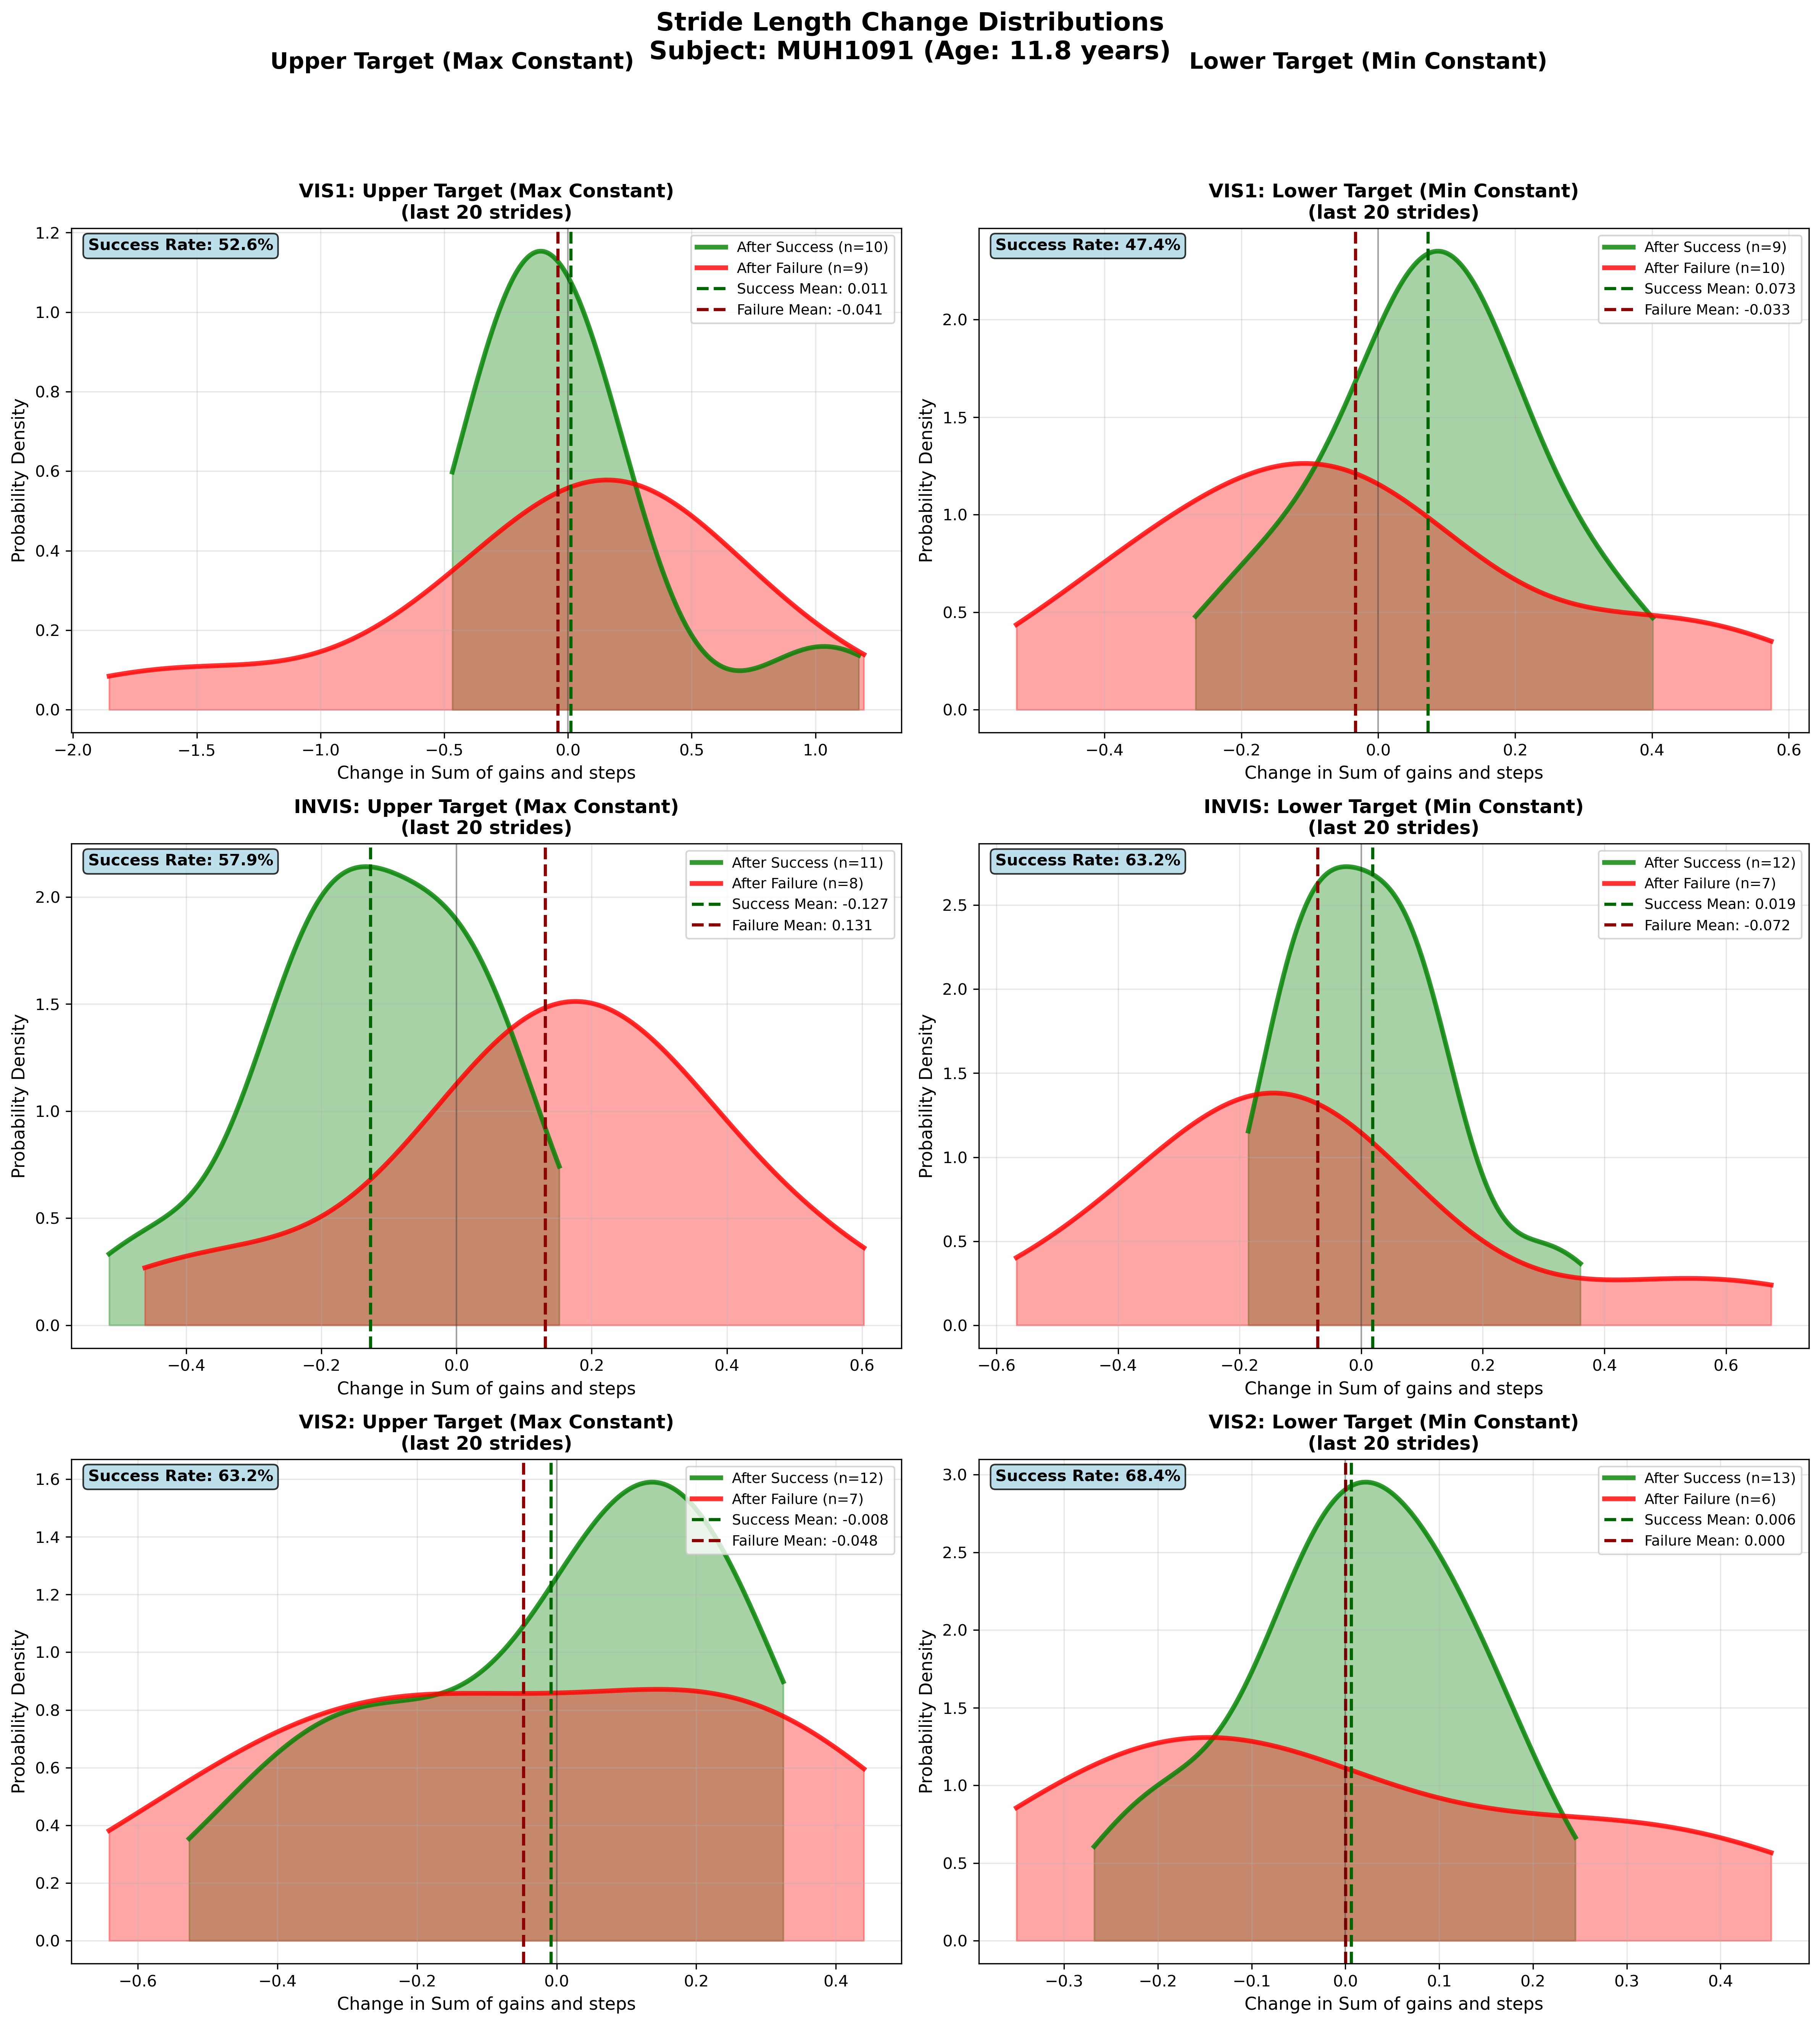
Subject MUH1091 (Age: 11.8 years) - Slide 36 of 69

Slide 38
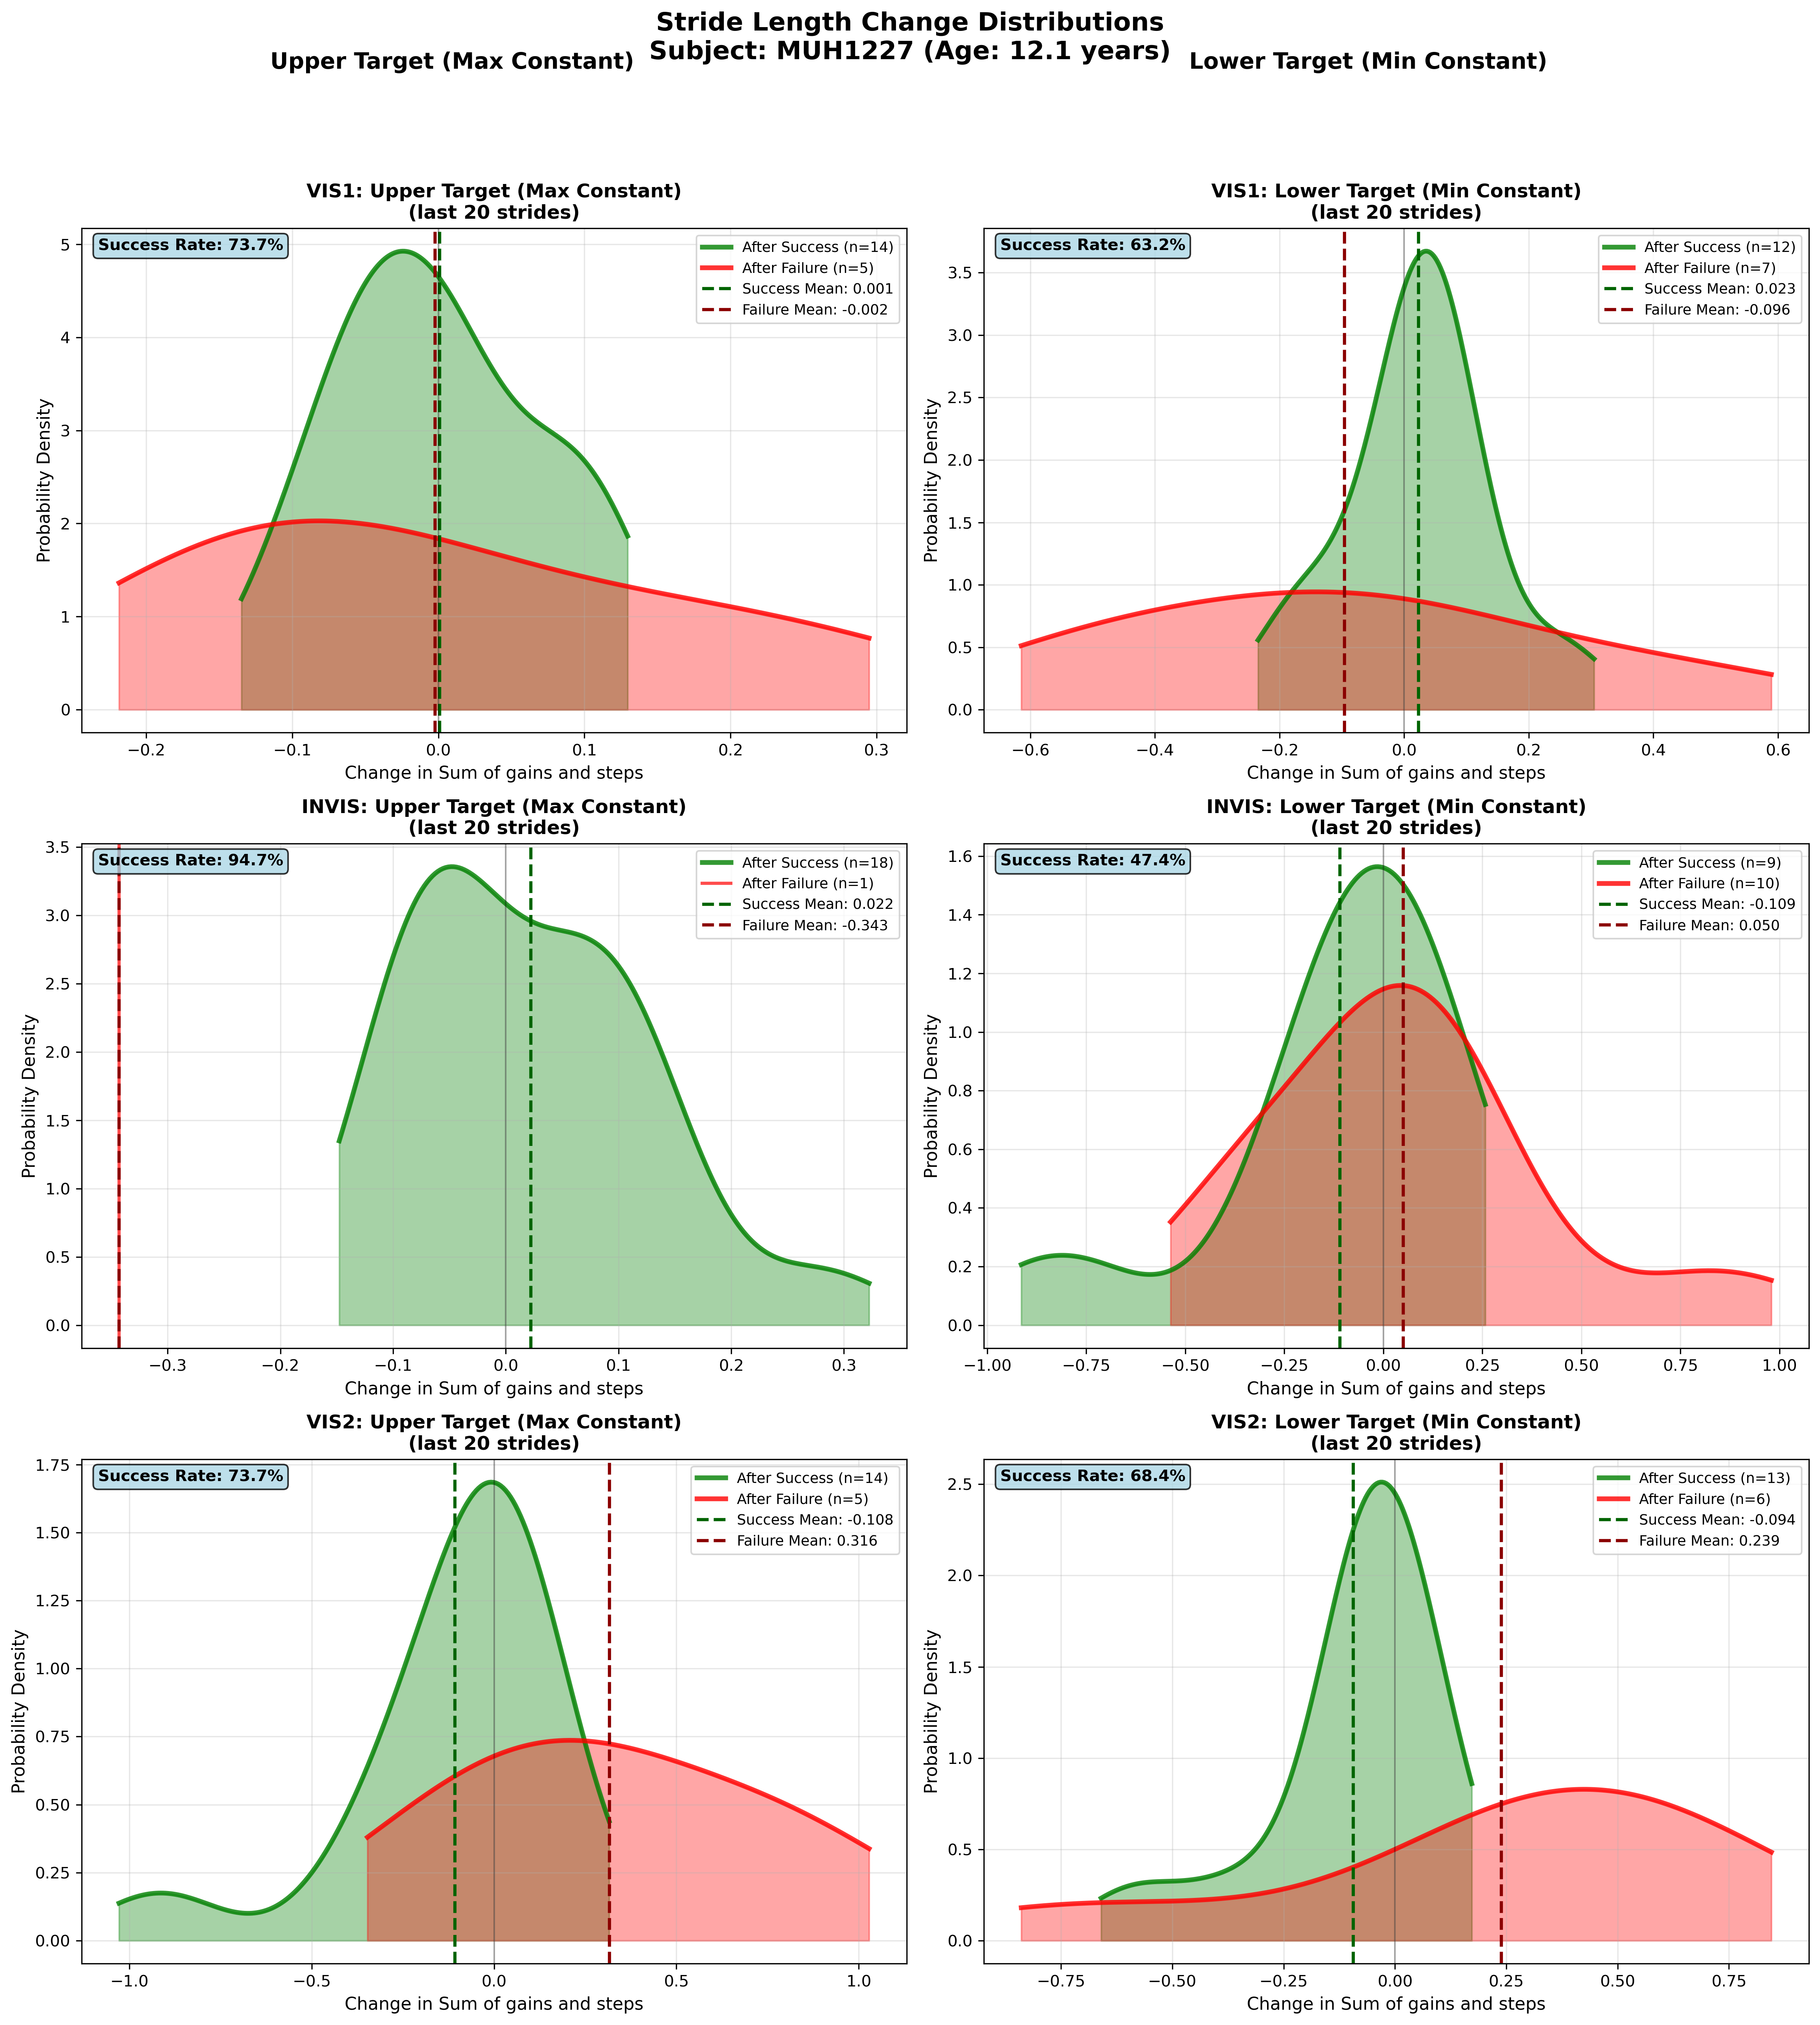
Subject MUH1227 (Age: 12.1 years) - Slide 37 of 69

Slide 39
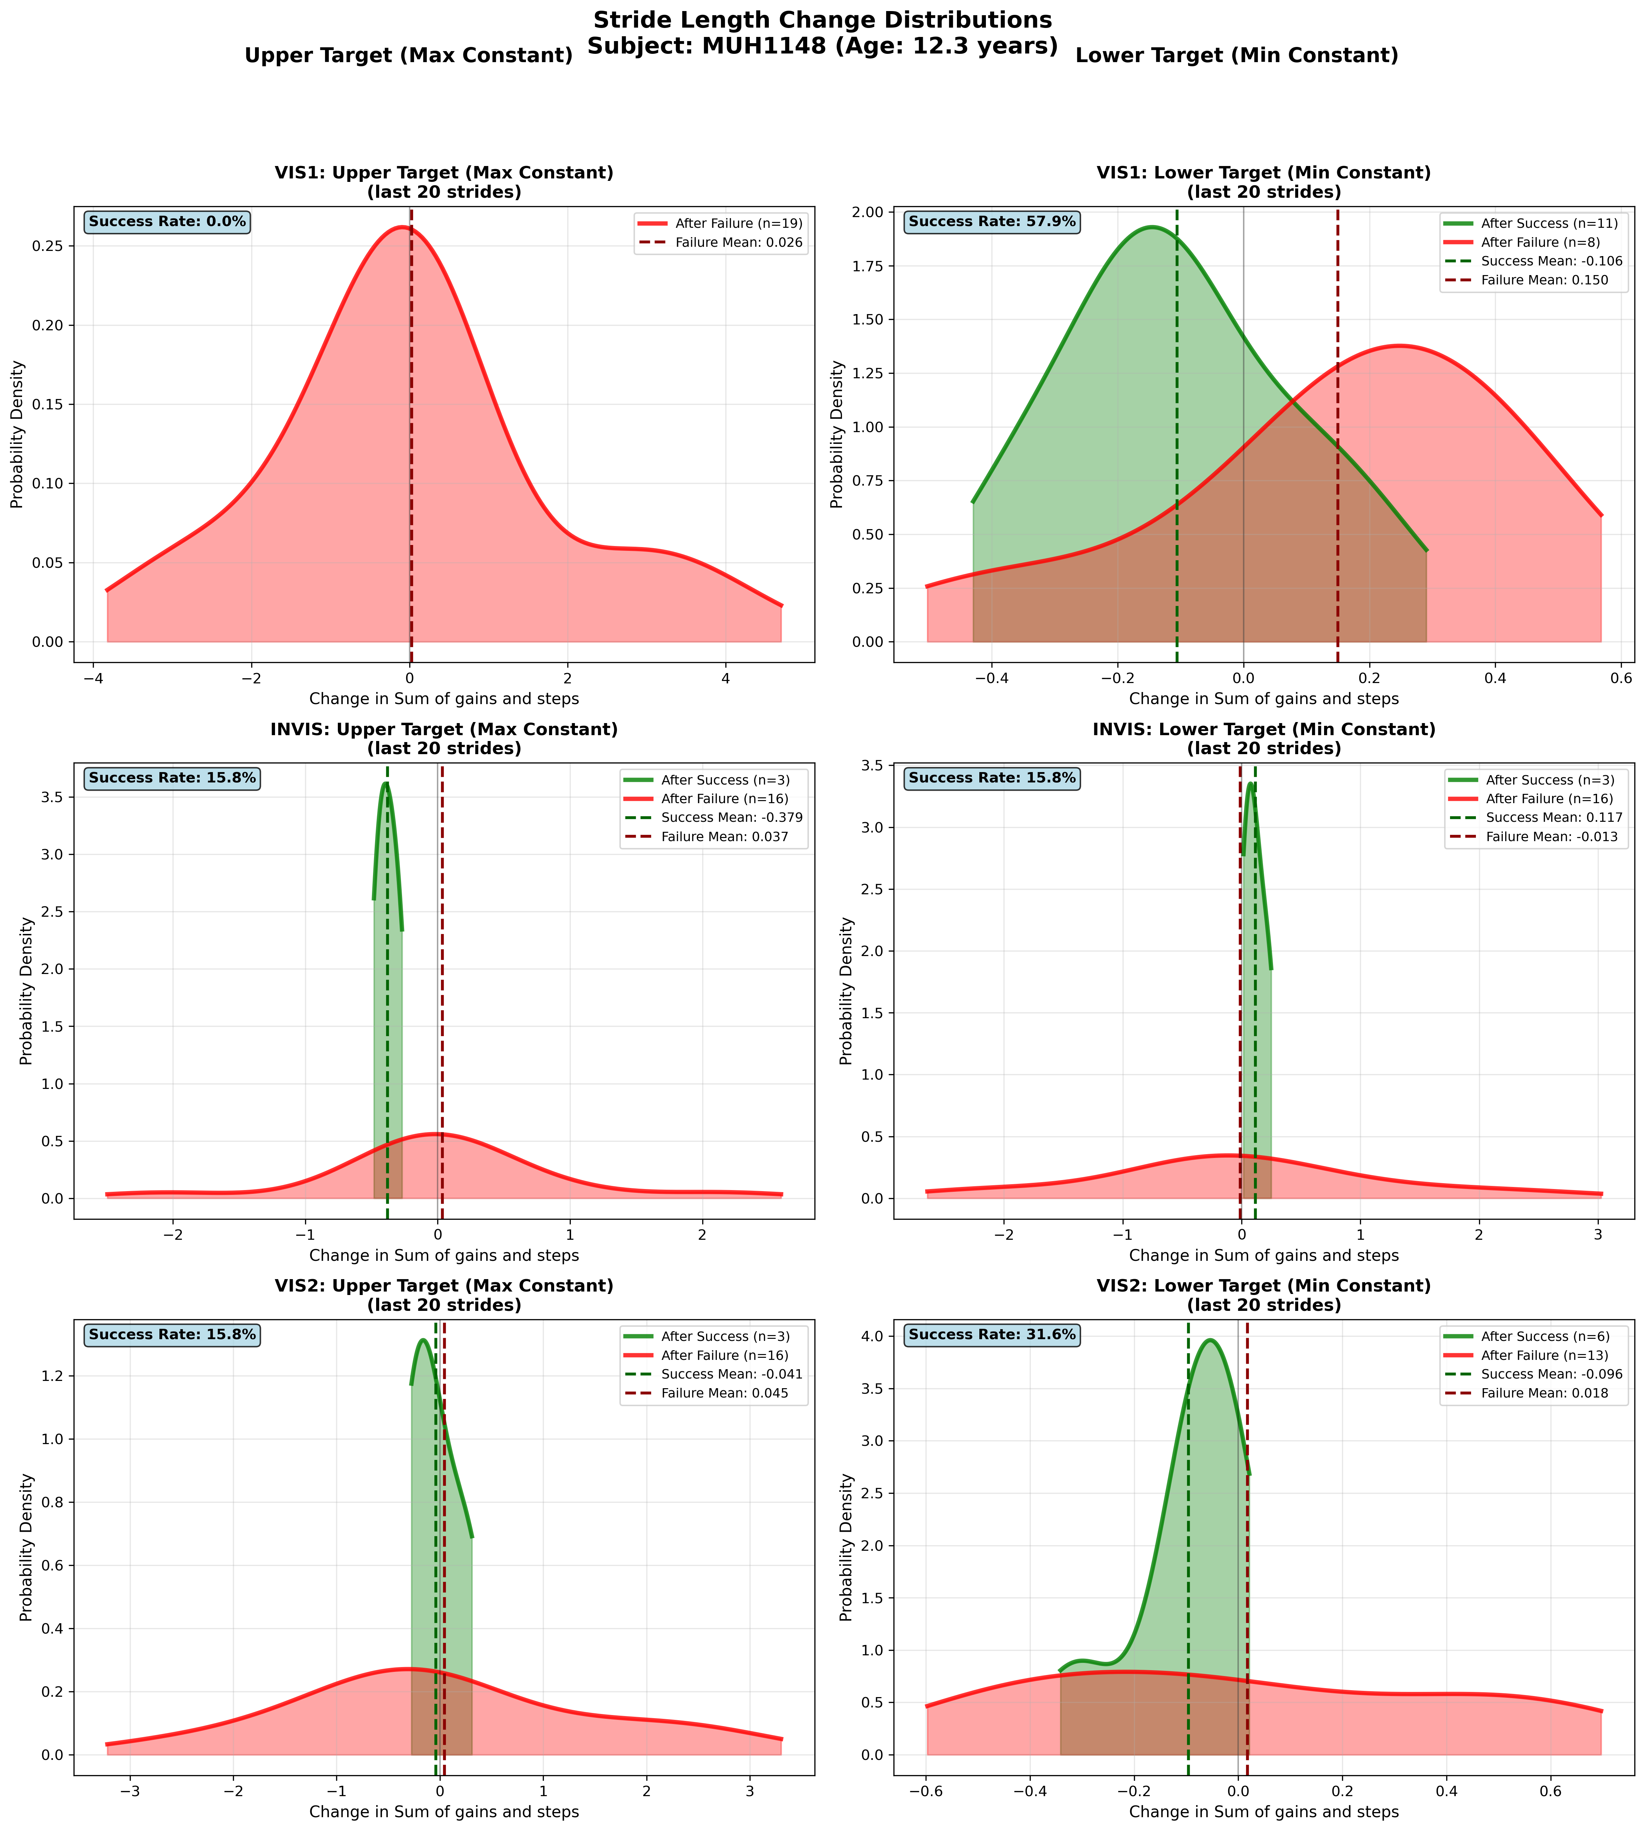
Subject MUH1148 (Age: 12.3 years) - Slide 38 of 69

Slide 40
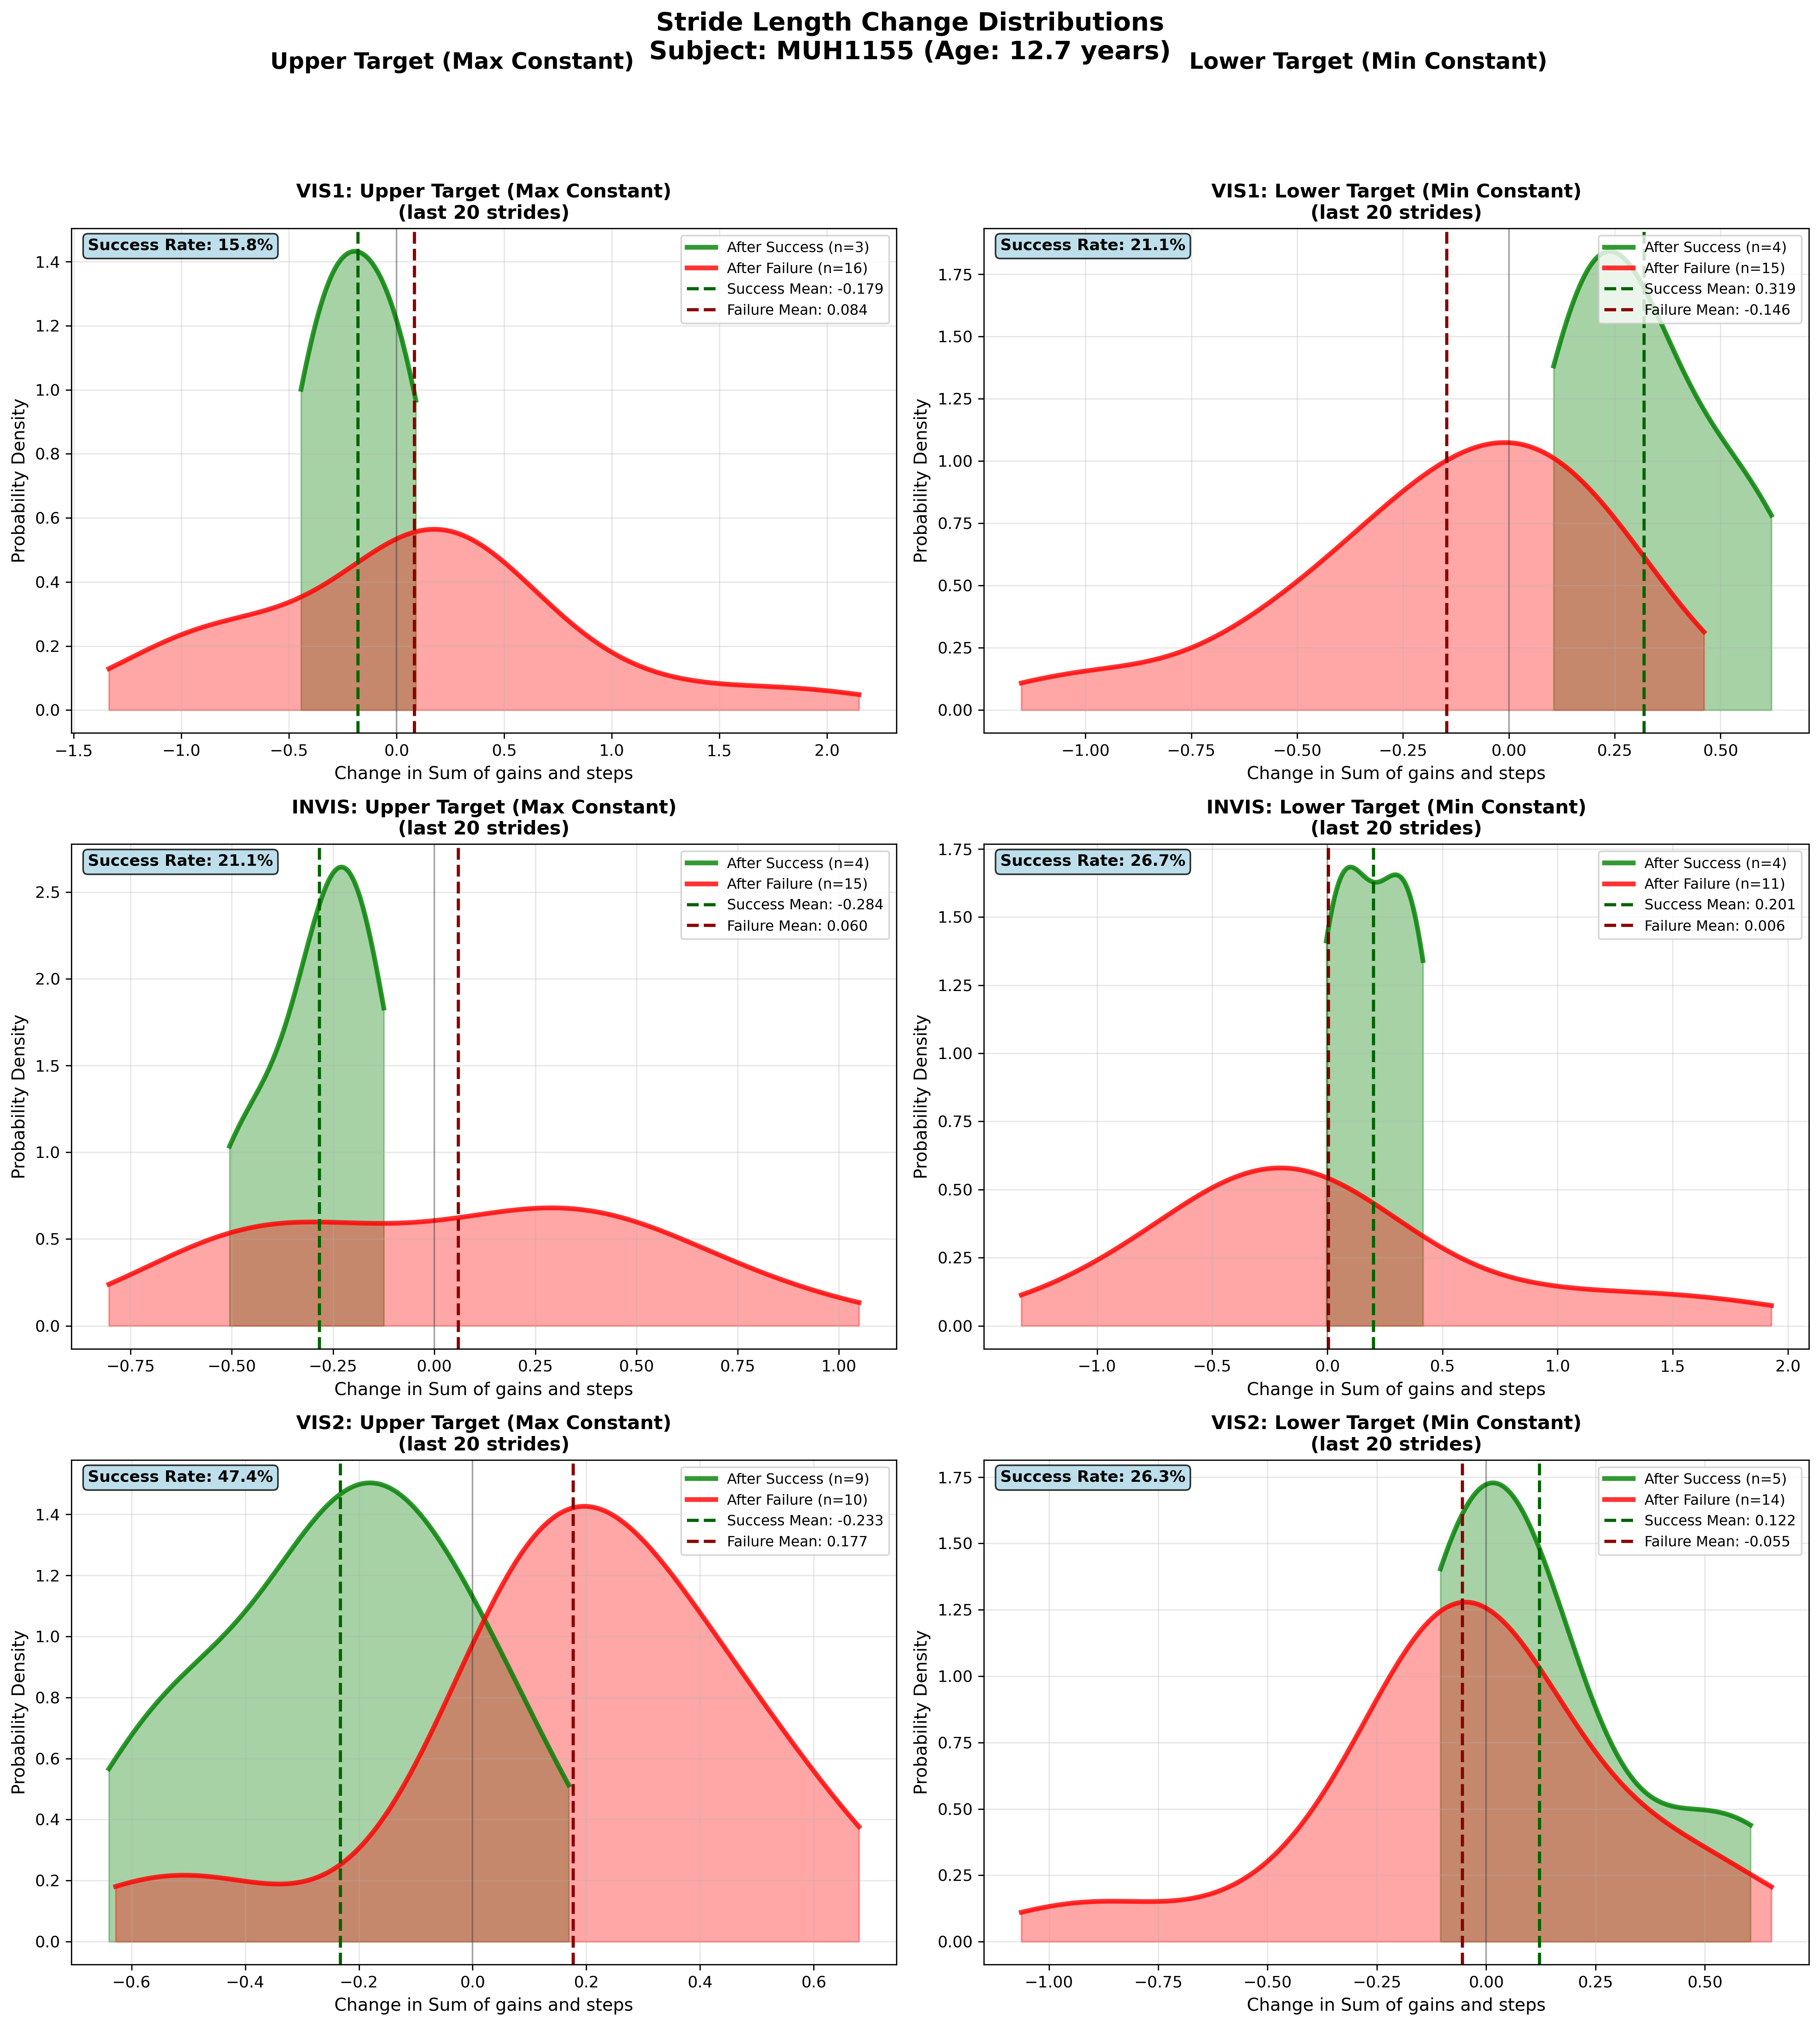
Subject MUH1155 (Age: 12.7 years) - Slide 39 of 69

Slide 41
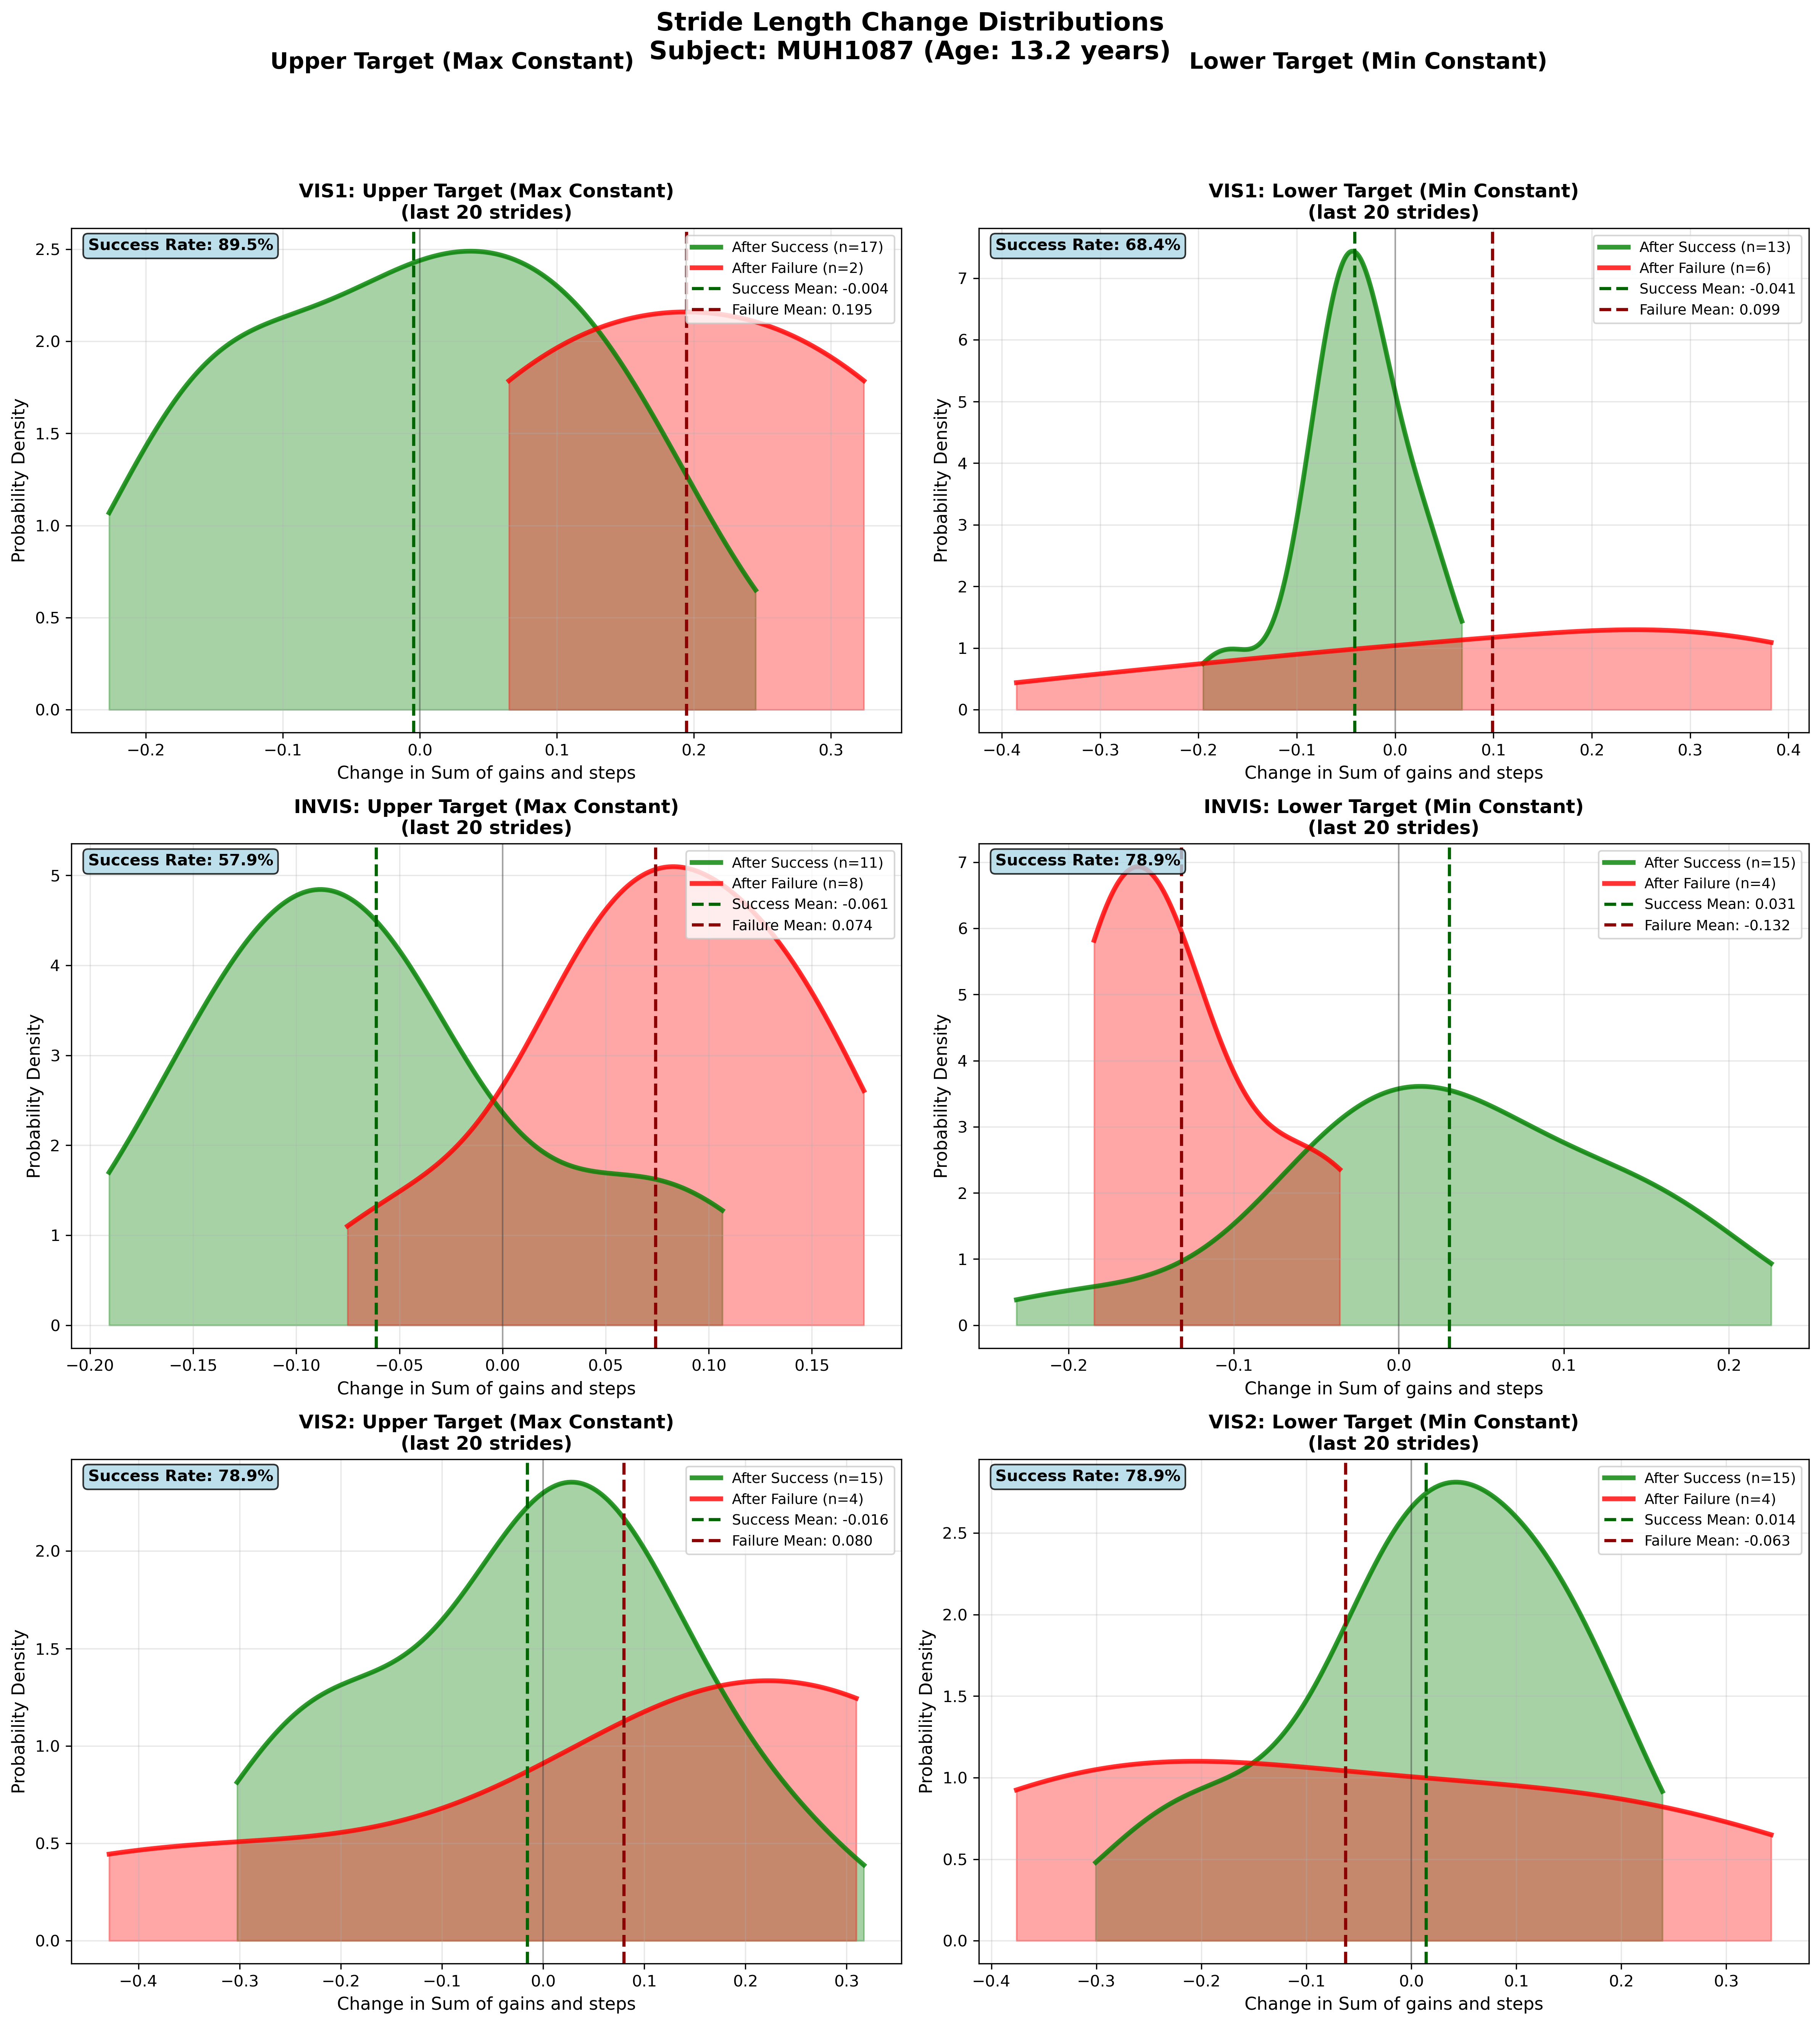
Subject MUH1087 (Age: 13.2 years) - Slide 40 of 69

Slide 42
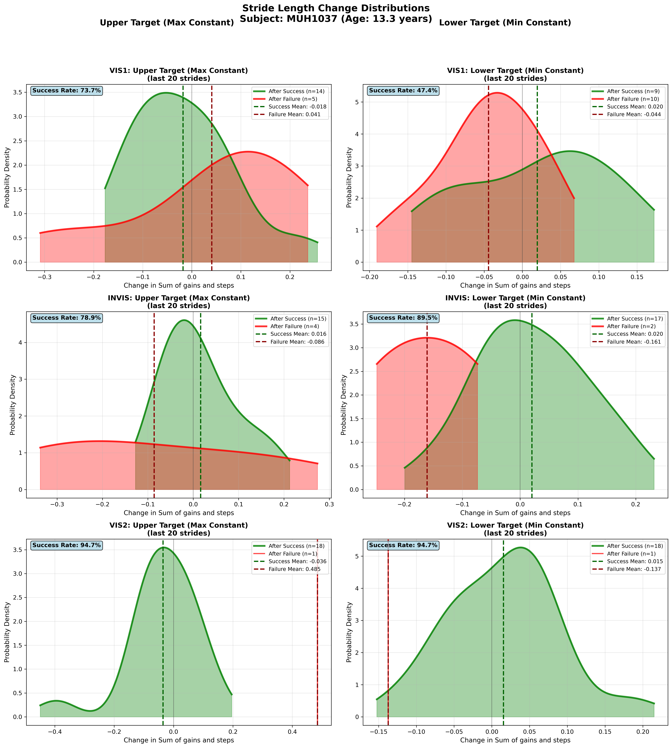
Subject MUH1037 (Age: 13.3 years) - Slide 41 of 69

Slide 43
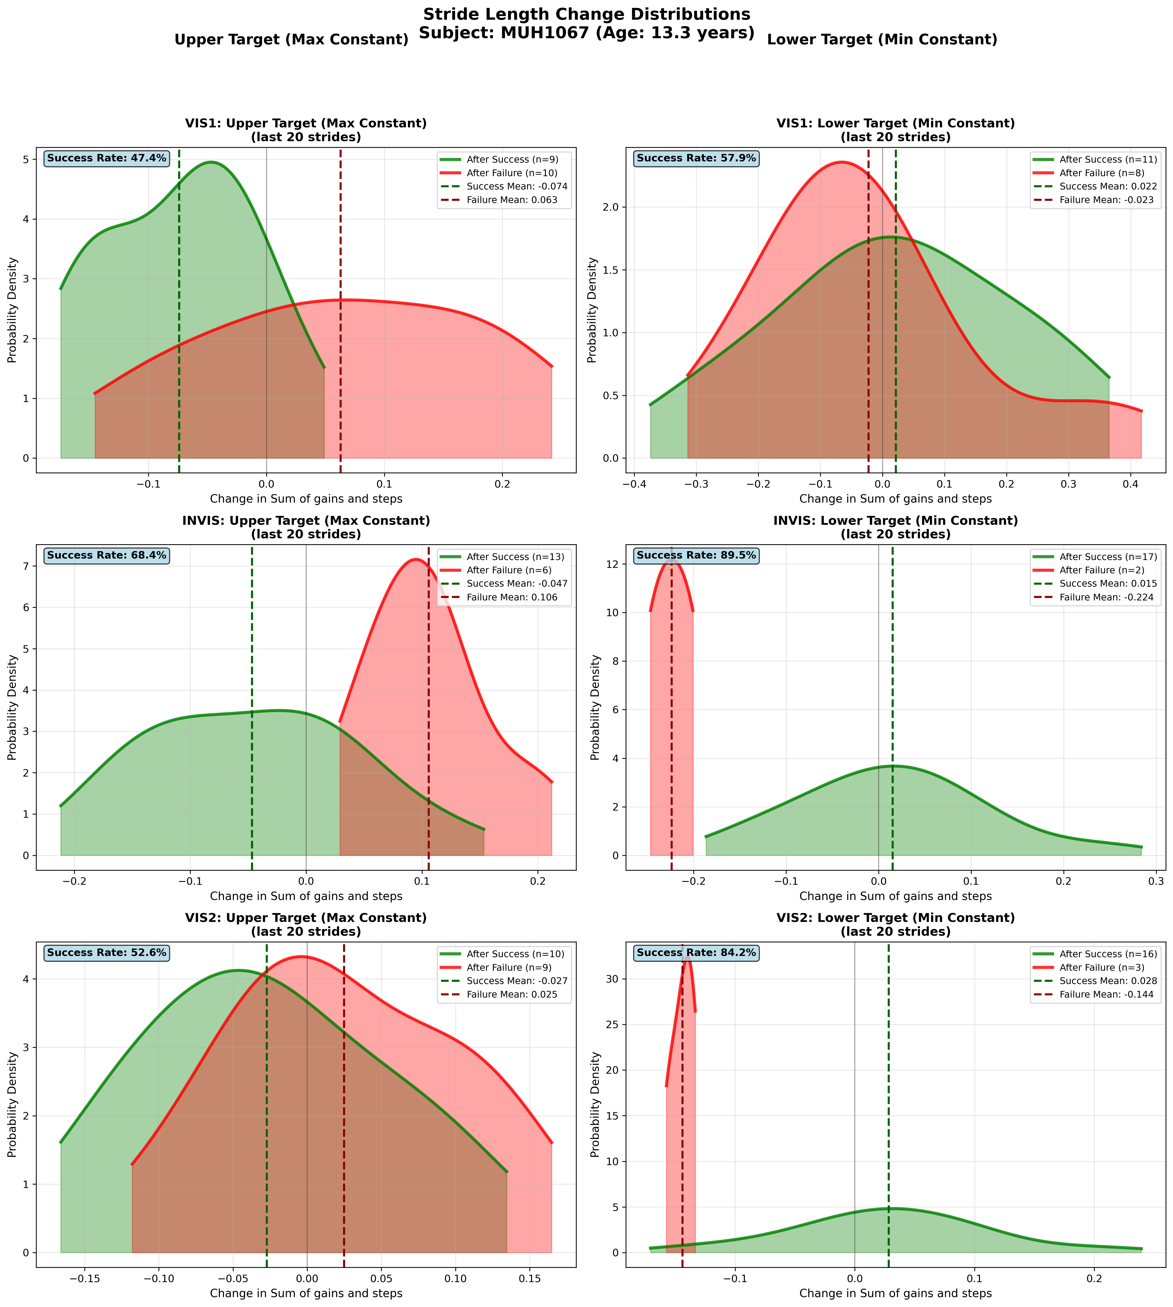
Subject MUH1067 (Age: 13.3 years) - Slide 42 of 69

Slide 44
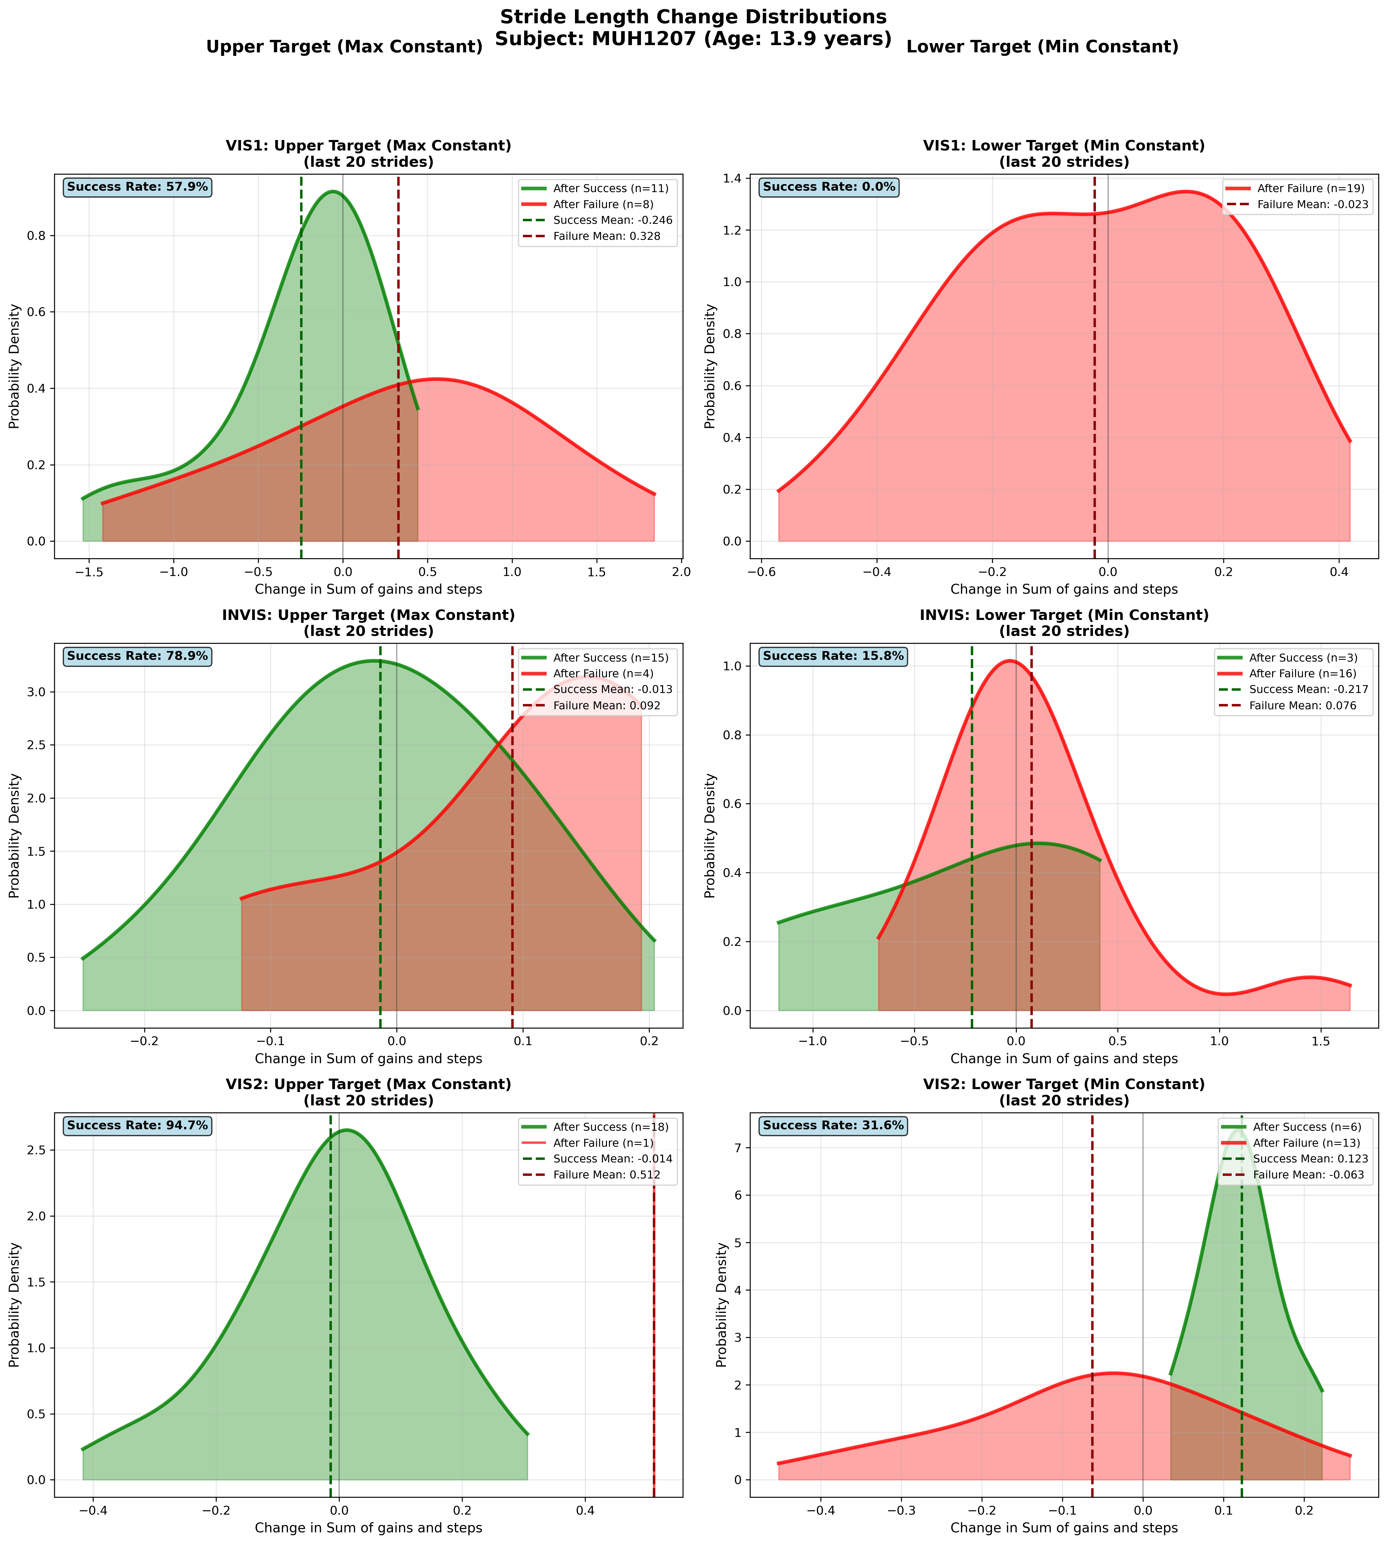
Subject MUH1207 (Age: 13.9 years) - Slide 43 of 69

Slide 45
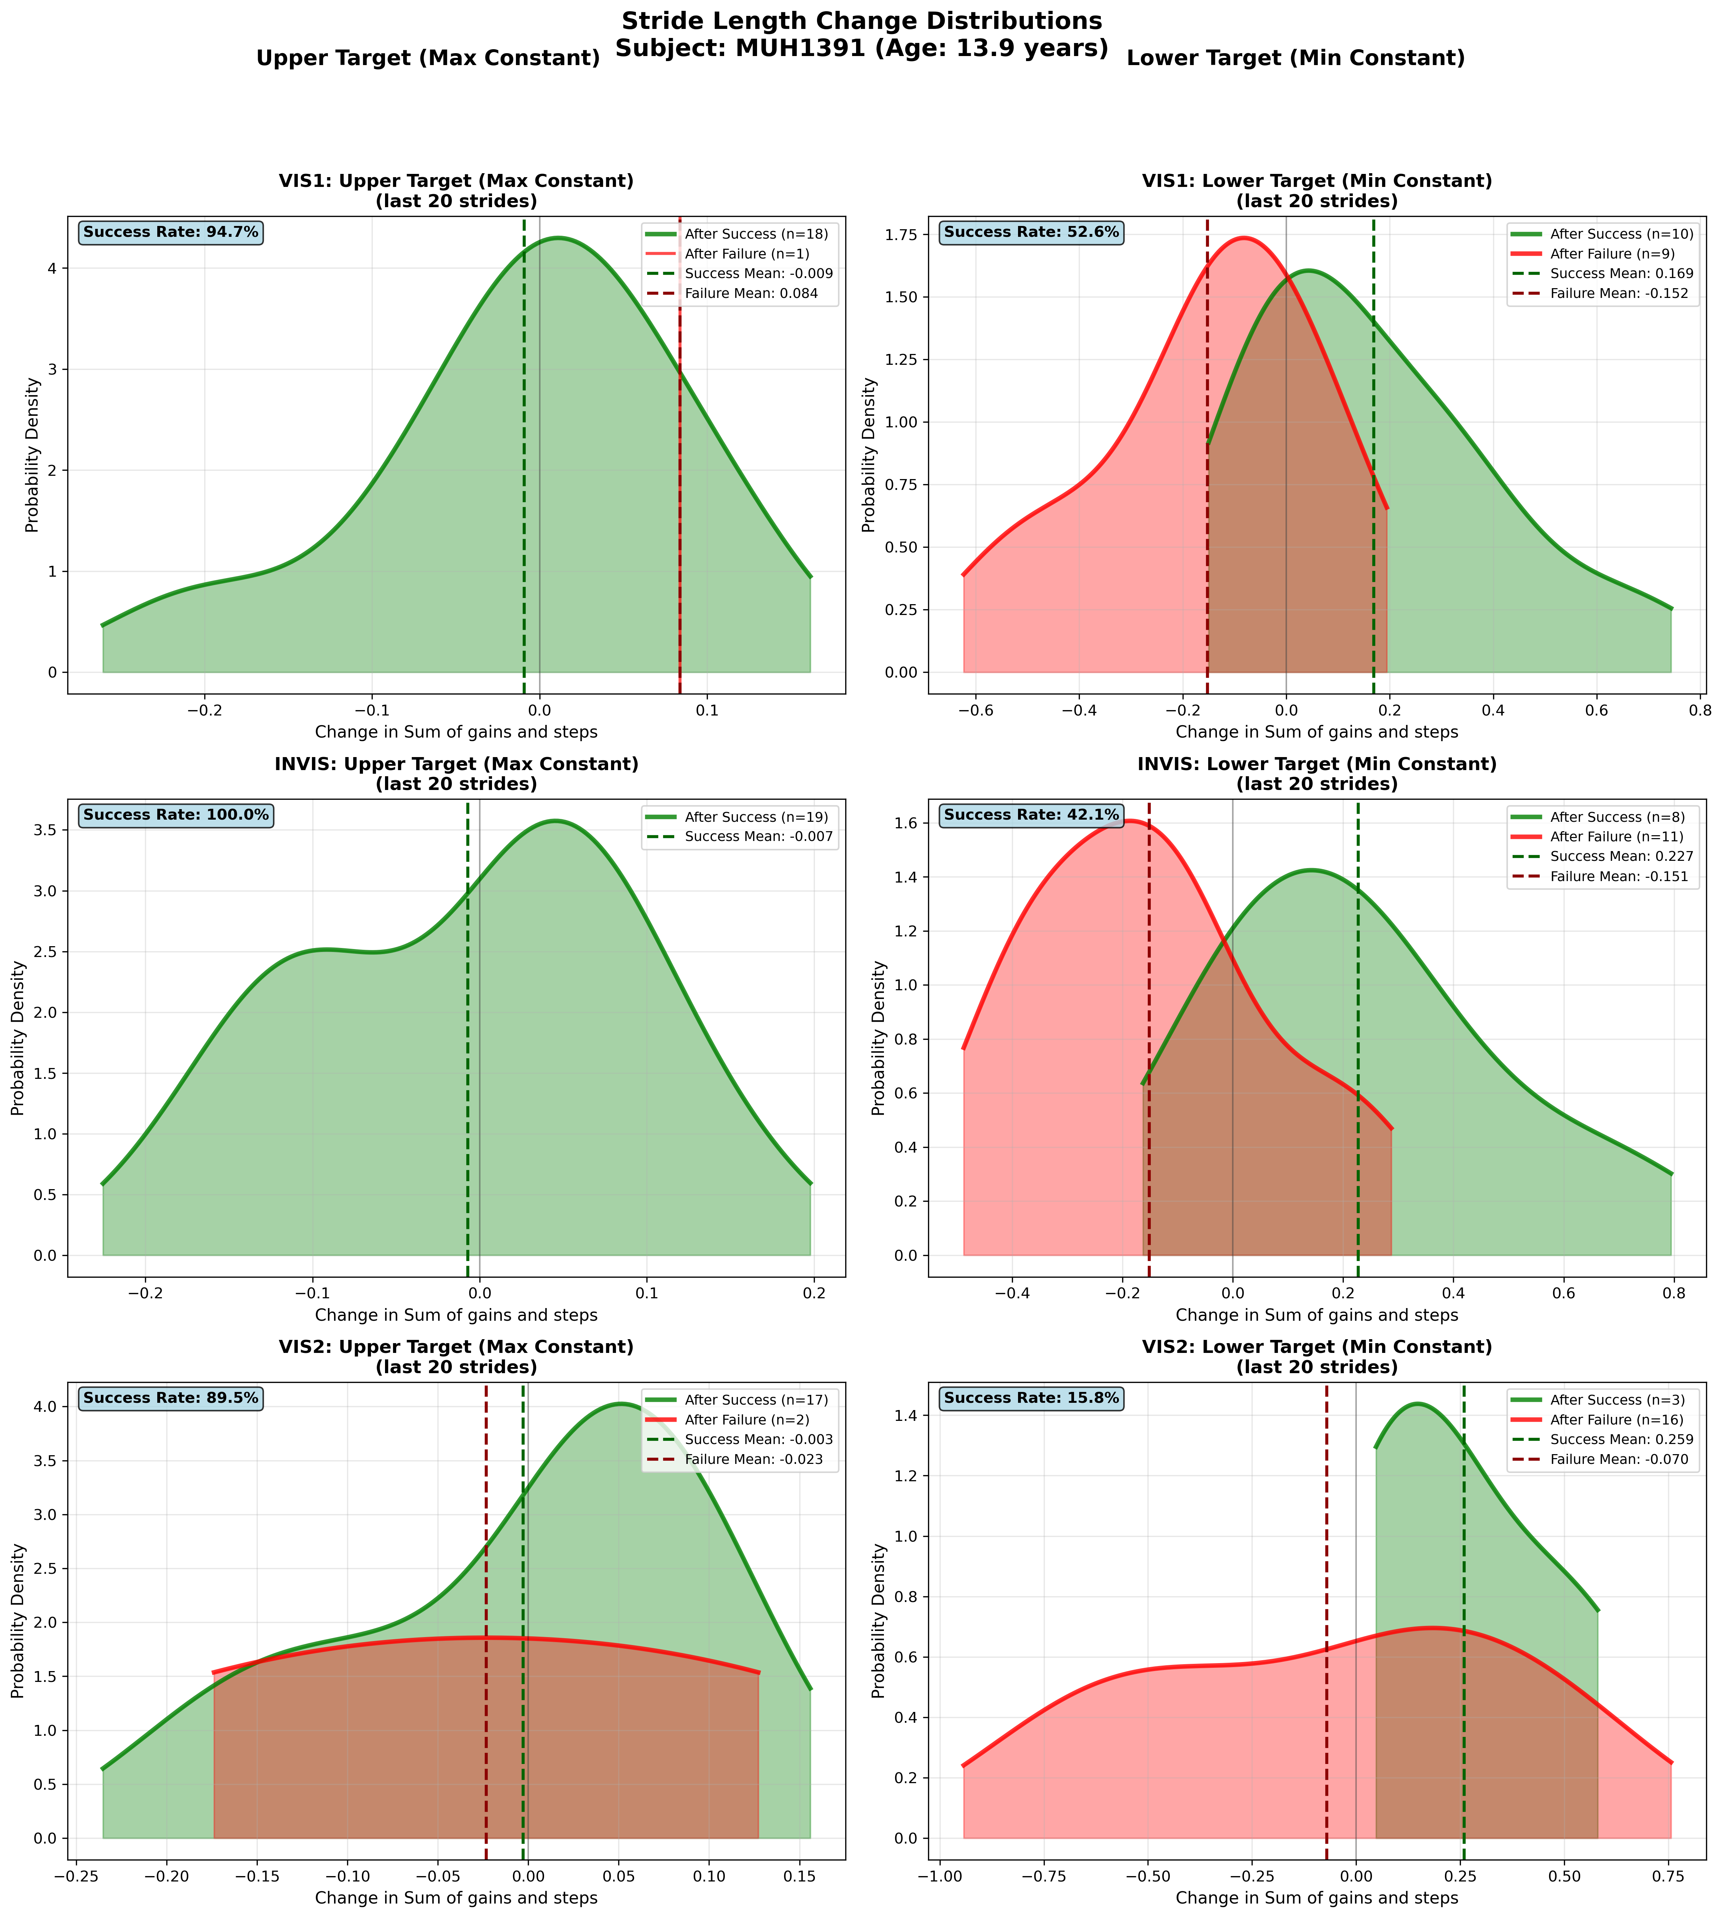
Subject MUH1391 (Age: 13.9 years) - Slide 44 of 69

Slide 46
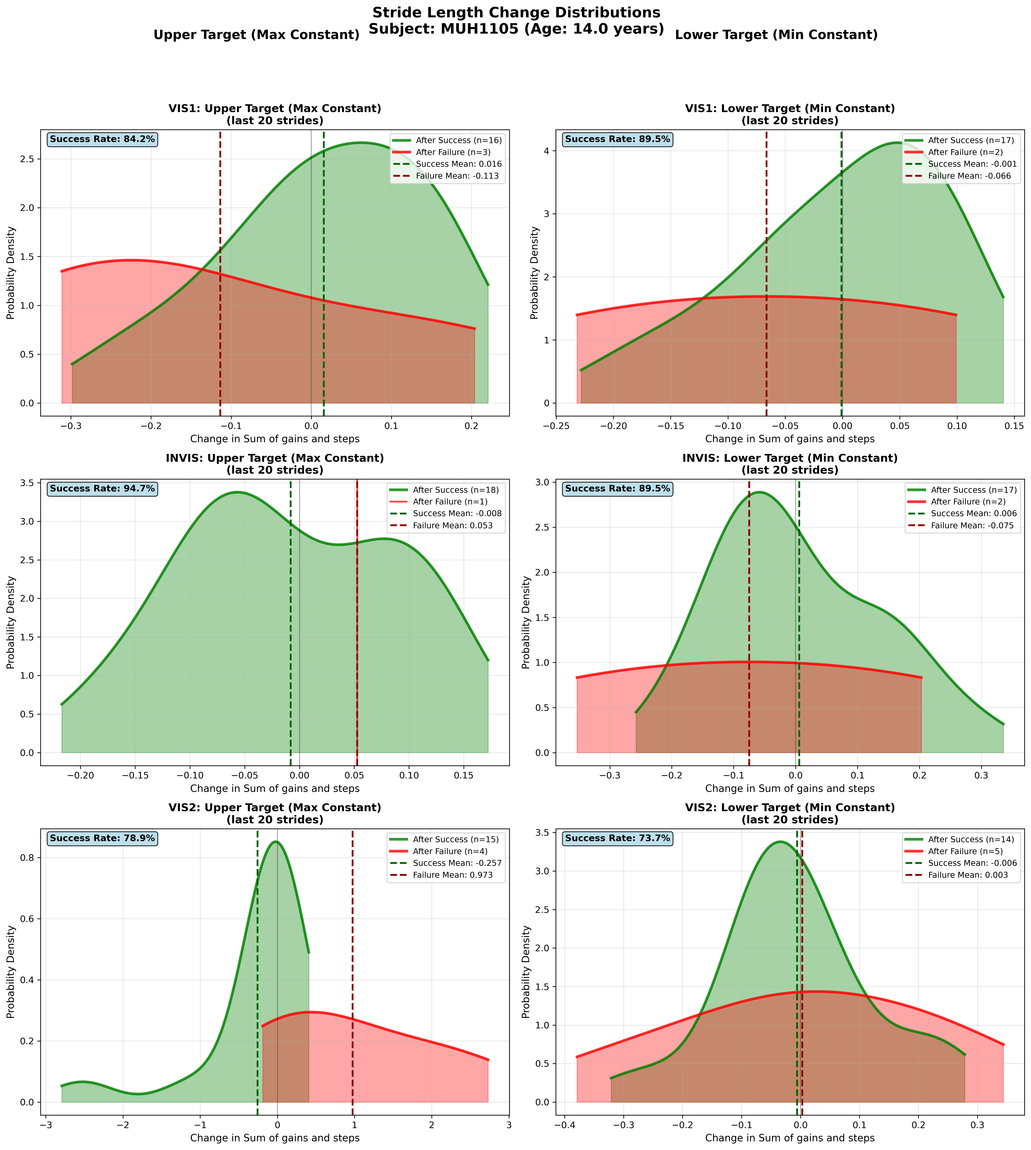
Subject MUH1105 (Age: 14.0 years) - Slide 45 of 69

Slide 47
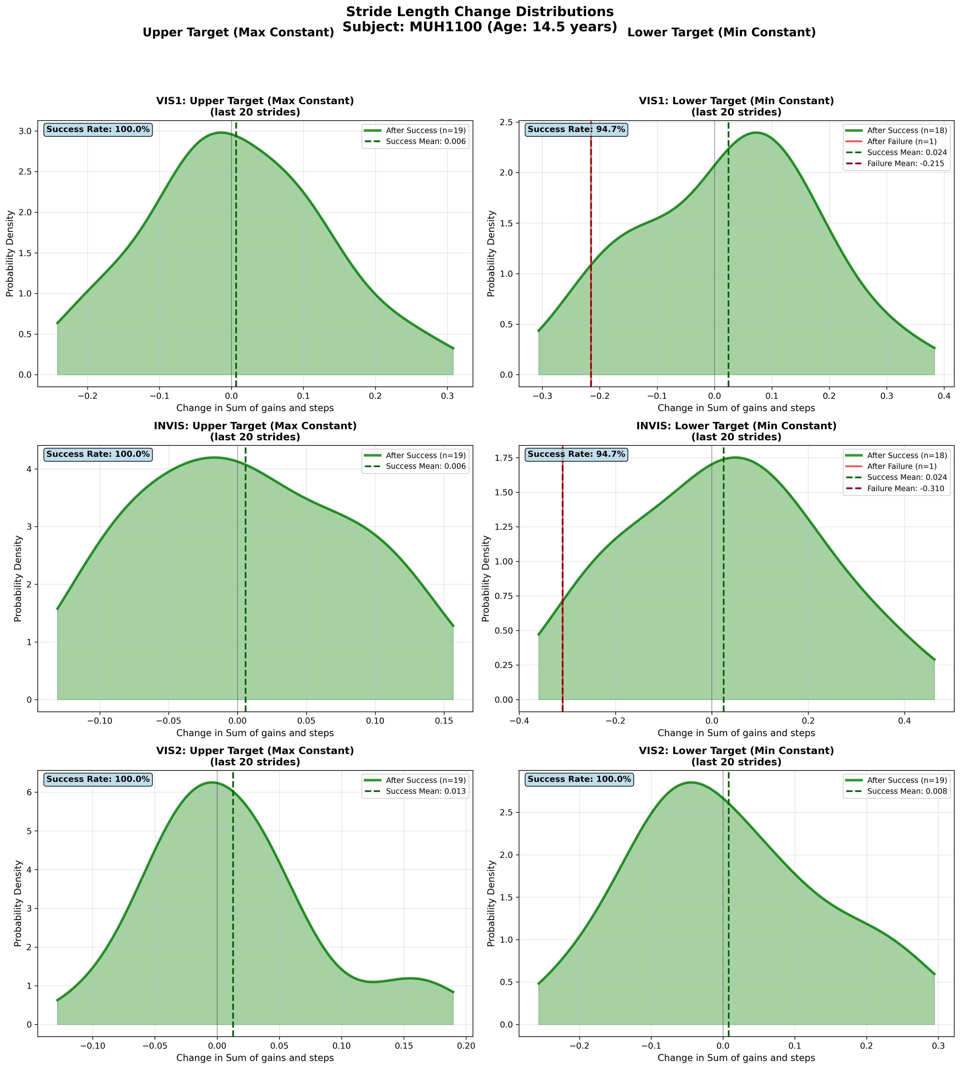
Subject MUH1100 (Age: 14.5 years) - Slide 46 of 69

Slide 48
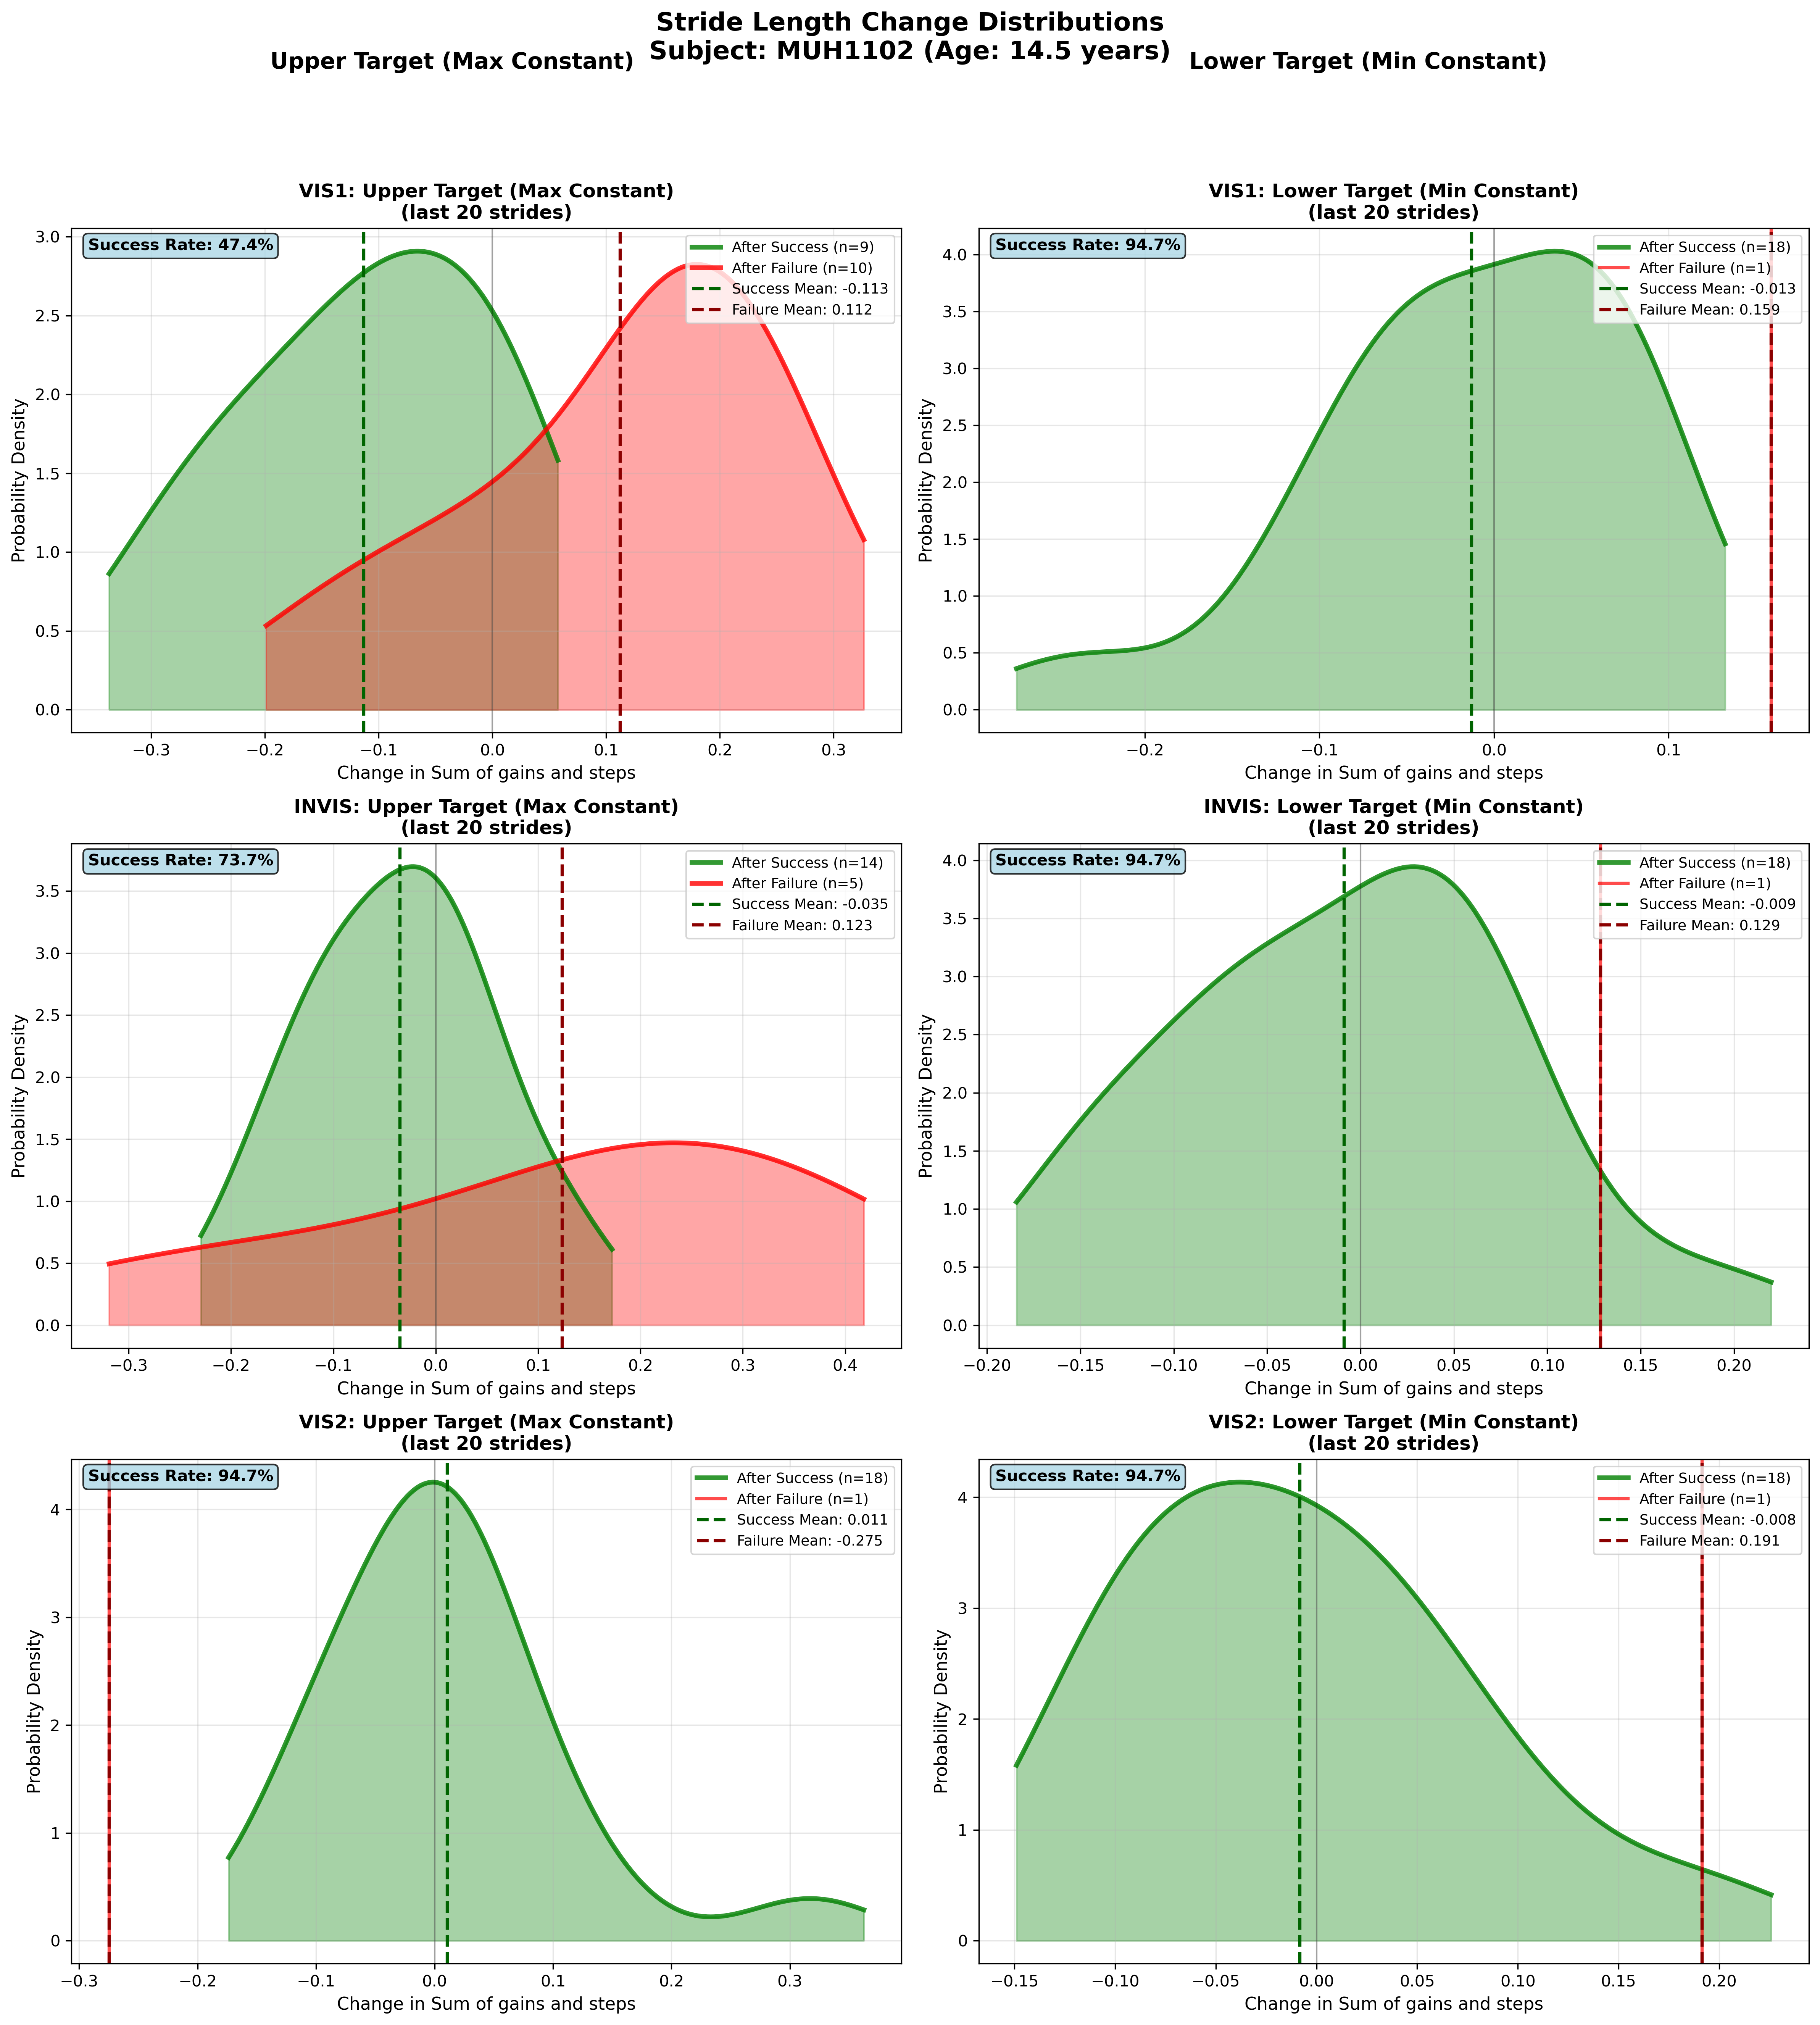
Subject MUH1102 (Age: 14.5 years) - Slide 47 of 69

Slide 49
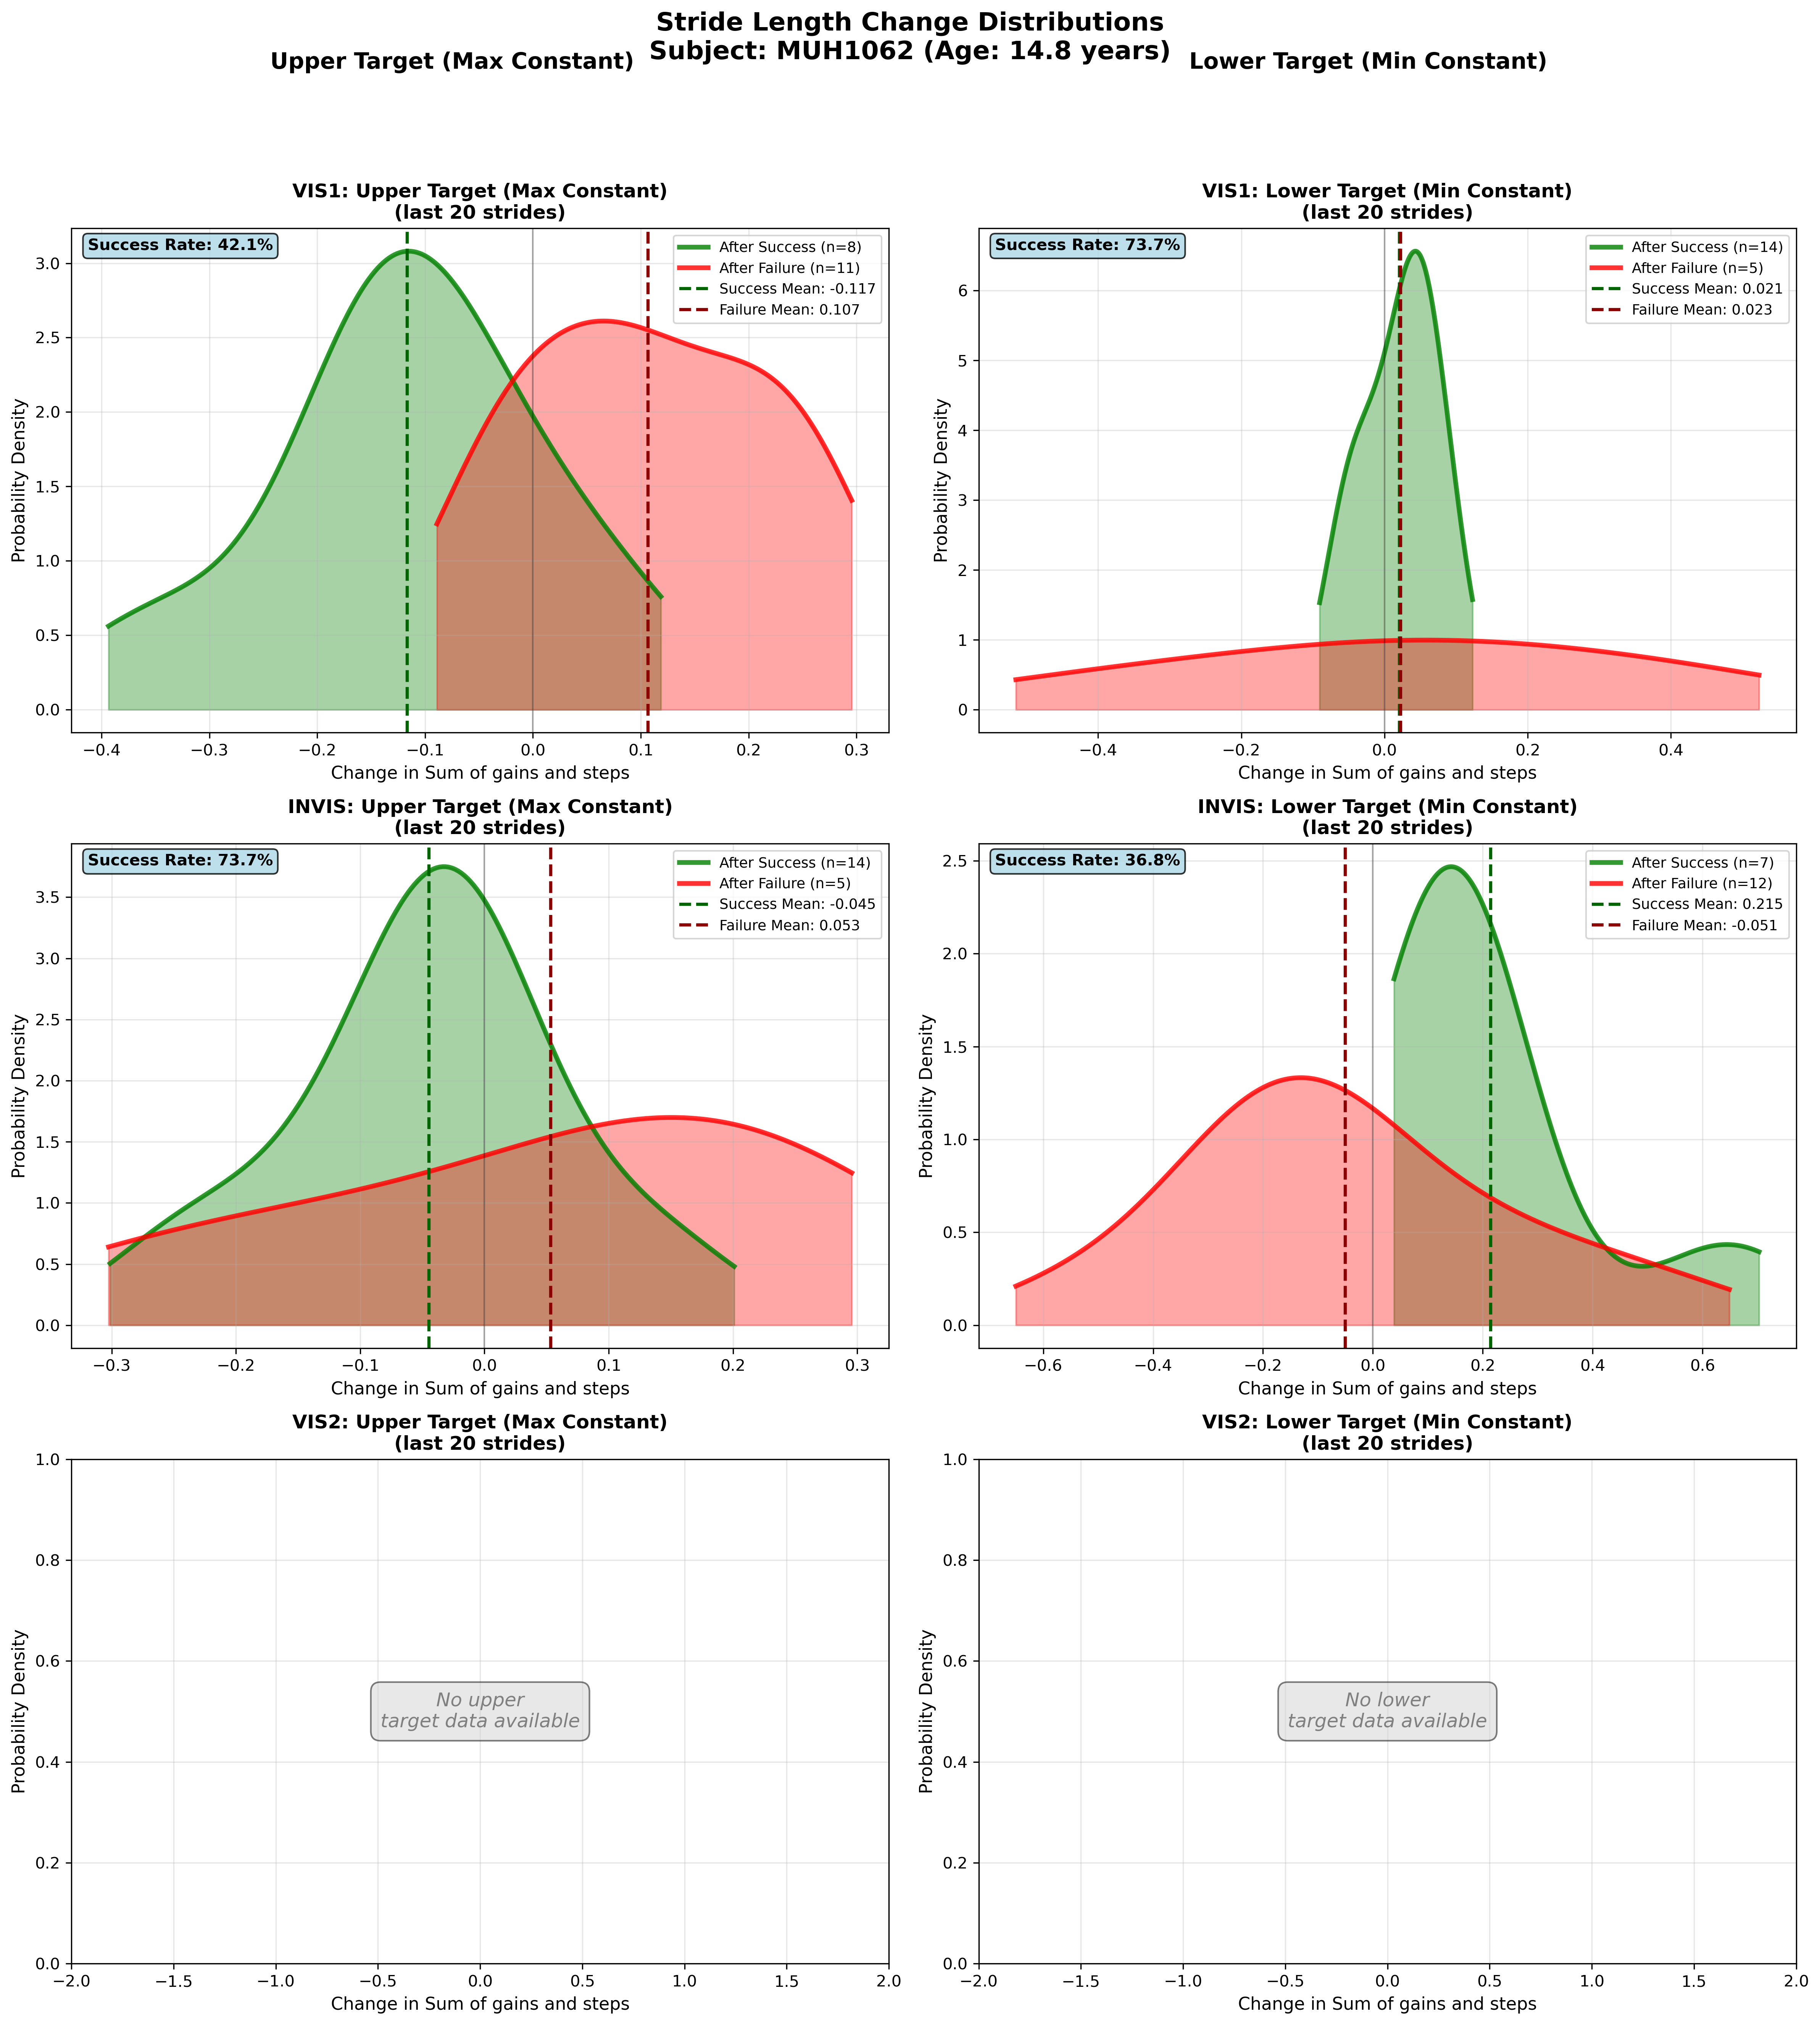
Subject MUH1062 (Age: 14.8 years) - Slide 48 of 69

Slide 50
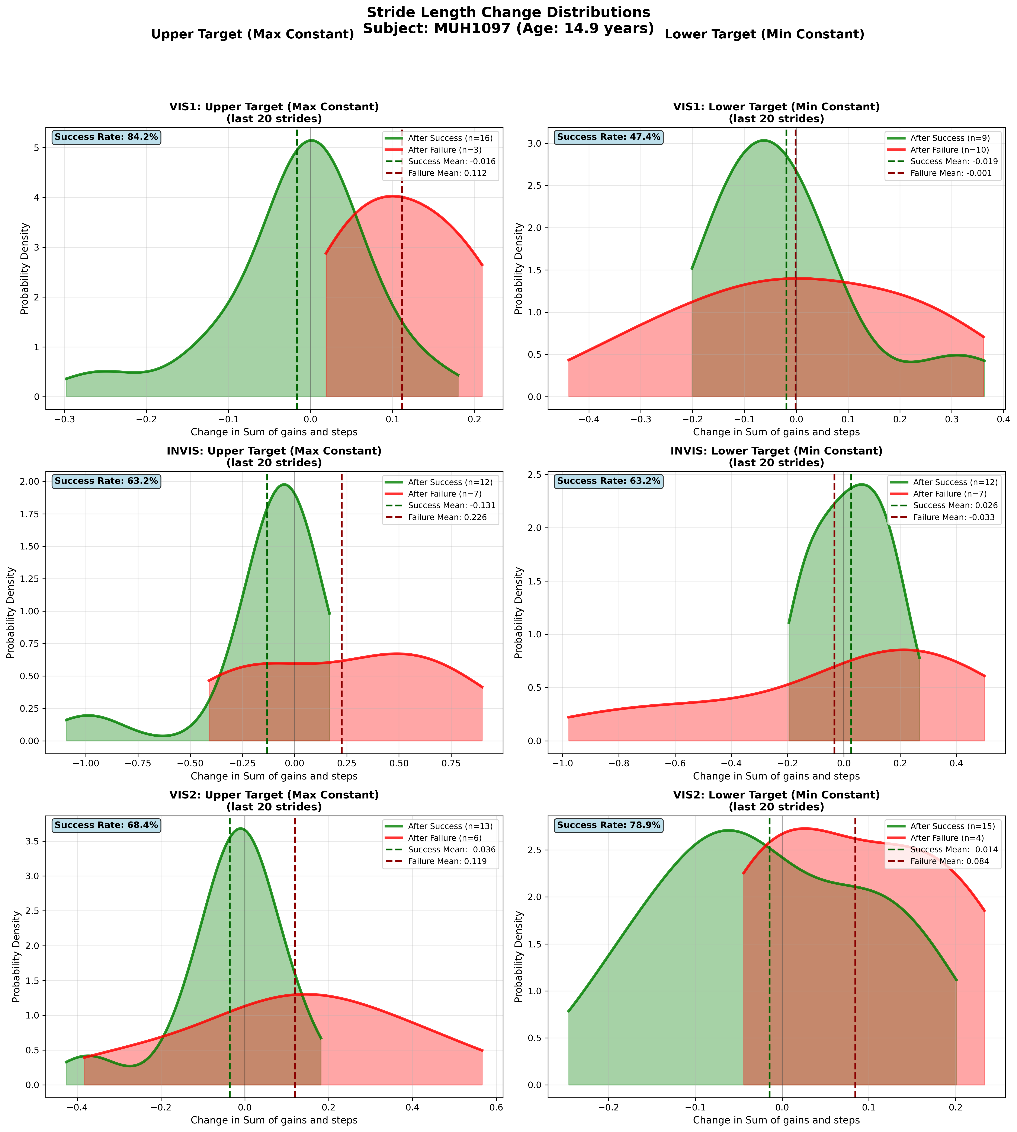
Subject MUH1097 (Age: 14.9 years) - Slide 49 of 69

Slide 51
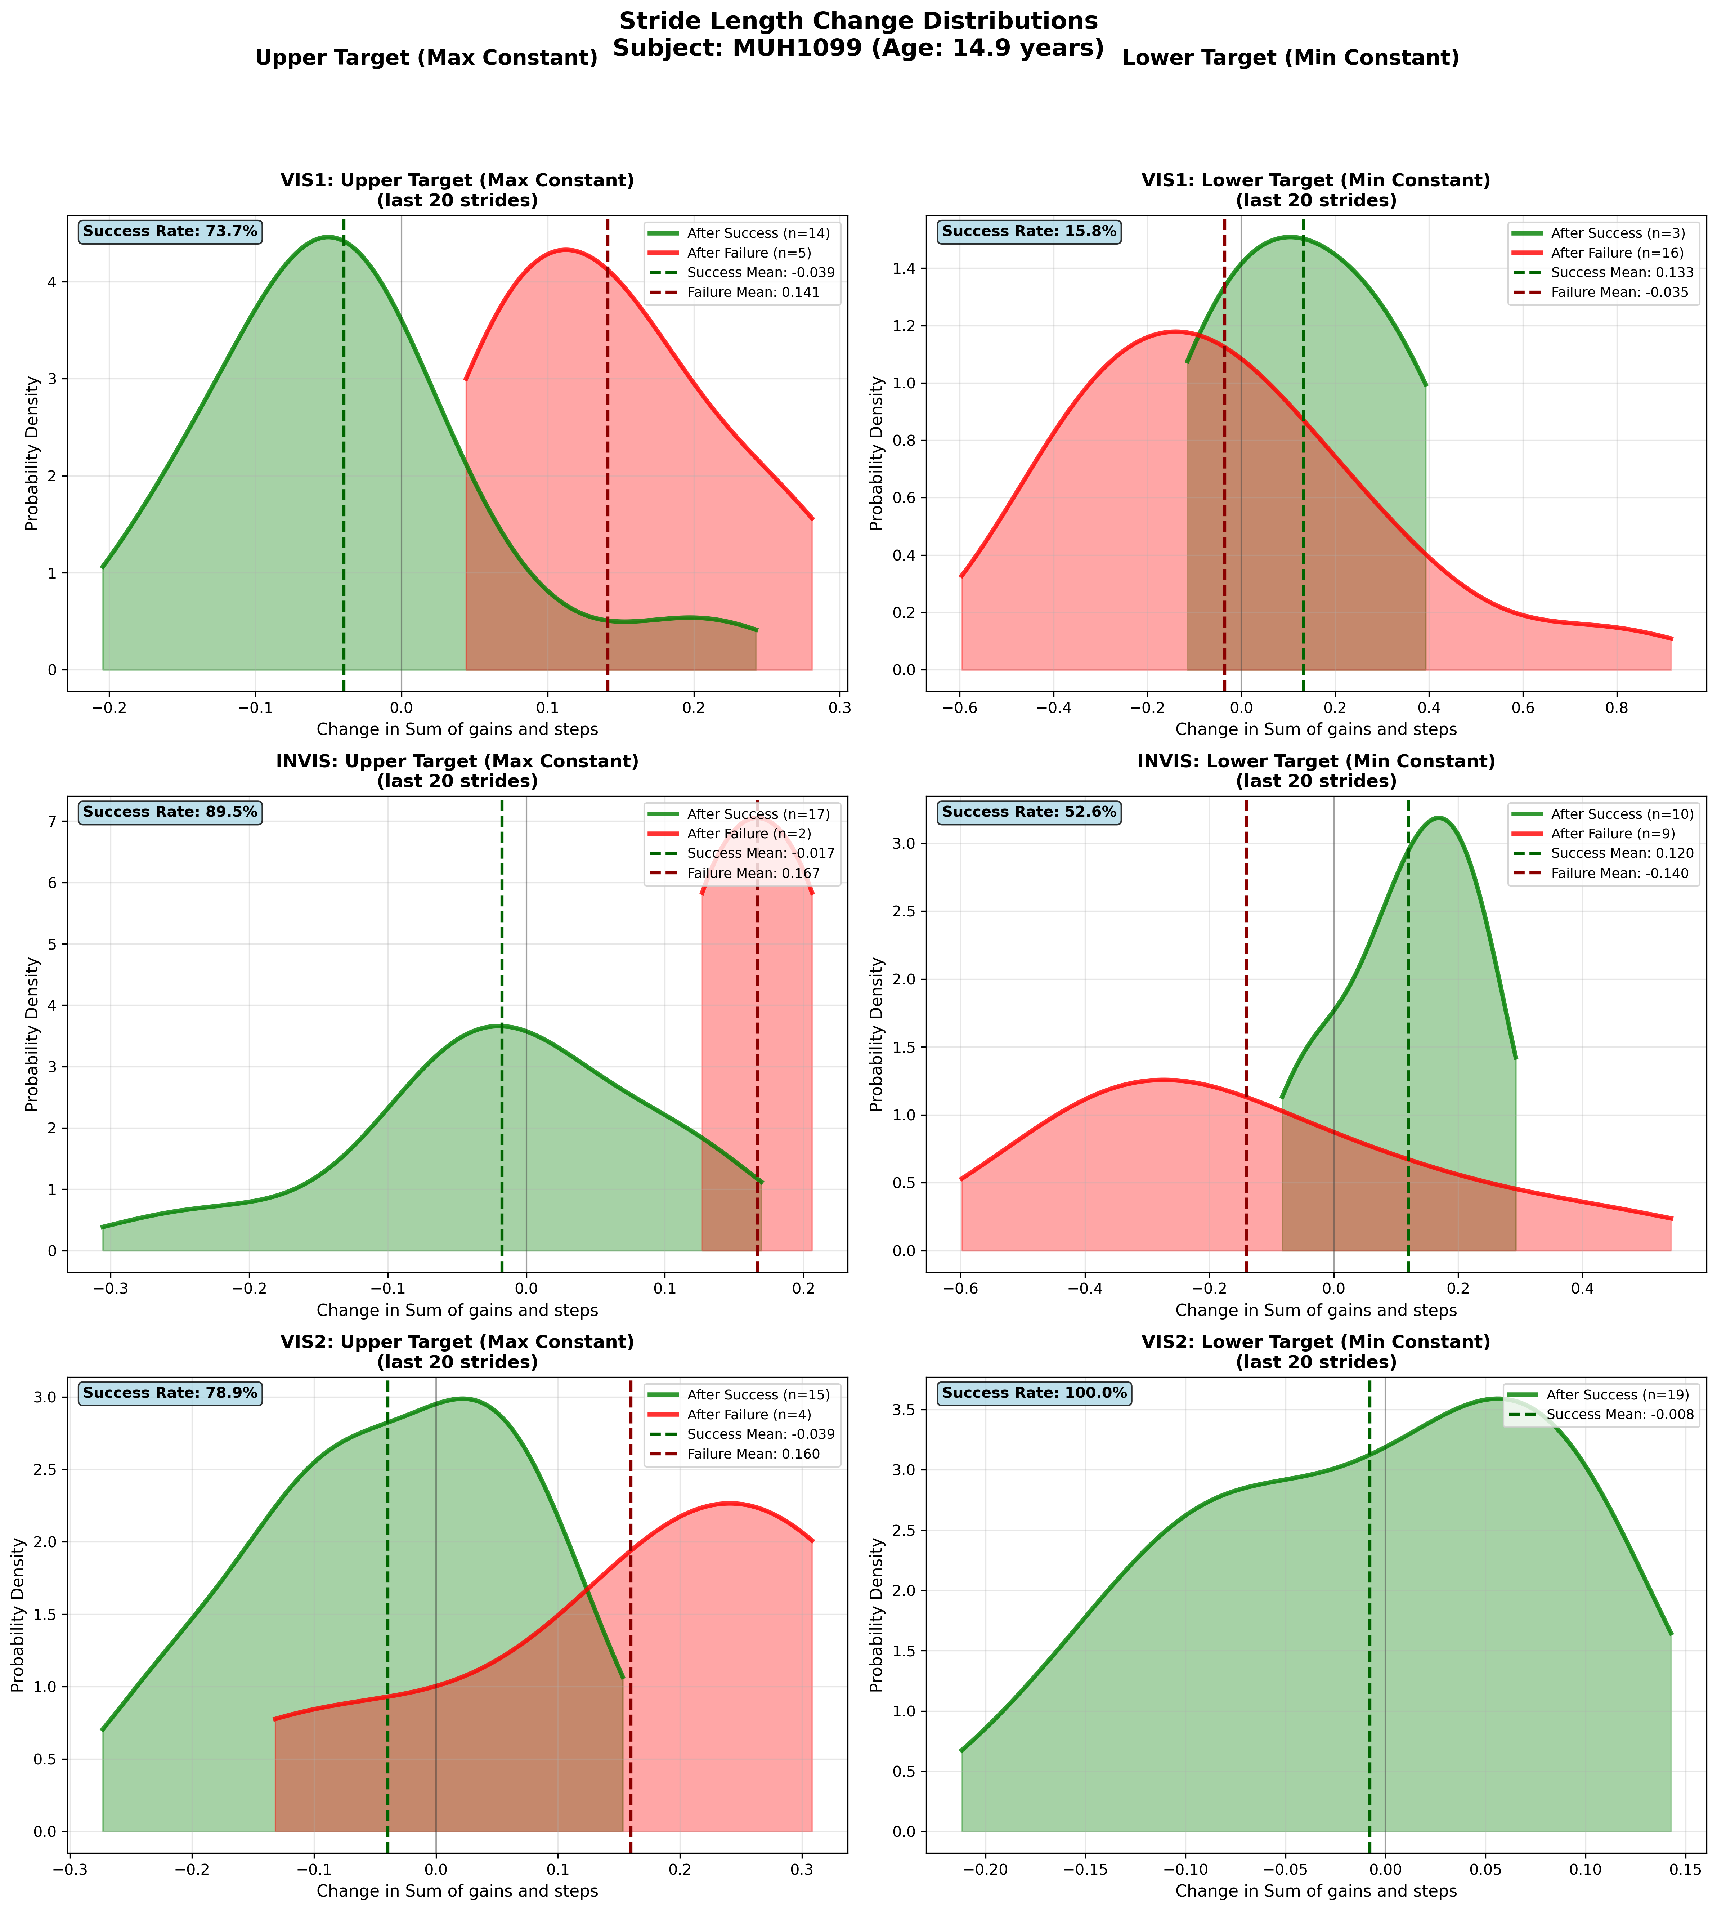
Subject MUH1099 (Age: 14.9 years) - Slide 50 of 69

Slide 52

Subject MUH1068 (Age: 15.0 years) - Slide 51 of 69

Slide 53

Subject MUH1084 (Age: 15.2 years) - Slide 52 of 69

Slide 54

Subject MUH1072 (Age: 15.2 years) - Slide 53 of 69

Slide 55

Subject MUH1079 (Age: 15.3 years) - Slide 54 of 69

Slide 56

Subject MUH1096 (Age: 15.3 years) - Slide 55 of 69

Slide 57

Subject MUH1088 (Age: 15.6 years) - Slide 56 of 69

Slide 58

Subject MUH1089 (Age: 15.6 years) - Slide 57 of 69

Slide 59

Subject MUH1080 (Age: 15.7 years) - Slide 58 of 69

Slide 60

Subject MUH1117 (Age: 16.2 years) - Slide 59 of 69

Slide 61

Subject MUH1358 (Age: 16.4 years) - Slide 60 of 69

Slide 62

Subject MUH1083 (Age: 16.6 years) - Slide 61 of 69

Slide 63

Subject MUH1144 (Age: 16.6 years) - Slide 62 of 69

Slide 64

Subject MUH1069 (Age: 16.8 years) - Slide 63 of 69

Slide 65

Subject MUH1118 (Age: 16.8 years) - Slide 64 of 69

Slide 66

Subject MUH1073 (Age: 17.7 years) - Slide 65 of 69

Slide 67

Subject MUH1086 (Age: 17.8 years) - Slide 66 of 69

Slide 68

Subject MUH1106 (Age: 17.8 years) - Slide 67 of 69

Slide 69

Subject MUH1085 (Age: 17.9 years) - Slide 68 of 69

Slide 70

Subject MUH1103 (Age: 17.9 years) - Slide 69 of 69

